Slide 1
SUID Categorization
Chase Foster | SDY Coordinator

Slide 2
Overview
Criteria for SUID Case Registry Categorization
Categorization Using the Algorithm
Mechanism Selection for Possible and Explained Suffocation
Database Entry

Slide 3
Reminders for SUID Case Registry Categorization
SUID/SDY Categorization DOES NOT change the COD!
Always follow the algorithm from the top to bottom
SUID Categorization is for a child less than 1 year of age who dies sudden and unexpectedly
Typical COD on Death Certificate
Unknown
Undetermined
SIDS/SUID
Asphyxia

Slide 4
Criteria for SUID Case Registry
Unintentional sleep-related asphyxia, suffocation, accidental strangulation
Unspecified suffocation
Cardiac or respiratory arrest without other well-defined causes
Unspecified causes with contributing unsafe sleep
Such as pneumonia, RSV, rhinovirus
Notes:
Think of conditions in which the child was well, died in an unsafe sleep situation, and that the COD typically wouldn’t cause an otherwise healthy child to die.

Slide 5
How to Categorize?

Slide 6
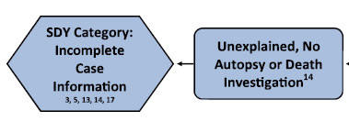
Algorithm Categorization
Was an autopsy AND death investigation completed?
Yes: move onto next step
No:
Unexplained, No Autopsy or Death Investigation
SDY Categorization vs SUID Categorization
Notes:
ALL teams state wide should be categorizing cases based on the algorithm at the CFR meeting. If your team hasn’t been categorizing at the meetings and you need assistance please let me know.

Slide 7
Categorization, Cont.
If an autopsy was performed, were ALL of the following also completed?
Toxicology
Imaging
Pathology
Yes: move onto the next step.
No:
Unexplained, Incomplete Case Information

Slide 8
Categorization, Cont.
Is there detailed information about the location AND position of how the infant was placed and found?
This information needs to be consistent. If multiple people have reported different scenarios this would be a true unknown.
Where: couch, crib, adult bed, bassinet
Position: on back, on stomach, on side, face up, face down, face turned
Yes: move onto next step
No:
Unexplained, Incomplete Case Information
Example:
Mother and father completed doll reenactment, and both placed infant in bassinet, face up.
Hospital notes indicate mother stated they were sleeping with the infant in their bed.
Statements were later made to the MEI that the parents couldn’t remember if the infant was on found their back or stomach.

Slide 9
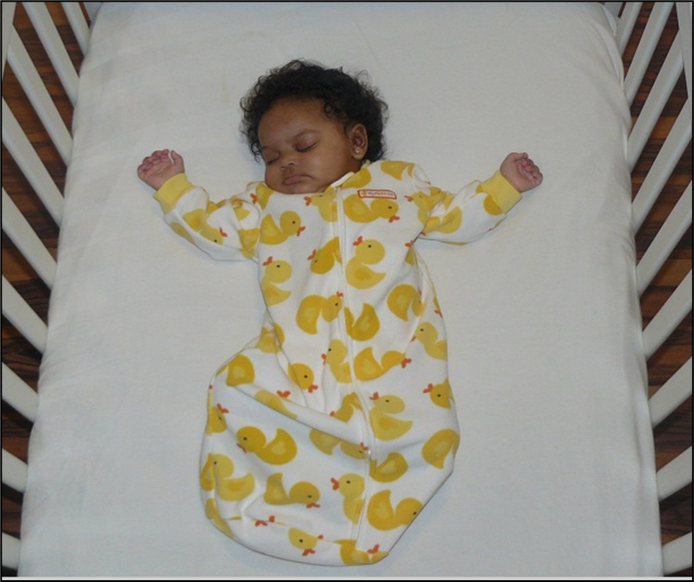
Categorization, Cont.
Was there ANY evidence of Unsafe Sleep Factors?
Co-sleeping: with another person or animal
Soft bedding: blankets, pillows
Stuffed animals
Placed on stomach or side
Sleep positioners used (doc-a-tot, crib incliner)
Placed to sleep anywhere not a crib: swing, infant seat, car seat, adult bed
Yes: move onto next step
No:
Unexplained, No Unsafe Sleep Factors
This category also includes infants who were witnessed going unresponsive.

Slide 10
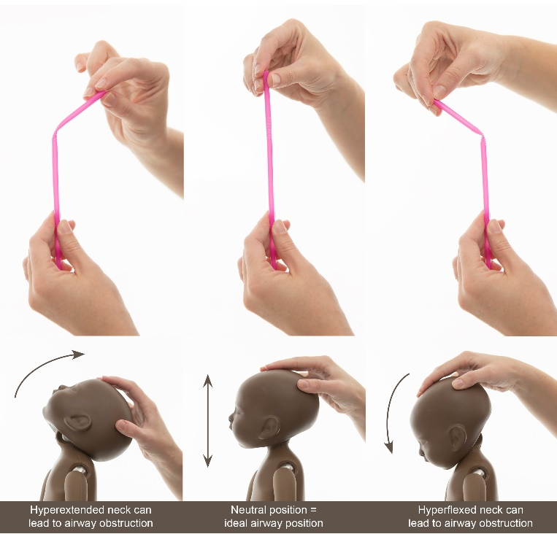
Categorization, Cont.
Was there evidence of partial or full obstruction of the airway?
Nose or mouth obstructed
Chest compressed
Head was chin to chest or hyperextended
Infants was found face down on a surface, including a crib (exception is if the infant was at an age they could roll, typically 3 months)
Infant was trapped between mattress and wall.
Yes: move onto next step
No or Unknown
Unexplained, Unsafe Sleep Factors

Slide 11
Categorization, Cont.
Do we know WHAT obstructed the airway?
Adult mattress
Blanket
Sibling
Stuffed animal
Adult
Swing padding
Lose clothing
Yes: Move onto next step
No or unknown
Unexplained, Unsafe Sleep Factors

Slide 12
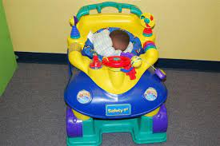
Categorization, Cont.
Were ALL of the following present?
Non-conflicting and reliable witness accounts
No other potentially fatal findings
An age/developmental stage that suffocation is feasible
Strong evidence of full external obstruction when found.
No or unknown
Unexplained, Possible Suffocation with Unsafe Sleep Factors
Continue to next step: Mechanism
Yes:
Explained Suffocation with Unsafe Sleep Factors
Continue to next step: Mechanism
Example of Possible Suffocation:
Infant was placed on an adult comforter
Infant was found on their side, with the left nostril pressed into the mattress.
Mouth was not obstructed.
https://www.in.gov/isdh/files/SUIDI%20and%20DOSE%20Training.pdf

Slide 13
Last step: Mechanism Selection
For possible suffocation and explained suffocation categories
Four Possible Mechanisms
Soft Bedding
Wedging
Overlay
Other
A Combination of Mechanisms May be Selected
Note: Cause of death does not indicate category. Example, COD: Asphyxia, but the way the infant was found does not fit into explained suffocation category.

Slide 14
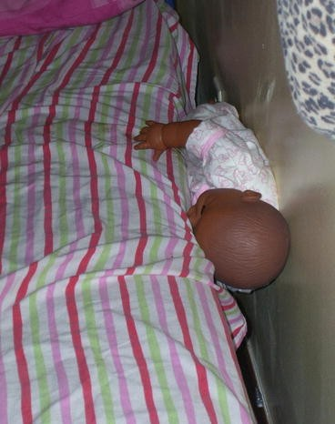
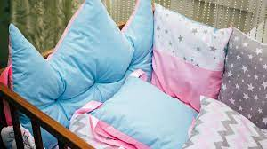
Mechanism Selection
Soft Bedding
Wedging
https://www.google.com/url?sa=i&url=https%3A%2F%2Fwww.cnn.com%2F2021%2F04%2F27%2Fhealth%2Fsids-infant-death-soft-bedding-wellness%2Findex.html&psig=AOvVaw2pRGkrnav-tV7pnvwOSaVP&ust=1620153950730000&source=images&cd=vfe&ved=2ahUKEwiCsv72la7wAhXEs1MKHXSzBZcQr4kDegUIARC-AQ
https://media.springernature.com/lw785/springer-static/image/chp%3A10.1007%2F978-1-61779-403-2_28/MediaObjects/186001_1_En_28_Fig17_HTML.jpg

Slide 15
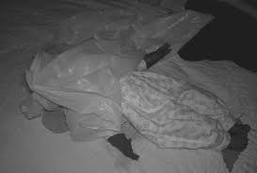
Mechanism Selection
Overlay
Other
https://cdn.shortpixel.ai/client/to_webp,q_glossy,ret_img,w_576/https://www.safesleepacademy.org/wp-content/uploads/Bed-sharing-vs.-Room-sharing-2.jpg
https://encrypted-tbn0.gstatic.com/images?q=tbn:ANd9GcRPLV9Htoi4oTOgRINEpngVHh3q7L_LZQr7cg&usqp=CAU

Slide 16
Case 1
Cause of Death | Undetermined
Autopsy | Completed
Toxicology | Completed
Imaging | Completed
Postmortem Cultures | Completed
Circumstances:
8 month old infant was placed to sleep on their back in a bassinet. The bassinet was placed in the same room as the parents but was not too close to the bed. Child was placed in a sleep sack and was using a pacifier when they were last known to be alive. There were no items in the bassinet. Doll reenactments were completed by both parents, which confirmed the infant was placed on their back face-up, and found on their back and face-up.
Health History | No known health issues, last well child check day before death
Unexplained, Incomplete Case Information
Unexplained, No Unsafe Sleep Factors
Unexplained, Unsafe Sleep Factors
Unexplained, Possible Suffocation with Unsafe Sleep Factors
Explained, Suffocation with Unsafe Sleep Factors

Slide 17
Case 2
Cause of Death | Asphyxia
Autopsy | Completed
Toxicology | Completed
Imaging | Completed
Postmortem Cultures | Completed
Circumstances:
A 3 month old infant was discovered unresponsive on a couch. The infant’s caretaker (unknown relation to infant) had placed them to sleep 30 minutes prior. They were placed in the far back corner of a sectional surrounded with pillows. The caretaker stated they did not want them to roll off. The doll reenactment confirmed that the infant’s head was turned to the side and their nose was partially obstructed by the couch cushion.
Health History | No known health issues, unknown last well-child check.
Unexplained, Incomplete Case Information
Unexplained, No Unsafe Sleep Factors
Unexplained, Unsafe Sleep Factors
Unexplained, Possible Suffocation with Unsafe Sleep Factors
Explained, Suffocation with Unsafe Sleep Factors

Slide 18
Case 2: Unexplained, Possible Suffocation with Unsafe Sleep Factors
Mechanism Selection:
Soft Bedding
Wedging
Overlay
Other

Slide 19
Case 3
Cause of Death | Sudden unexplained infant death
Autopsy | Completed
Toxicology | Completed
Imaging | Not complete-Scanner not working
Postmortem Cultures | Completed
Circumstances:
A 5 month old infant was sleeping with their parents in a queen size bed. Parents noted that the child was heard crying approximately 1 hour before they were discovered unresponsive. The mother stated child cried for a few minutes then went to sleep. Parents did not want to do a doll reenactment. Their interviews were both consistent with the position of the child, and the events leading up to death. Child was found face up and their airway was unobstructed.
Health History | No known health issues
Unexplained, Incomplete Case Information
Unexplained, No Unsafe Sleep Factors
Unexplained, Unsafe Sleep Factors
Unexplained, Possible Suffocation with Unsafe Sleep Factors
Explained, Suffocation with Unsafe Sleep Factors

Slide 20
Database Entry

Slide 21
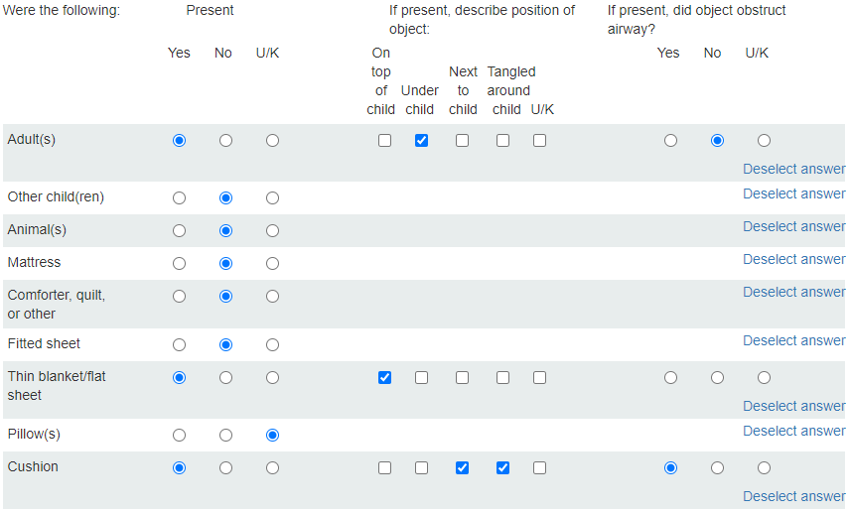
Database Entry
Make sure the sleep related section I2 is filled out as thoroughly as possible
Data MUST match categorization

Slide 22
Database Entry, SECTION N (SUID/SDY)
Select categorization from algorithm
If appropriate select mechanism related to suffocation.
Complete entry by adding a detailed narrative in section O1

Slide 23
Questions?

Slide 24
Contact Information
Chase Foster
Sudden Death in the Young Coordinator Phone: 615-253-2657 Email: chase.foster@tn.gov

