Slide 1

Safe Sleep:
Monroe Carell JR Children’s Hospital at Vanderbilt
Melissa Hill, BSN, RN, CCRN
Quality Improvement Analyst
5/13/2021

Slide 2
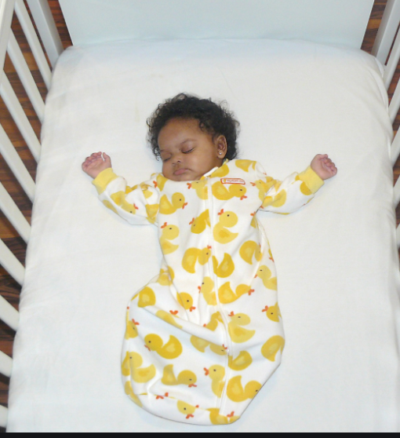
The Problem
Tennessee has a high rate of sleep-related infant deaths
  In 2017, 144 infant deaths in Tennessee were related to unsafe sleeping practices.
  Infants born prematurely, exposed to tobacco/alcohol, and otherwise admitted to the NICU are at highest risk.
  Our goal is to educate families when they are in our care.
Notes:
Infants born early or admitted to the NICU (approximately 1 in 10) are at highest risk. These infants are often the highest needs type babies as well, causing more fatigue and stress on the parents. This also comprises obviously a good percentage of our patients. 99% of newborns are born in a hospital which is also a prime educational opportunity.

Slide 3

Monroe Carell Jr Children’s Hospital at Vanderbilt
4,400 births in 2019
1,600 NICU admissions per year
  Level IV NICU
    Prematurity
    Cardiac defects
    Surgical cases/ ECMO
    Congenital Anomalies
Notes:
High acuity/ low acuity.

Slide 4
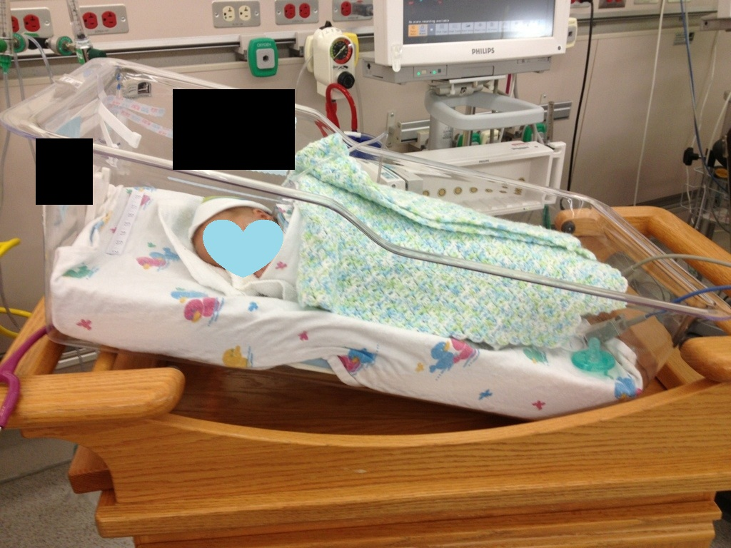
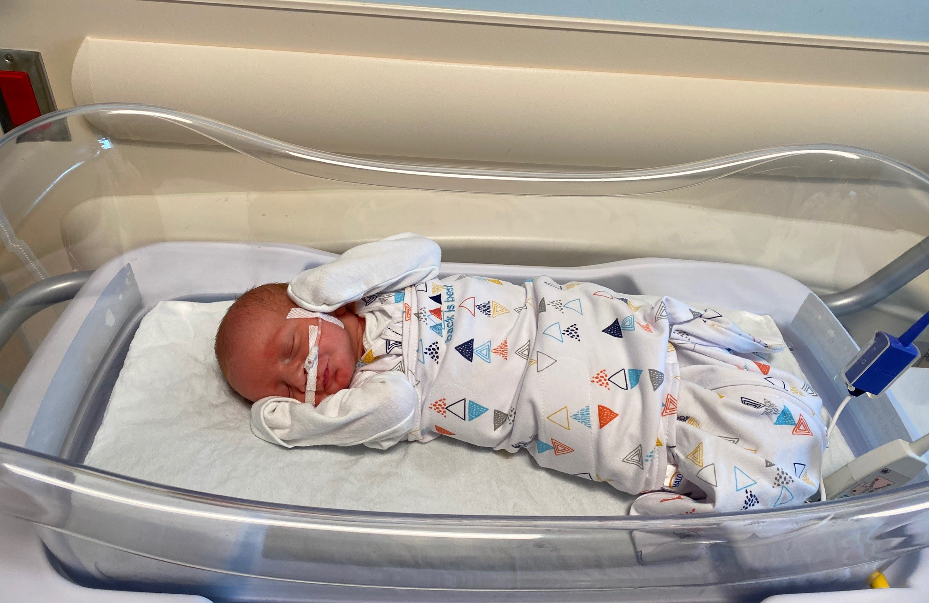
History of Safe Sleep Practices
In early 2013, safe sleep practices were introduced to Vanderbilt in the NICU.
  This included: an order set and practice; education for families and all levels of providers in our unit; and appropriate linens to model best practice.
In 2017, we began a second focused workgroup:
  This included: a switch to a nurse-driven policy in the NICU, education, and weekly audits of the NICU and the newborn nursery.
Notes:
Patients often require therapeutic positioning and unsafe sleep practices while in high acuity phase of stay. The initial workgroup was key to our work today. The NICU in particular was not used to safe sleep practices being started prior to discharge. Babies often slept not on their back with nesting and head of bed elevation. We had NICU linen that included clothing and blankets. This workgroup also was able to get our first sleep sacks into the NICU. They brought us very far. The top picture is not from our NICU but is a common example of our previous practices. Our goal is the bottom picture.
Once the policy was in place, progress was made, but overtime we had new staff, changes in providers, and other things that allowed a backslide in the compliance. The NICU has a unique population who often requires modification to the usual practices, but are at highest risk for sleep related deaths. The ownership of this practice has changed hands multiple times over the last few years. We did in this time period move the safe sleep practice to a nurse driven policy instead of one that begins with an order. This models our thermoregulation practice and places ownership to those who most often provide care in the hospital.

Slide 5

Keys To Success
Consistent Messaging
Consistent Modeling
Safe Babies
&
Fewer Deaths
Parents and caregivers:
Hear same message from all providers
Hear message multiple times
Hear message in multiple ways
All staff:
Put babies to sleep in the safest position
Conform with hospital policy at all times
Find “teachable moments” to correct unsafe behaviors
All together:
We will save babies!
Notes:
We all have to be sharing the same message, that babies should sleep Alone, on their Back, and in a Crib. Families will pay attention to the message even more if they hear that same message from everyone who interacts with them, multiple times, and in multiple settings. We learn things when they are repeated—so it is important for families to hear this message multiple times in multiple ways.
Families pay attention to what we do. So in order to be successful, we also have to model the correct behavior. We have to put babies to sleep in the safest position and we have to comply with the hospital policy all the time. If we see families engaging in unsafe behaviors, we need to take advantage of those teachable moments and point out the safer behaviors.
Out goal is to save babies. We at times spend large amounts of time with our families due to long stays. It is absolutely heart-breaking to have one of our own babies come back in and not make it, when it could have been prevented.

Slide 6
Current Work
Safe Sleep Work-group formed in December 2019.
Staff nurses from NICU, Special Care Nursery, and Mother/Baby Unit
Physicians
Managers from each Unit
NICU Quality and Safety Advisor
Monthly meetings
Follows Quality Improvement Methodology
Notes:
Include all of the key stake-holders. We also have a specialist in pediatric trauma and injury prevention.
Meet monthly, review our data and plan next steps.
Following quality methodology. Set goals and key drivers and then set interventions to trial prior to intiating unit wide

Slide 7
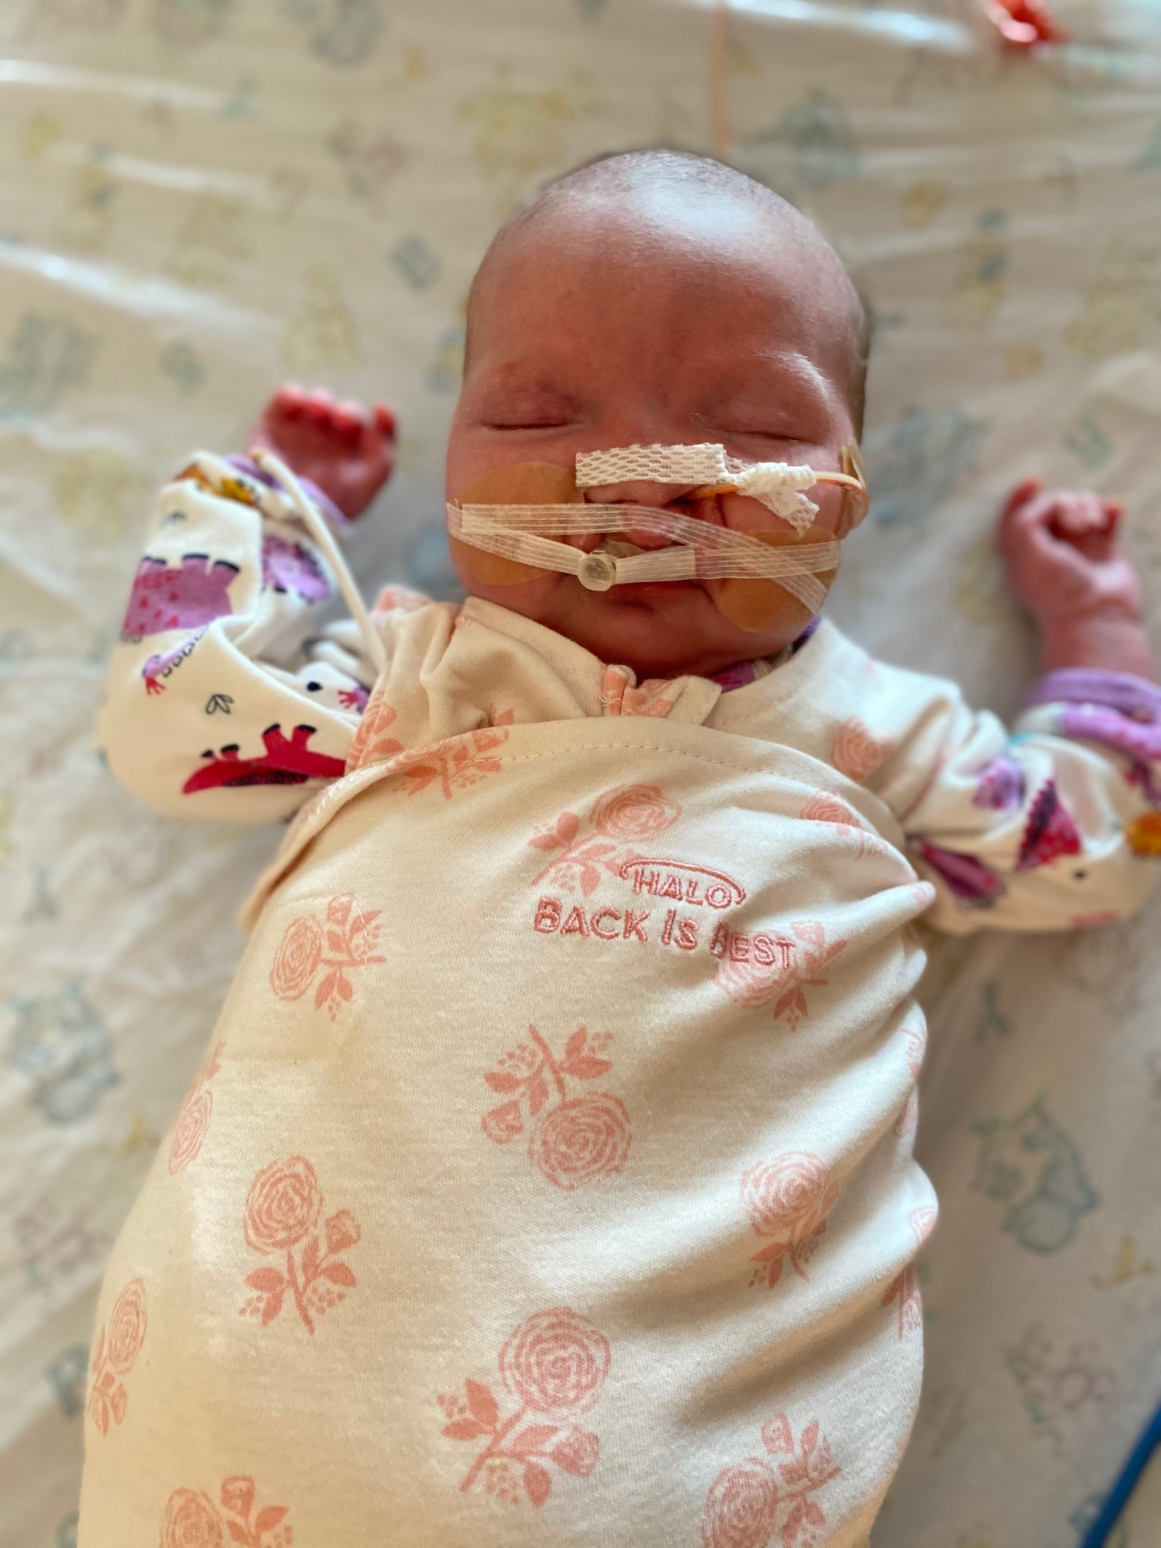
Safe Sleep Work
Covers multiple units through the hospital
Mother Baby Unit
Special Care Nursery
Stahlman NICU
Vanderbilt Children’s 4th floor NICU
Vanderbilt Children’s 11th floor NICU
Notes:
We essentially cover five units throughout the hospital. Mother baby and Special Care are located in the same space, but staffed by different units. Stahlman and VCH 4th floor are staffed by mixed acuity and have both high and low acuity patients. VCH 11th floor NICU has low acuity patients only currently. I share the variety of the units to highlight the difficulty in one size fits all teaching. All of these units function slightly differently, so one intervention may not work as it does elsewhere.

Slide 8
Safe Sleep Work-Group: MBO/SCN
Key Driver Diagram
7/8/2020
Key Drivers
Interventions
Weekly audits by QIAs with in the moment feedback
SMART Aim
Knowledge of Safe Sleep Environment
The RNs and Care Partners who care for the patients in the Special Care Nursery and Mother-Baby unit at Vanderbilt will increase their compliance with AAP guidelines* for safe sleep from 76% to 90% by June 30, 2021.
Safe Sleep Forms on Admission and Education Prior to Discharge
Protocol for Safe Sleep in the Nursery
Appropriate Staffing
Stocking of sleep sacks with snaps and thicker material
Access to Appropriate Linen
Global Aim
Hats off at 24 Hours
There will be a reduction in sleep-related deaths in Tennessee.
Family Education
Bassinette Sheets
Provide family education to all parents during routine care and prior to discharge
Signage
Gold shaded box – in progress
Dashed line – future work
CONFIDENTIAL INFORMATION. This information is confidential and privileged pursuant to TCA 63-1-150, and 68-11-272 et seq., and has as one of its purposes to improve the quality and safety of patient care. Do not forward or otherwise share this information external to Vanderbilt.

Slide 9
Weekly audits with “in the moment” teaching by QIA initiated
SCN/MBO split
Change in audit definition
COVID-19
TIPQC Safe to Sleep Project started
Desired Direction
CONFIDENTIAL INFORMATION. This information is confidential and privileged pursuant to TCA 63-1-150, and 68-11-272 et seq., and has as one of its purposes to improve the quality and safety of patient care. Do not forward or otherwise share this information external to Vanderbilt.

Slide 10
Most Common Problems
Hats past 24 hours
Should be removed with the 24 hours screening
Considerations for late pre-term newborns
Any exceptions require provider order
Extra blankets
Often were seen in the parent rooms
Items in the bed
Patient care items
Pacifier clips/stuffed animals
Washcloths
Notes:
Hats off at 24 hours is probably one of the teaching points that families are surprised by. Extra blankets are very common as well.

Slide 11
Mother Baby Unit and Special Care Interventions
Interventions that worked well:
Weekly audits
Sleep sacks and Linens
New Signage in Patient Rooms
Champions on each Unit
Removing blankets and hats from admission beds
Interventions that did not work well:
Signage in the nursery
Brief bump in compliance, but never lasts
Notes:
Continued weekly audits; worked with linen and will review these later in the presentation; signage in patient rooms; removing items from the bed that are used for new patients

Slide 12
Safe Sleep in the NICU
Key Driver Diagram
M. Hill, RN
12/2020
Interventions
Key Drivers
Weekly audits by QIAs with in the moment feedback
SMART Aim
Knowledge of Safe Sleep Environment
Layering of sheets and Chux to reduce workload
The RNs and Care Partners in the NICU at Vanderbilt will increase their compliance with AAP guidelines* for safe sleep from 70% to 90% by December 31, 2021.
Standardized Protocol to Start Safe Sleep in the NICU
Stocking of sleep sacks with snaps and thicker material
Appropriate Staffing
Access to Appropriate Linen
Signage
Global Aim
Staff Buy-In
Provide family education to all parents during routine care and prior to discharge
There will be a reduction in sleep-related deaths in Tennessee.
Parent/Family Education
Develop a policy that mirror AAP guidelines that has clear practices on when to begin safe sleep in the NICU
Gold shaded box – in progress
Dashed line – future work
CONFIDENTIAL INFORMATION. This information is confidential and privileged pursuant to TCA 63-1-150, and 68-11-272 et seq., and has as one of its purposes to improve the quality and safety of patient care. Do not forward or otherwise share this information external to Vanderbilt.

Slide 13
Weekly audits with in the moment teaching by QIA initiated
New policy went live
COVID-19
Desired Direction
CONFIDENTIAL INFORMATION. This information is confidential and privileged pursuant to TCA 63-1-150, and 68-11-272 et seq., and has as one of its purposes to improve the quality and safety of patient care. Do not forward or otherwise share this information external to Vanderbilt

Slide 14
Most Common Problems
Most common issue seen: failure to transition to safe sleep once medically stable.
Extra blankets
Used for swaddling or adding layers
Use of burp cloths, Chux pads
Items on the railing
Medical equipment, stuffed animals, pacifier clips
Items in the Bed
Medical equipment, stuffed animals, positioning devices
Notes:
Patients in the NICU require therapeutic positioning. Prone and side-lying can be used for respiratory distress. Premature infants often require developmental supports while still growing and requiring respiratory support.
It is often a gradual transition versus not ready and then ready the next day.
Extra blankets are often seen from both nursing and parents. The feeling that babies could get cold is strong. They are often used to protect the linen as well as with burp cloths and chux pads. Medical equipment is needed to be close by but is often left on the railings. Parents are also used to potentially seeing more items in the bed while the patients was on therapeutic positioning. This requires education and modeling from the nursing staff.

Slide 15
NICU Interventions
Interventions that Work Well
Weekly audits
Sleep sacks and Linen
Adding hooks and baskets to hold medical equipment nearby
Champions on the unit
Interventions that have not worked well:
Signage for nurses
Removing blankets/supports
Notes:
Weekly audits continue to help. Appropriate linen and clothing. We have added intended locations for the medical equipment in the unit. Nearby but handy if needed.
Removing blankets and supports has not worked well for us. Our unit often has acuity mixed through-out and we have not been able to remove items like that since they are needed for other patients.

Slide 16
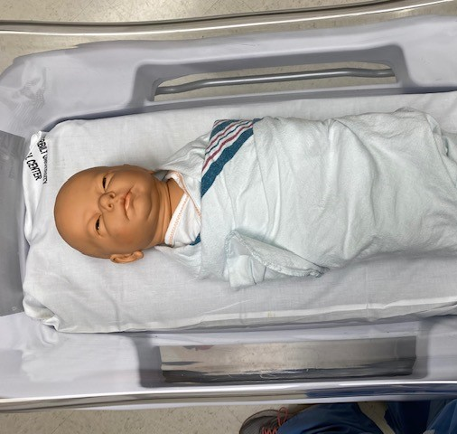
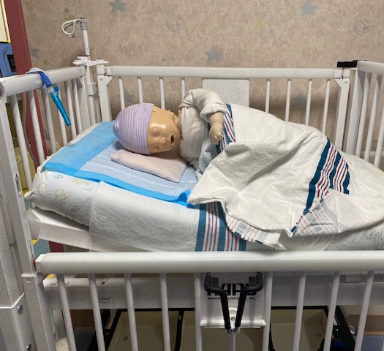
Education for Staff
Safe sleep has been taught on hire and annually for staff.
  A traveling road show is used to educate NICU staff.
In addition:
  In October, a weekly campaign for staff ran with a picture of a poor sleeping environment and asked them to note the errors.
  In December, one of the Tennessee medical examiners gave a ZOOM lecture to our staff on sleep-related deaths.

Slide 17
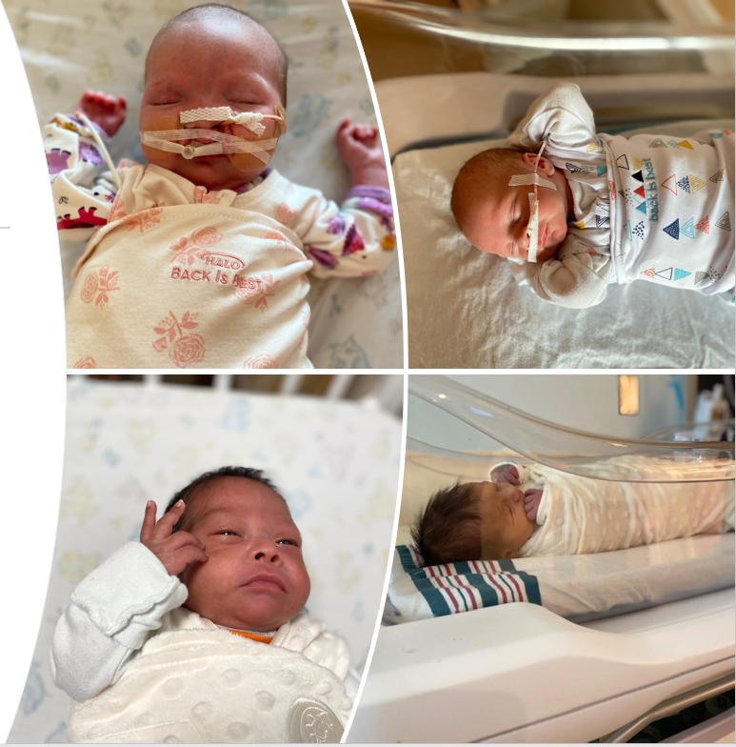
Education for Families
Evidence supports that families model after what they see done, and less so on what they are taught to do.
Every family is educated on safe sleep prior to discharge.
  Nursery families are also educated on safe sleep at admission.
  NICU families are educated throughout their stay and upon their infant’s transition to safe sleep.
Hospital social media models safe sleep or ensures that it is noted.
Notes:
Again families do what they see and we want them to see safe sleep while here. While NICU patients require therapeutic positioning, we educate on the reasons why and why it will no longer be safe.
When we do holiday photos or pictures, we try to note that the pictures do not represent safe sleep

Slide 18
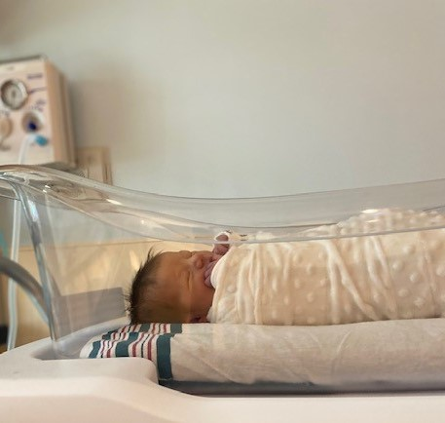
Our Challenges
Adequate supplies and linen
Media
Staff workload/ parental exhaustion
Personal experiences of staff and families
Cultural considerations

Slide 19
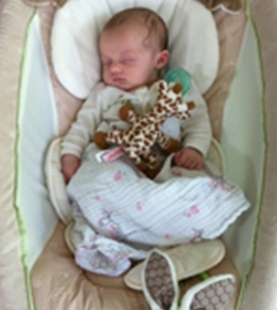
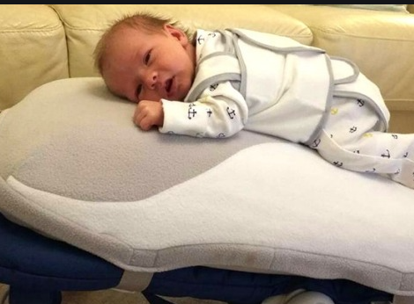
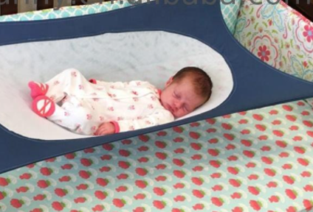
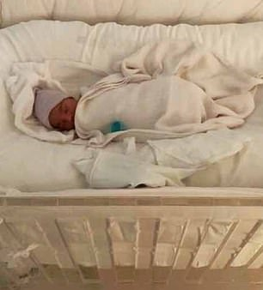
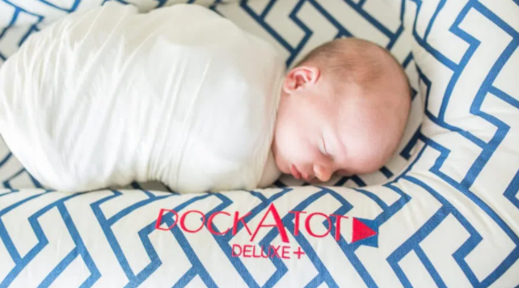
Unsafe Products on the Market
There are lots of products on the market that are not safe for sleep.
Recalled products still in circulation
Notes:
All of these types of products are sold and in wide circulation. Recalled products such as the rock and play are still in circulation. Bumpers are still sold and often still used.

Slide 20
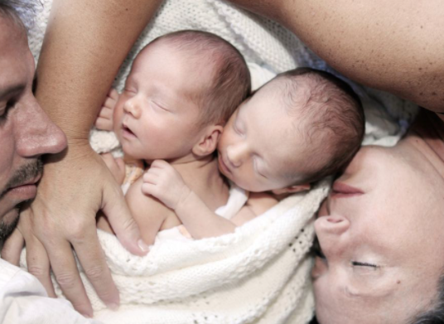
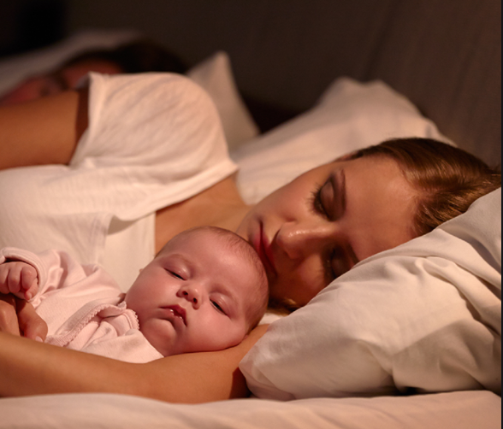

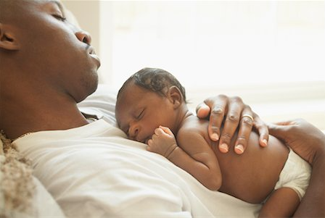
Media Portrayals of Safe Sleep
Notes:
As you saw on this slide and the last slide, there are often products and social norms that are expected and normalized. We see tons of photos just like these that are almost rites of passage, but are very unsafe

Slide 21
Cultural Considerations
Commonality of bed-sharing
Concerns about infant temperature
Can lead to overdressing or overheating
Sources of knowledge
Internal sources vs. external sources
Social determinants
Socio-economic status, breast-feeding rates, ability to afford safe sleeping surface
Notes:
Bedsharing is very common in many cultures. Assessing for where baby will sleep and teaching why families may not think that baby needs to sleep separately.
Concern about the baby being too cold or exposed is common. The removal of the hat at 1 day of life is often very surprising and we will need to remove it a few times.
Sources of knowledge for the family is a huge consideration. We work hard to make our voices heard, but often close family members and friends can teach or preach unsafe sleep practices. Families also can get outdated or unsafe recommendations from people that they see as healthcare experts such as doulas, midwifes, lactation consultants, or other groups.
Social dterminents are often two fold. They are less likely to be able to breast-feed, often smoke more, but they also may be unable to afford safe sleeping surfaces

Slide 22
Modeling in the Hospital
Our goal is to correct unsafe sleeping in the moment.
Goal is to have families understand that we teach this to prevent injury or the loss of their child.
  If we can show that the baby stays warm with just a sleep sack and clothing, then perhaps the family will see that as well.
  If the extra blankets are removed each time, the family may be more apt to understand the risk.
  If we educate that babies are more likely to aspirate on their stomach than back, the family may listen and change their habits of prone sleeping.
Notes:
We correct safe sleep in the moment. If a parent is asleep with their baby, we will wake them and put the baby into their own bed. We try very hard to always teach in the moment. If that moment is an exhausted parent, we will help them get some sleep with the baby in the nursery (if alone) and then educate when the parent is awake and more alert.
This is sometimes tough love teaching. The education is that your baby could die if… or these blankets could cause the baby to not be able to breath. We want them to know the reality without scaring them. Teaching is aimed at prevention.
You can see what we are fighting against. The media, some trusted people such as doulas, other moms, family members, have louder voices.

Slide 23
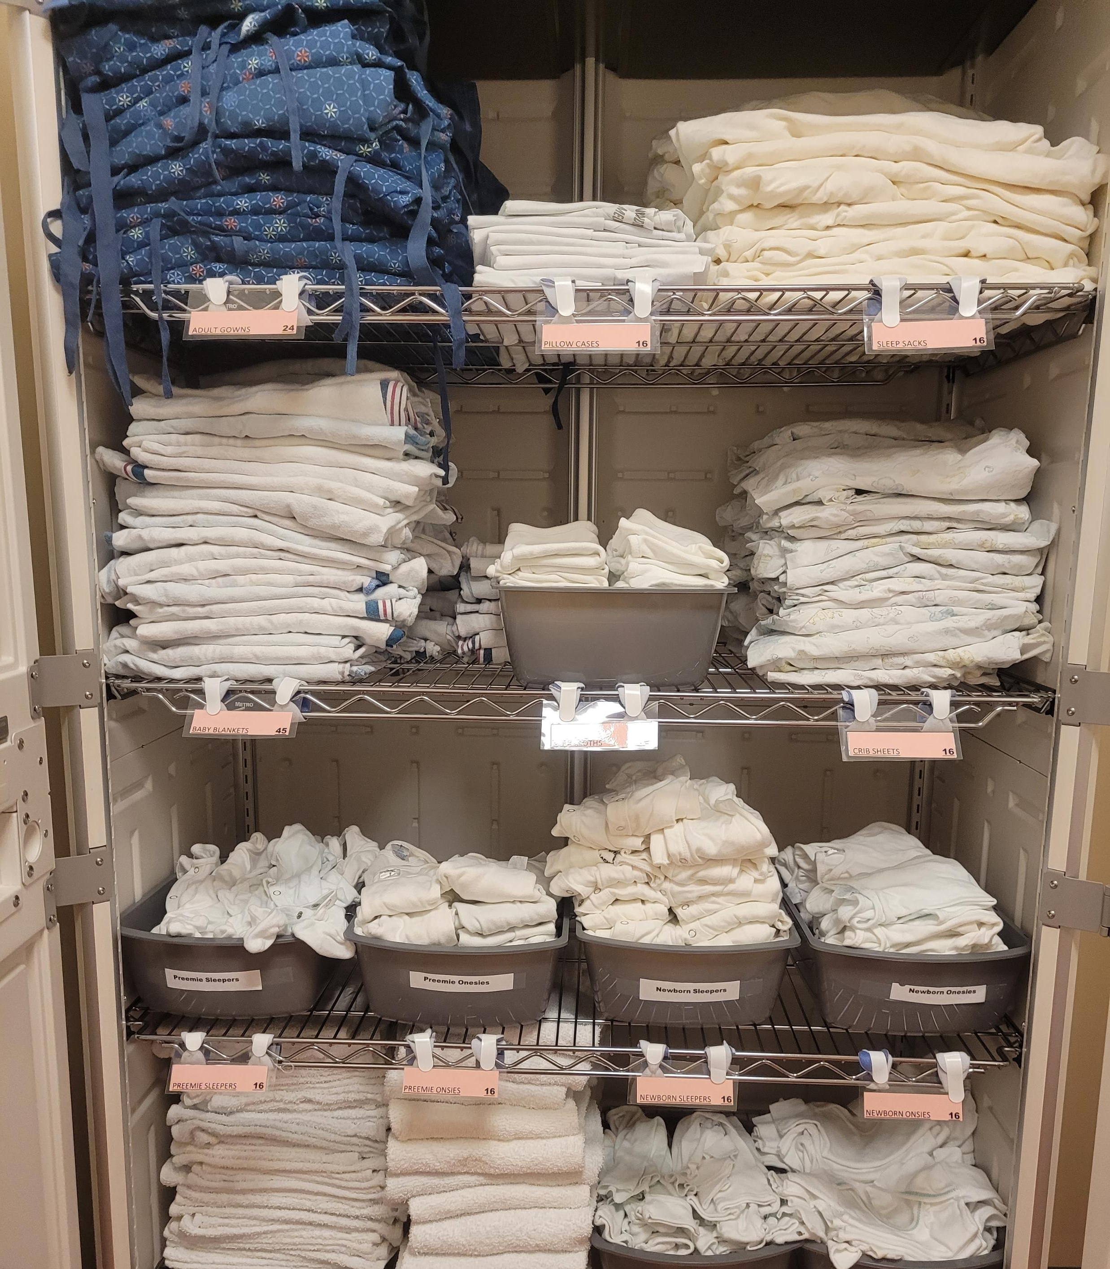
Linen Challenges
Sleep sacks
  Adequate amounts
Clothing
  Proper thermoregulation
High Census
Multiple Units with Different Populations
Solutions:
Par levels increased
Change in sleep sack brand
Changing cabinets to allow for easier stocking
Notes:
Linen honestly has been a big player for us. When we were initially looking at compliance and its roots, we often came back to that there was not enough of this, or they never bring this. We also are the only units to use some items, so the linen staff are not always familiar with the items we want. “whats a sleep sack” is a question I have gotten more than I would have liked. We continued to work with them and our spaces to create ways to ensure that we had what we needed. The time I have spent on linen was a huge player. If staff cannot do what we are asking then we need to fix the supply issue before we work on the will.
Clothing is all white, and that has been a confounder since we often use preemie and newborn sized clothing and could not get what we needed where. New newborn items are a slightly different cream color.
Our sleepsacks have been through a few brands before we have found our current product. Out initial ones with zippers did not survive the dryer. We also went through some brands with and without wings. We have landed on a brand with snaps that also unbutton at the shoulders to allow use with iv lines if needed.

Slide 24
Sleep Sack Usage
Notes:
We also collect data about the use of our sleepsacks so that we can ensure that we are using the items we have collected resources for and also we have seen that our compliance improves as our sleep sack rate do as well.

Slide 25
Staff workload and personal experiences
Shortcuts in the hospital can be those seen at home.
Using extra blankets to maintain clean linen
Allowing sleep in an infant swing or prone
Use of stuffed animal pacifiers
Many of our nurses and providers have children or grandchildren
Personal experiences from their own family
Experiences from previous NICU families
Notes:
Similar to the familys lived experiences we know that the nurses have them as well. Our education to them is also aimed at how we can show them the risks and the “whys” to bring impactful change.

Slide 26
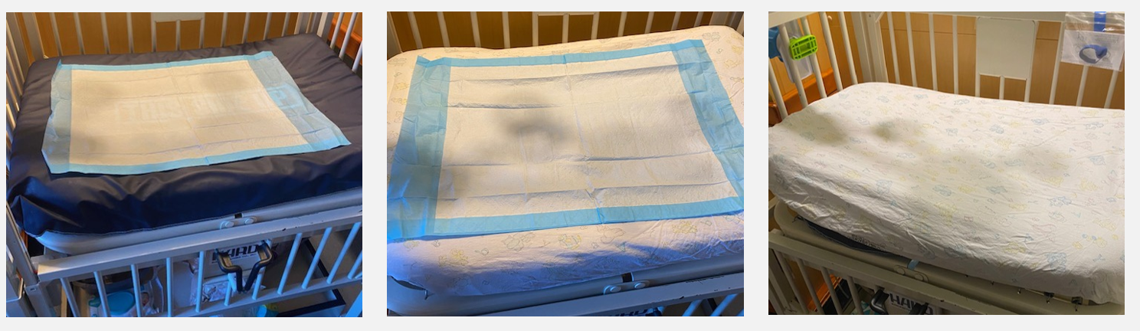
Solutions
Educate in a realistic way.
  Education with the medical examiner, trauma videos from our ER, staff awareness if a patient of ours has been lost
Disseminate new information
  Our policy has been edited twice to allow for new AAP recommendations.
Make the right way easier.
  We have taught a layering technique for hospital cribs that are safe and families can do it as well.
Notes:
We want our staff to be aware of the impact. This can be a much harder thing to visualize for some. In the hospital it is easy to link cause and effect with hand hygiene and infections for example. But for safe sleep, we often are not aware fo what happens after our patient leaves.
In terms of new information, we follow the AAP guidelines and one of the policy edits were aimed at allowing arms in swaddling if the patient requires it.

Slide 27
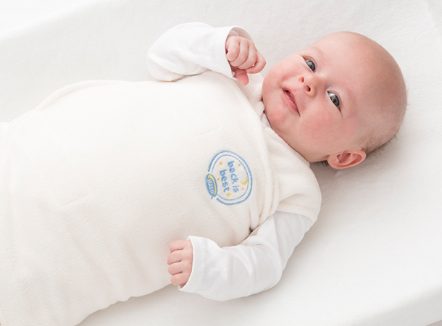
Next Steps
Continued improvement
Increased Sleep Sack Usage
New Discharge Education
Future Trials
  Therapeutic positioning vs Safe sleep protocol
  Daily Rounding on Safe Sleep by the providers
  Keepsake cards for families
Notes:
This work is highly ingrained in both units now. Audits are expected, The aim is to raise compliance to greater than 90%.
We are also looking to pieces of our program to ensure that we are providing the best education possible for each family. We also have some future ideas for small trials on the docket. We are looking at a therapeutic positioning procotol that will educate families and red-flag to staff to change to safe sleep. We also are working through some practices to see if they will impact safe sleep compliance.

Slide 28
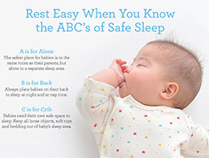
Questions?

