Slide 1
Safe Sleep Initiatives
May 28 , 2020

Slide 2
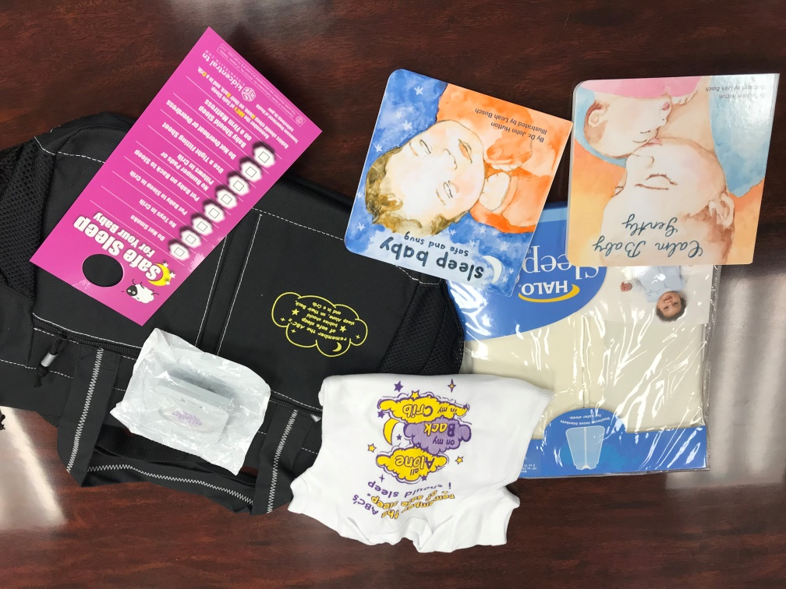
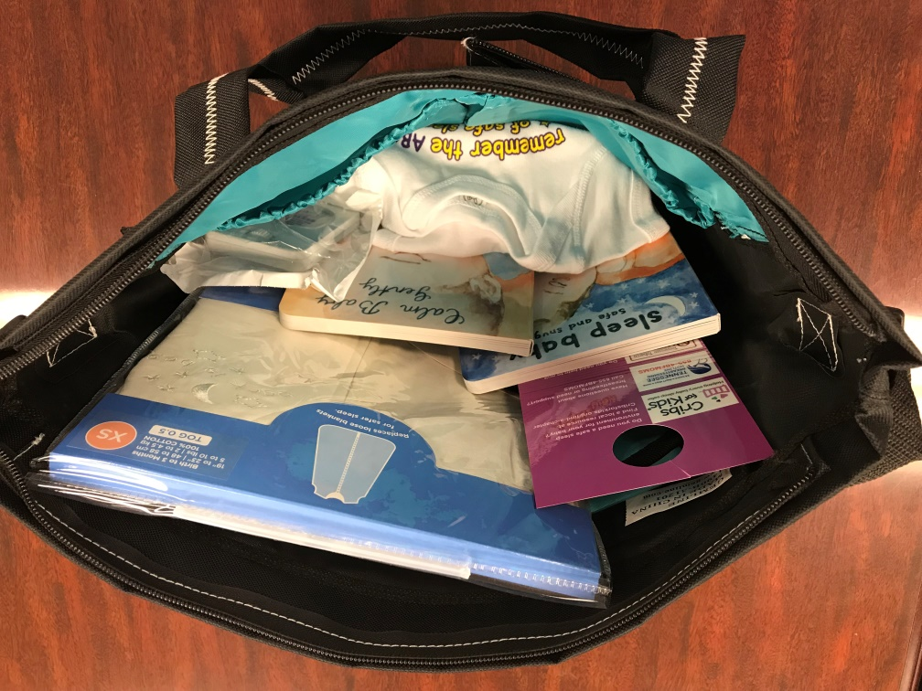
Safe Sleep Diaper Bag Project
Diaper Bag
2-sided Door Hanger
Sleep Baby Safe and Snug Book
Calm Baby Gently Book
Infant Sleep Sack
Infant Onesie
Infant Nightlight

Slide 3
Safe Sleep Diaper Bag Data
EBHV
677 Bags distributed
219 (33%) state an item in the bag contributed to behavior change
  Sleep Sacks (51%)
  Door Hangers (40%)
  Safe and Snug Book (31%)
CHANT
244 Bags distributed
135 (59%) state an item in the bag contributed to behavior change
  Sleep Sacks (56%)
  Safe and Snug Book (46%)
  Door Hangers (39%)
Biggest change:
  Baby only sleeps in crib, bassinet, or pack and play (67%)
  Baby now always sleeps alone (65%)

Slide 4

BEST for Babies-Birthing Facility Award
Breastfeeding
Early Elective Delivery
Safe sleep
for Tennessee Babies
18 Facilities Awarded in 2019
Continuing award for 2020!
New TIPQC hospital safe sleep initiative includes crib audits and modeling safe sleep behavior in hospitals

Slide 5
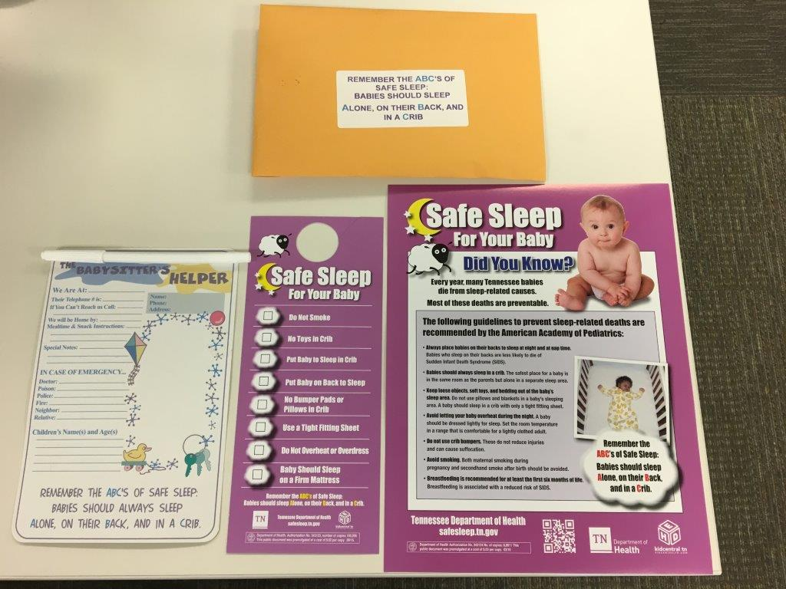
DOSE- First Responders
Educates maintenance staff and first responders to recognize an unsafe sleep environment
Provides resources to residents and assists in obtaining a safe sleep environment

Slide 6
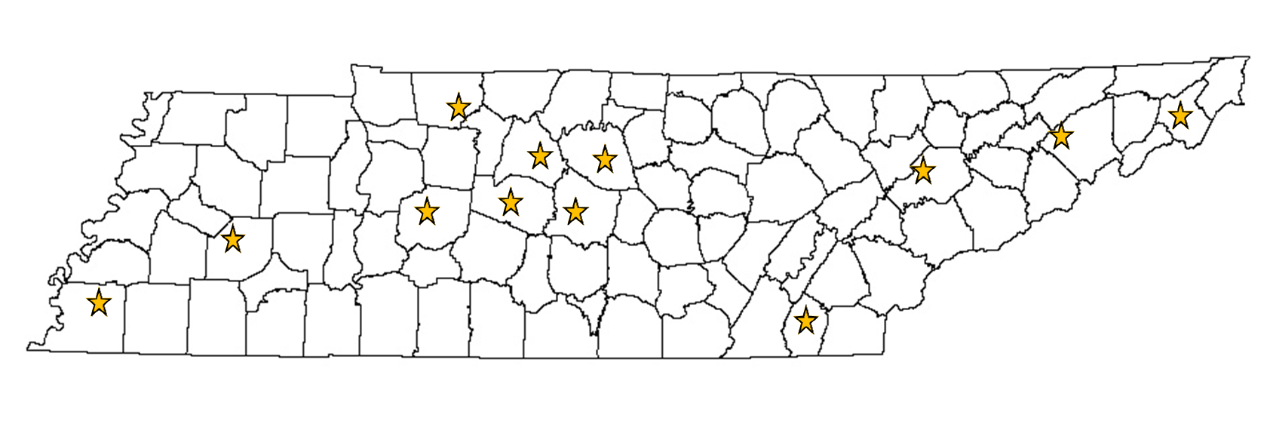
DOSE Locations

Slide 7
Housing authorities and safe sleep
Train maintenance staff and office staff on infant safe sleep
Provide education and resources to families with infants
Provide a portable crib either directly through the housing authority or local health department

Slide 8

WIC Educational Module
Safe Sleep and Breastfeeding
Utilizes the stages of change to assess and provide appropriate education to the learner
Combines messages of safe sleep and the importance of breastfeeding, and how a parent can do both
Available at WIC online nutrition education at www.wichealth.org

Slide 9
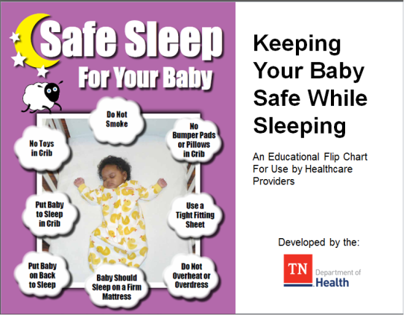
Area on Aging and Disability
Piloting in Shelby County
Providing education to second generation caregivers on safe sleep

Slide 10
Questions
Type in the chat box:
What are some ways you can support the activities was have described?
What community partners are you already working with to provide safe sleep education?
What additional unique partners can you collaborate with for infant safe sleep?
How is COVID impacting your safe sleep work?

Slide 11
Thank you
If you are interested in any of our safe sleep materials or building partnerships please contact:
April Kincaid
april.kincaid@tn.gov
Rachel Heitmann
rachel.heitmann@tn.gov

