Slide 1
SUID Categorization
MAY 27, 2020
Tennessee department of health
Annual child fatality review Training
Alexa Erck, MPH
Epidemiologist and Program Manager
SUID & SDY Case Registry

Slide 2
SUID: Difficult to Define
No agreed upon standard definitions
No biological marker - autopsy alone often cannot establish cause
Inconsistent use of standardized protocols for death scene investigation and autopsy
Difficult to ascertain information as many occur during sleep, or are unwitnessed
Differential certification of deaths based on medical examiners/coroners jurisdictional practices
Notes:
We, at CDC and the SUID Case registry, acknowledge that SUID is a hard cause of death to define.
There isn’t a standard, agreed upon definition. Definitions vary from one state to the next-sometime from one jurisdiction to the next!
Unlike some other causes of death, there are no known biological markers in SUIDs, so autopsy alone can’t establish cause
What takes place during the autopsy and DSI for these cases can vary widely
Scene investigations often don’t document info on where and how a baby is found
Also ME/Cs may certify deaths differently depending jurisdictional practices

Slide 3
Classification System: Why?
Provide a standardized way to group SUID cases into categories
Consistently monitor SUID trends and characteristics
Account for unknown and incomplete investigation information
Document the uncertainty about how suffocation may or may not have contributed to death
Notes:
Addressing some of these limitations is exactly the reason the SUID Classification system was developed.
Specifically, the four objectives of the SUID classification system are:
To provide a standardized grouping method which will allow for consistent monitoring of SUID trends and characteristics over time
To account for unknown and incomplete investigation information which can inform efforts to improve case investigations
And
To acknowledge uncertainty about how suffocation/asphyxiation may or may not have contributed to the death so that SUIDs can be more appropriately characterized according to the evidence available.

Slide 4
Classification System: Implications
Accurately track the magnitude of specific types of SUID over time and across states/jurisdictions
Identify gaps in SUID case investigation
Assist in identifying highest risk groups for focused interventions
Notes:
As a result of using the classification system we expect that CDR programs will be able
to more accurately track SUIDs over time
Compare patterns in SUID across states/jurisdictions
Identify gaps in SUID case investigation and reporting including, death scene investigation, autopsy practices
And more easily identify the highest risk groups to target for intervention or other services.
DON’T READ:
A few specific ideas for how to use data on how cases were categorized are:
Include your annual reports
Feed directly to stakeholder’s including Governor’s office
Use to develop county- or region-specific reports on the SUID categories.

Slide 5
Classification System: Key Attributes
Assigns categories using group consensus
Has explicit category definitions and an algorithm
Does NOT reclassify official cause of death
Builds on previous systems, but tailored to the multidisciplinary Child Death Review model including the SUID Case Registry
Categorization should take place through a discussion with your Child Death Review Team
Notes:
Key features of the classification system are that it:
Assigns categories using group consensus
Has explicit category definitions and an algorithm
Does not reclassify official cause of death
Incorporates contributions of other previously developed and implemented classification systems, but is specific for the SUID Case Registry and other users of the multi-disciplinary child death review model.

Slide 6
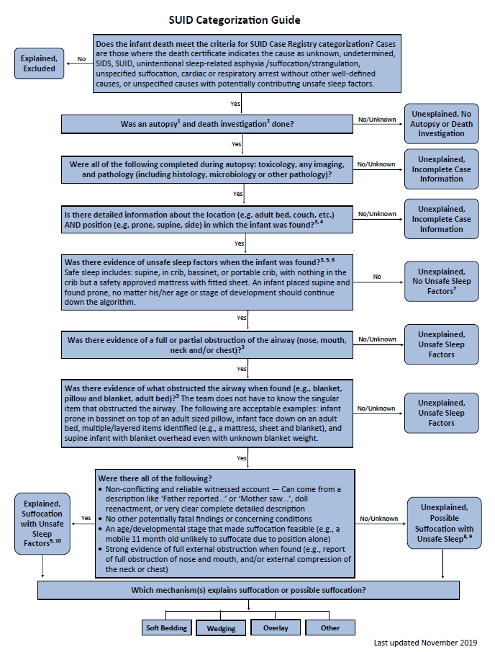
Source: Shapiro-Mendoza C K et al. Pediatrics
Notes:
Now, let’s walk through the algorithm

Slide 7
Source: Shapiro-Mendoza C K et al. Pediatrics
Notes:
Now, let’s walk through the algorithm
The basic layout is that the major questions to be asked and answered during the process are down the middle shown here in the blue box
It is very important that the algorithm be followed from top to bottom for every case. It can be very tempting to jump to a question to which you have evidence to support but each question needs to be answered in order.

Slide 8
Source: Shapiro-Mendoza C K et al. Pediatrics
Notes:
The actual SUID categories being assigned to cases are along the sides in the two blue oblong boxes here
The categories along the left are considered explained death categories: excluded; other causes and explained suffocation with unsafe sleep factors
The categories along the right are considered unexplained death categories; ranging from top to bottom of the algorithm by level of evidence available.

Slide 9
Does the death meet case criteria?
Cause of death (on the death certificate) is:
Unknown or undetermined
SIDS or SUID
Unintentional sleep-related asphyxia, suffocation, or strangulation
Unspecified suffocation
Cardiac or respiratory arrest without other well-defined causes
Ill-defined causes (e.g., unspecified injury, pneumonia) with potentially contributing unsafe sleep factors (e.g., soft bedding, prone sleeping)
Intentional homicides are excluded
Notes:
Starting at the top of the algorithm with the first box in the middle of the page, the first step is to determines whether a case meets criteria for categorization....in other words, does it meet the SUID Case Registry case definition
The case meets the SUID Case Registry case definition if the cause of death (on the death certificate) is one of the following:
Unknown or undetermined
SIDS or SUID
Unintentional sleep-related asphyxia, suffocation, or strangulation
Unspecified suffocation
Cardiac or respiratory arrest without other well-defined causes
Ill-defined causes (e.g., unspecified injury, pneumonia) with potentially contributing unsafe sleep factors (e.g., soft bedding, prone sleeping)
Intentional homicides are excluded
This will generally be done before the meeting.

Slide 10
Does the death meet case criteria?
No → Explained, Excluded
Yes → Case continues down the algorithm
Notes:
If the answer is no, then the case is Excluded. As an explained; other cause death
If the answer is yes, then the case continues down the algorithm…

Slide 11
Was an autopsy and death investigation done?
Yes, if you have…
Knowledge that the death investigation and autopsy were completed
Information from the reports (e.g., verbally), or
Access to death investigation and autopsy reports
Notes on death investigation
Yes, if any group investigated the circumstances of the death (doesn’t have to be law enforcement or the coroner/medical examiner’s office)
Yes, even if the death investigation did not occur at the incident scene
Notes:
…to the next question in the middle, and that is whether an autopsy and DSI were done
If you refer to the definitions and criteria in table 1 in the original categorization manuscript cited in these slides, you see that in order say an autopsy and DSI were done, you have to have…
Knowledge that the death investigation and autopsy were completed
Information from the reports (e.g., verbally), or
Access to death investigation and autopsy reports
TWO IMPORTANT Notes:
You can say yes to this questions if…
any group investigated the circumstances of the death (doesn’t have to be law enforcement or the coroner/medical examiner’s office)
And if there was an in depth death investigation even if it did not occur at the incident scene

Slide 12
Was an autopsy and death investigation done?
No → Unexplained, No Autopsy or
Death Investigation
Yes → Case continues down the algorithm
Notes:
If you don’t have information for both an autopsy and DSI having been done;
That is if either one is missing,
then the answer is no, and the case is assigned the SUID category of “No autopsy/DSI”. And the case stops here.
If you answer yes, then the case continues down the algorithm….

Slide 13
Were tox, imaging and pathology completed?
Pathology can include histology, microbiology, or other pathology such as genetic testing, but not solely gross examination
Imaging includes any kind (e.g., single view, complete skeletal, cat scan)
All three tests (tox, imaging, path) must have been performed after death or during the same hospitalization as the death
Notes:
…to the next step in the decision-making algorithm
Which is were the toxicology, imaging and pathology completed?
**pathology can consist of any combination of histology, micro, or other tests like genetic testing)
**imaging can include single, multiple view, complete skeletal series or other imaging
**All three tests (tox, imaging, path) must have been performed
Minimum autopsy criteria established based on expert opinion and on recommendations set forth in a white paper from the National Association of Medical Examiners.

Slide 14
Were tox, imaging and pathology completed?
No → Unexplained, Incomplete Case Information
Yes → Case continues down the algorithm
Notes:
If any of the three tests, tox, imaging or pathology were NOT performed or documented then the case is categorized as incomplete case information and goes no further.
If all three tests were performed then the case continues down the algorithm…

Slide 15
Were the found location and position known?
Location = where (e.g., adult bed, crib)
Position = how (e.g., prone, supine)
Notes:
to were the found location AND Position of the infant known.
Location is where the infant was found (e.g., adult bed, crib)
Position is how the infant was found (e.g., prone, supine)

Slide 16
Were the found location and position known?
No/Unknown → Unexplained, Incomplete Case
Information
Yes → Case continues down the algorithm
Notes:
If you don’t have this much detail and can’t tell either the location or position the infant was found in. then the case gets categorized as incomplete case information
If the answer is yes, the case continues down the algorithm….

Slide 17
Where there unsafe sleep factors?
Unsafe sleep (as defined by AAP) includes:
Non-supine when found
Surface-sharing
Not on firm sleep surface (i.e., in a crib, bassinette, pack ‘n play)
Presence of soft objects (e.g., loose bedding, bumper pads, clothing)
Other strangulation/suffocation sources present in sleep area
Notes:
…to were there any unsafe sleep factors present.
Here, we mean anything but alone, on their back and in a crib/bassinette or pack n play.
Examples of unsafe sleep factors are:
Non-supine position,
Non-firm sleep surface,
Shared-sleep surface with an adult or another child,
Presence of soft objects/bedding,
Or presence any other Strangulation/suffocation hazards in the sleep environment.

Slide 18
Where there unsafe sleep factors?
No → Unexplained, No Unsafe
Sleep Factors
Yes → Case continues down the algorithm
If the infant was awake at the time of death → Unexplained, No Unsafe Sleep Factors
Notes:
If there were no unsafe sleep factors present, the case is categorized as No Unsafe Sleep Factors.
If there were any unsafe sleep factors, the case continues down the algorithm.
If the infant was awake at the time of death, an infant who is witnessed going unresponsive, then you answer no to this question and categorize the case as No Unsafe Sleep Factors

Slide 19
Was there an airway obstruction?
Full or partial
Nose, mouth, chest or neck
Notes:
If there are indeed unsafe sleep factors then the case moves on to the next step of the algorithm which is to determine whether or not there was any evidence of obstruction of the airway
in other words, evidence of the child's airway having been obstructed by some element of the unsafe sleep environment.
Examples of factors for suffocation are:
Nose and or mouth being partially or fully obstructed
Chest being partially or fully compressed

Slide 20
Was there an airway obstruction?
No/Unknown → Unexplained, Unsafe Sleep
Factors
Yes → Case continues down the algorithm
Notes:
If the answer is No or you don’t know then
the case is categorized as unsafe safe sleep factors and goes no further in the decision-making algorithm

Slide 21
Was there evidence of what obstructed the airway?
Examples:
Nose and/or mouth partially obstructed BY MATTRESS
Chest fully compressed due to overlay by sibling
Less straight-forward examples:
Face down, prone on an ADULT MATTRESS
Prone infant in a bassinet on top of an ADULT PILLOW
Supine infant with a blanket over head
Notes:
If the answer is yes, then you need to determine whether you know WHAT exactly obstructed the airway.
Example are:
Nose and/or mouth partially or fully obstructed by adult mattress,
Chest partially or fully compressed due to overlay by older sibling

Slide 22
Was there evidence of what obstructed the airway?
No/Unknown → Unexplained, Unsafe Sleep
Factors
Yes → Case continues down the algorithm
Notes:
IF you don’t know WHAT obstructed the airway, then the case gets categorized as unsafe sleep factors.

Slide 23
Where there all of the following?
Non-conflicting and reliable witness account
No other potentially fatal findings or concerning conditions
An age/developmental-state that made suffocation feasible
Strong evidence of full external obstruction when found
Notes:
If the answer to the previous question is yes, you do know WHAT obstructed the airway, then you can continue on to the next box which contains a series of questions.
These four final questions determine whether a case should be categorized as explained suffocation or possible suffocation.
Was there:
Full airway obstruction or external compression of neck or chest?
Reliable, non-conflicting account of the circumstances from witnesses, doll re-enactments, scene photos?
No competing cause of death or potentially fatal findings/concerning conditions?
And was suffocation feasible given the infant’s age and stage of development?

Slide 24
Where there all of the following?
No/Unknown → Unexplained, Possible
Suffocation with Unsafe Sleep
Factors
Yes → Explained, Suffocation with Unsafe Sleep
Factors
Notes:
If you CAN answer yes to ALL four of those criteria, you have the highest level of suffocation evidence, and the case is categorized as suffocation with unsafe sleep factors.
If you can’t answer all four of those criteria, then the case gets categorized as possible suffocation with unsafe sleep factors

Slide 25
Which mechanism(s) explain the obstruction?
One or more mechanisms assigned to each case categorized as Possible Suffocation or Explained Suffocation
Mechanisms
Soft Bedding
Overlay
Wedging
Other
Notes:
The final step is that for cases that are categorized as either suffocation OR possible suffocation, you also need to indicate the most likely mechanism
The choices being soft bedding, wedging, overlay, other
NOTE that in the case report system, you are allowed to enter multiple mechanisms for a case for those instances where there are competing mechanisms.
Also, the “other” mechanism can be a little confusing;
Common examples are baby was lying on someone rather than being overlaid, say sleeping on Dad’s chest.
OR maybe a non-soft bedding object, like a plastic bag in the crib, obstructed baby’s airway.

Slide 26
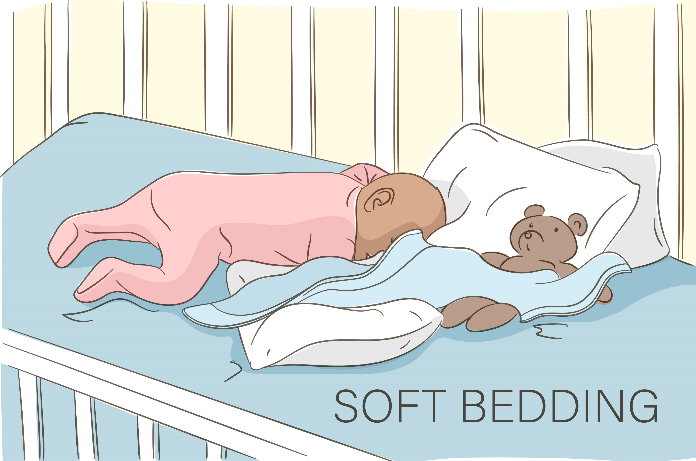
Soft Bedding
When an infant’s airway is obstructed by soft/loose blankets, sheets, pillows or stuffed toys.

Slide 27
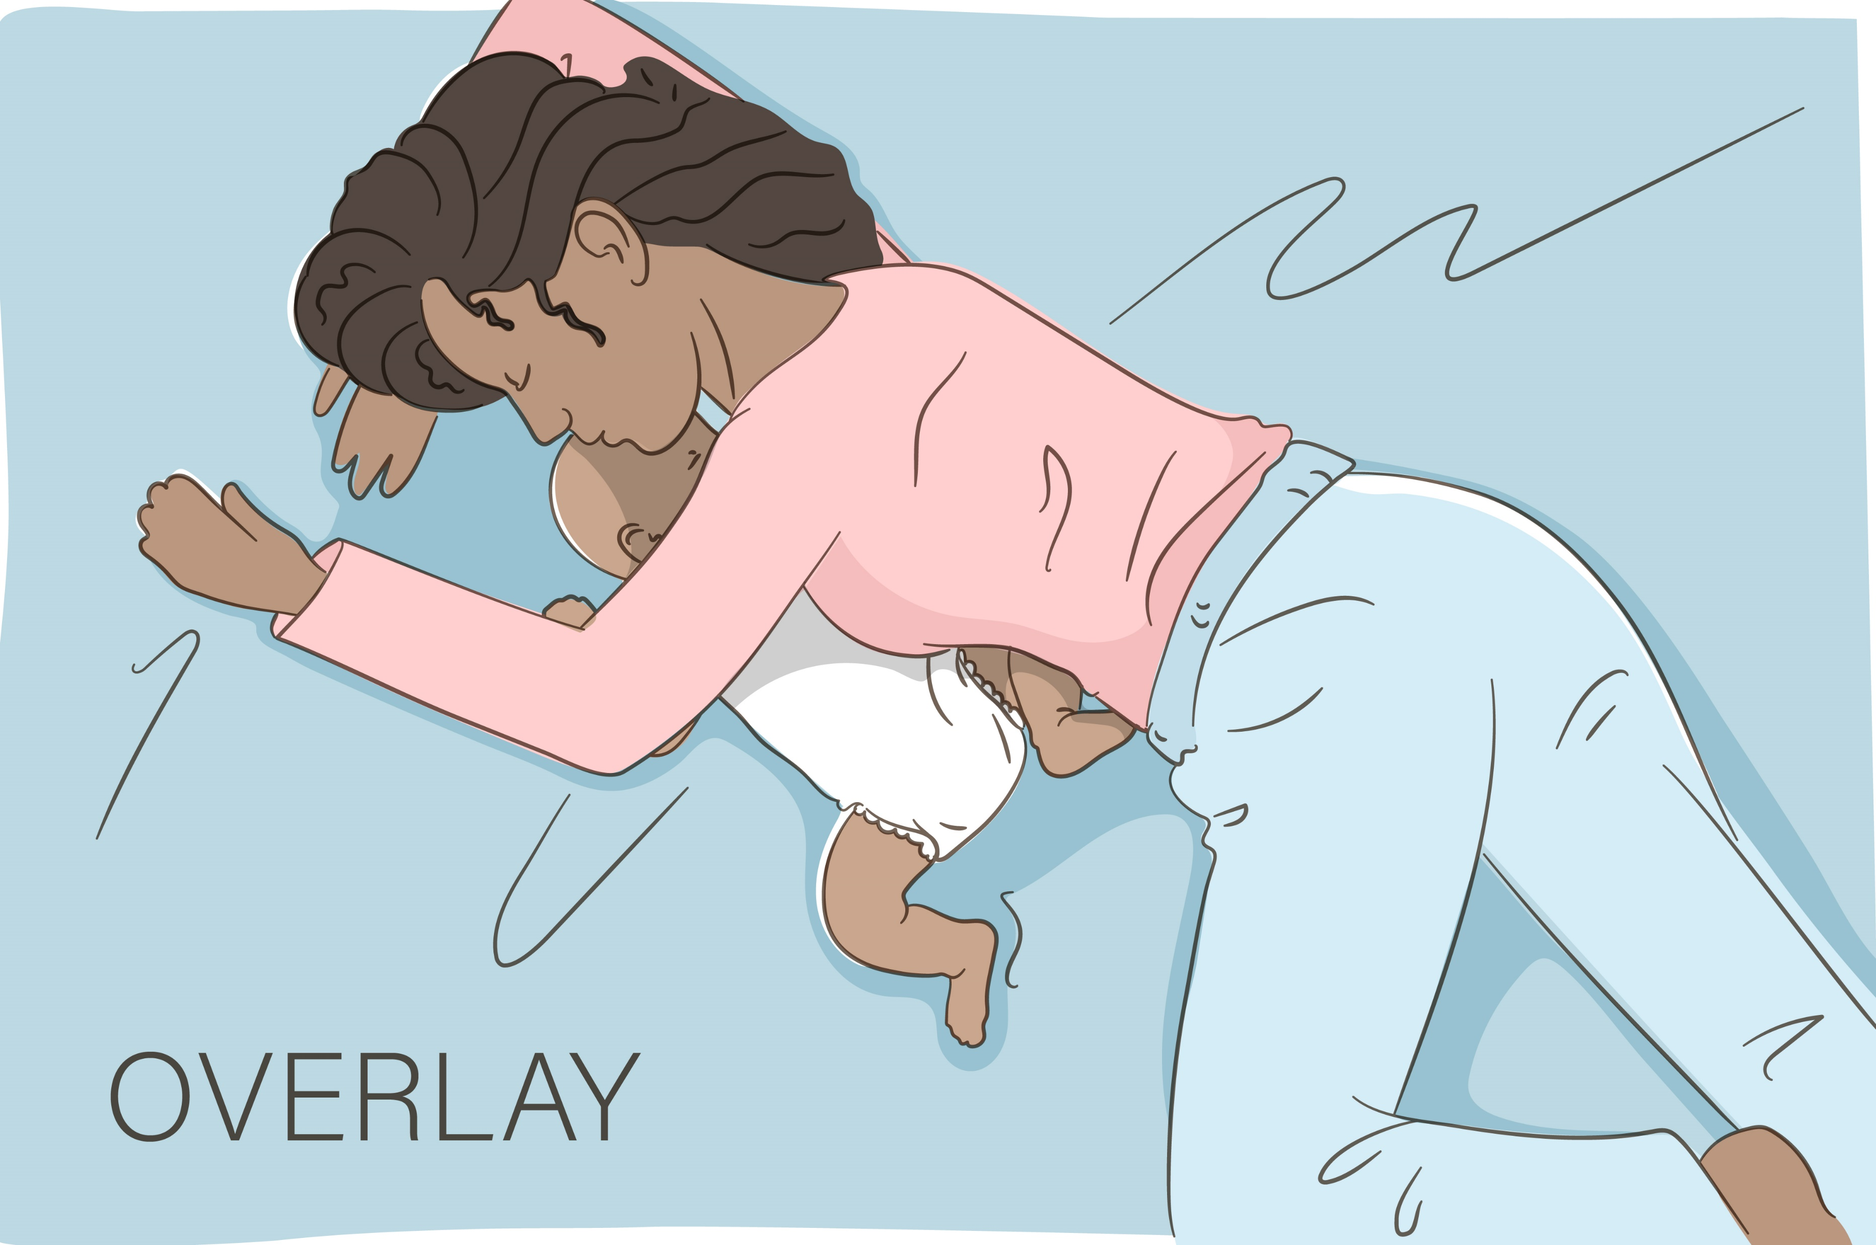
Overlay
When a person rolls on top of or against an infant obstructing their airway.

Slide 28
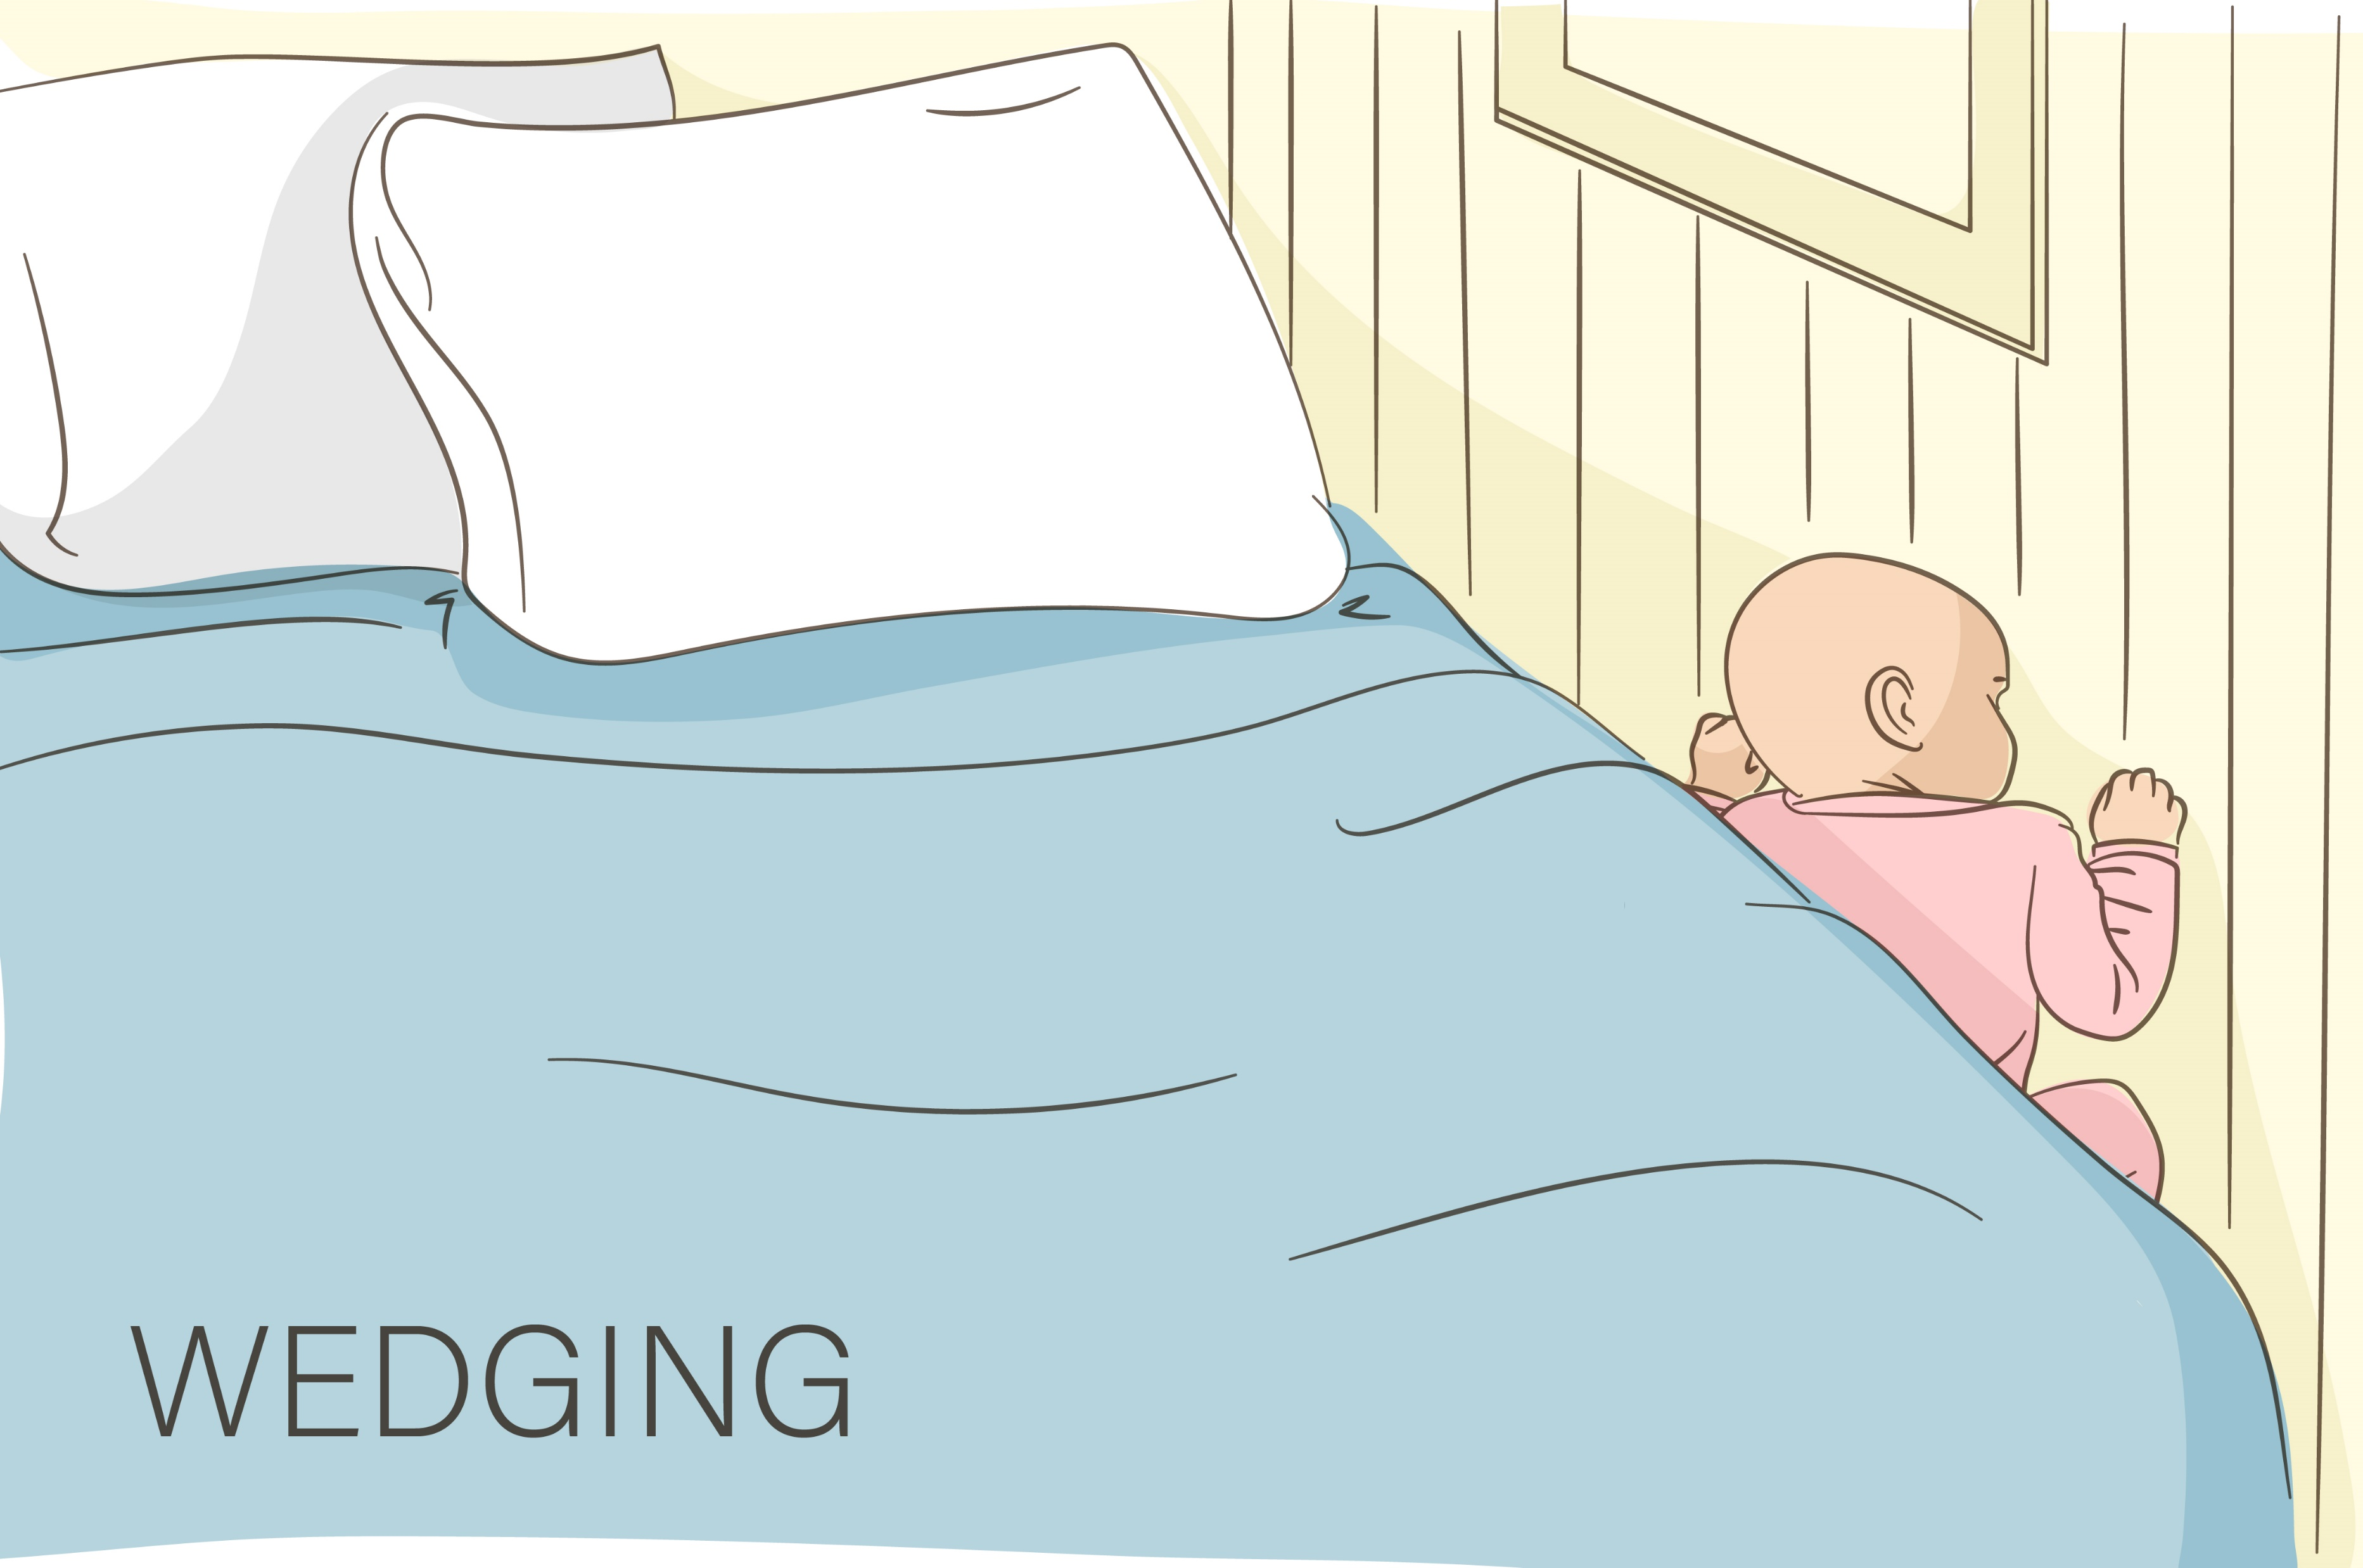
Wedging
When an infant’s airway is obstructed as a result of being stuck or trapped between two objects.

Slide 29
Other
When the infant’s airway is obstructed by something in the sleep environment other than soft bedding, overlay or wedging, such as a plastic bag.

Slide 30
Categorization Process
The awardee CDR Team categorizes the case
The awardee enters the data and cleans the case
CDC receives the case in a quarterly data download
CDC reviews the case and sends feedback on the category selected by the awardee CDR Team
CDC and the awardee discuss the feedback on the one-on-one call
In cases of disagreement, the awardee updates the data and/or the category
GOAL: CDC and awardee agree on the category initially or after
feedback/discussion on one-on-one call and this is reflected in the data
Notes:
We know that because of transitional purposes or lack of leadership of CDR some awardees are categorizing as an internal group.
This is not how the categorization process was conceptualized but if this is the best way to do it in your jurisdiction then just make sure you’re doing it with at least 3 people for every case

Slide 31
Exercise Structure
I will review each case
You will select what you think is the correct category
We will discuss
Make sure to have the SUID Case Registry Algorithm in front of you

Slide 32
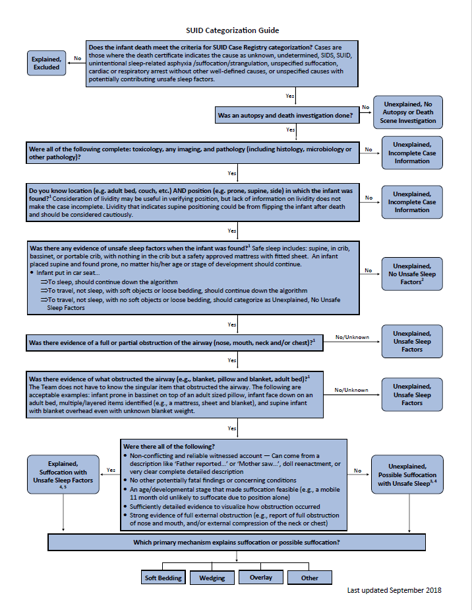

Slide 33
Categorization Questions
Meets case criteria?
Autopsy and death investigation done?
Tox, imaging and path completed?
Known found location and position?
Unsafe sleep factors present?
Airway obstructed?
Evidence of what obstructed the airway?
Non-conflicting, reliable witness account?
No other potentially fatal findings or concerning conditions?
Suffocation feasible at age/stage of development?
Strong evidence of full external obstruction?
Notes:
these are the questions. you need to ask and answer...as we review each case,....

Slide 34
Case 1

Slide 35
Manner and Cause from DC: SUID, Williams Syndrome and Unsafe Sleeping Environment
Age: 3 Months Sex: Male Gestational Age: 34 Weeks | Weight at Death: 6.9 lbs Weight at Birth: 3.3 lbs | Autopsy DSI | Toxicology X-Ray Pathology
Location: Adult Bed Position Placed: On side Position Found: Unknown Airway: Unknown Face/Neck Position: Unknown | Narrative: Per autopsy: Infant had William's Syndrome and was co-sleeping with its father in an adult bed with several blankets and boppy type pillow. Per SUIDI: There were three individuals who completed a doll reenactment. Each individual placed the doll in a different position for the location of the child when found. The true position of the child when found remains unknown.
Meets case criteria?
Autopsy and death investigation done?
Tox, imaging and path completed?
Known found location and position?
Unsafe sleep factors present?
Airway obstructed?
Evidence of what obstructed the airway?
Non-conflicting, reliable witness account?
No other potentially fatal findings or concerning conditions?
Suffocation feasible at age/stage of development?
Strong evidence of full external obstruction?
Notes:
ID# 289359
Incomplete Case Information

Slide 36
Manner and Cause from DC: SUID, Williams Syndrome and Unsafe Sleeping Environment
Age: 3 Months Sex: Male Gestational Age: 34 Weeks | Weight at Death: 6.9 lbs Weight at Birth: 3.3 lbs | Autopsy DSI | Toxicology X-Ray Pathology
Location: Adult Bed Position Placed: On side Position Found: Unknown Airway: Unknown Face/Neck Position: Unknown | Narrative: Per autopsy: Infant had William's Syndrome and was co-sleeping with its father in an adult bed with several blankets and boppy type pillow. Per SUIDI: There were three individuals who completed a doll reenactment. Each individual placed the doll in a different position for the location of the child when found. The true position of the child when found remains unknown.
Meets case criteria?
Autopsy and death investigation done?
Tox, imaging and path completed?
Known found location and position?
Unsafe sleep factors present?
Airway obstructed?
Evidence of what obstructed the airway?
Non-conflicting, reliable witness account?
No other potentially fatal findings or concerning conditions?
Suffocation feasible at age/stage of development?
Strong evidence of full external obstruction?
Notes:
ID# 289359
Incomplete Case Information

Slide 37
Manner and Cause from DC: SUID, Williams Syndrome and Unsafe Sleeping Environment
Age: 3 Months Sex: Male Gestational Age: 34 Weeks | Weight at Death: 6.9 lbs Weight at Birth: 3.3 lbs | Autopsy DSI | Toxicology X-Ray Pathology
Location: Adult Bed Position Placed: On side Position Found: Unknown Airway: Unknown Face/Neck Position: Unknown | Narrative: Per autopsy: Infant had William's Syndrome and was co-sleeping with its father in an adult bed with several blankets and boppy type pillow. Per SUIDI: There were three individuals who completed a doll reenactment. Each individual placed the doll in a different position for the location of the child when found. The true position of the child when found remains unknown.
Meets case criteria?
Autopsy and death investigation done?
Tox, imaging and path completed?
Known found location and position?
Unsafe sleep factors present?
Airway obstructed?
Evidence of what obstructed the airway?
Non-conflicting, reliable witness account?
No other potentially fatal findings or concerning conditions?
Suffocation feasible at age/stage of development?
Strong evidence of full external obstruction?
Notes:
ID# 289359
Incomplete Case Information

Slide 38
Manner and Cause from DC: SUID, Williams Syndrome and Unsafe Sleeping Environment
Age: 3 Months Sex: Male Gestational Age: 34 Weeks | Weight at Death: 6.9 lbs Weight at Birth: 3.3 lbs | Autopsy DSI | Toxicology X-Ray Pathology
Location: Adult Bed Position Placed: On side Position Found: Unknown Airway: Unknown Face/Neck Position: Unknown | Narrative: Per autopsy: Infant had William's Syndrome and was co-sleeping with its father in an adult bed with several blankets and boppy type pillow. Per SUIDI: There were three individuals who completed a doll reenactment. Each individual placed the doll in a different position for the location of the child when found. The true position of the child when found remains unknown.
Meets case criteria?
Autopsy and death investigation done?
Tox, imaging and path completed?
Known found location and position?
Unsafe sleep factors present?
Airway obstructed?
Evidence of what obstructed the airway?
Non-conflicting, reliable witness account?
No other potentially fatal findings or concerning conditions?
Suffocation feasible at age/stage of development?
Strong evidence of full external obstruction?
Notes:
ID# 289359
Incomplete Case Information

Slide 39
Manner and Cause from DC: SUID, Williams Syndrome and Unsafe Sleeping Environment
Age: 3 Months Sex: Male Gestational Age: 34 Weeks | Weight at Death: 6.9 lbs Weight at Birth: 3.3 lbs | Autopsy DSI | Toxicology X-Ray Pathology
Location: Adult Bed Position Placed: On side Position Found: Unknown Airway: Unknown Face/Neck Position: Unknown | Narrative: Per autopsy: Infant had William's Syndrome and was co-sleeping with its father in an adult bed with several blankets and boppy type pillow. Per SUIDI: There were three individuals who completed a doll reenactment. Each individual placed the doll in a different position for the location of the child when found. The true position of the child when found remains unknown.
Meets case criteria?
Autopsy and death investigation done?
Tox, imaging and path completed?
Known found location and position?
Unsafe sleep factors present?
Airway obstructed?
Evidence of what obstructed the airway?
Non-conflicting, reliable witness account?
No other potentially fatal findings or concerning conditions?
Suffocation feasible at age/stage of development?
Strong evidence of full external obstruction?
No
Notes:
ID# 289359
Incomplete Case Information

Slide 40
How would you categorize this case?
Excluded
Unexplained; No autopsy or DSI
Unexplained; Incomplete Case Information
Unexplained; No Unsafe sleep factors
Unexplained; Unsafe Sleep Factors
Unexplained; Possible suffocation with unsafe sleep factors
Explained; Suffocation with unsafe sleep factors

Slide 41
Manner and Cause from DC: SUID, Williams Syndrome and Unsafe Sleeping Environment
Age: 3 Months Sex: Male Gestational Age: 34 Weeks | Weight at Death: 6.9 lbs Weight at Birth: 3.3 lbs | Autopsy DSI | Toxicology X-Ray Pathology
Location: Adult Bed Position Placed: On side Position Found: Unknown Airway: Unknown Face/Neck Position: Unknown | Narrative: Per autopsy: Infant had William's Syndrome and was co-sleeping with its father in an adult bed with several blankets and boppy type pillow. Per SUIDI: There were three individuals who completed a doll reenactment. Each individual placed the doll in a different position for the location of the child when found. The true position of the child when found remains unknown.
Incomplete Case Info
Meets case criteria?
Autopsy and death investigation done?
Tox, imaging and path completed?
Known found location and position?
Unsafe sleep factors present?
Airway obstructed?
Evidence of what obstructed the airway?
Non-conflicting, reliable witness account?
No other potentially fatal findings or concerning conditions?
Suffocation feasible at age/stage of development?
Strong evidence of full external obstruction?
No
Notes:
ID# 289359
Incomplete Case Information

Slide 42
Case 2

Slide 43
Manner and Cause from DC: Undetermined
Age: 3 Months Sex: Male Gestational Age: 38 Weeks | Weight at Death: 15.4 lbs Weight at Birth: 6.9 lbs | Autopsy DSI | Toxicology X-Ray Pathology
Location: Adult Bed Position Placed: Back Position Found: Stomach Airway: Partially Obstructed Face/Neck Position: To left or right | Narrative: His father placed the infant on his back with his face up and his neck in a neutral position. A pillow was noted to be next to the child (to the left) and there was a sheet and comforter in the bed. When found the infant was laying on his stomach with his face turned left and his neck in a turned position. It is noted that his nose and mouth were partially obstructed by the pillow laying next to the child (he had turned his face into the pillow).
Meets case criteria?
Autopsy and death investigation done?
Tox, imaging and path completed?
Known found location and position?
Unsafe sleep factors present?
Airway obstructed?
Evidence of what obstructed the airway?
Non-conflicting, reliable witness account?
No other potentially fatal findings or concerning conditions?
Suffocation feasible at age/stage of development?
Strong evidence of full external obstruction?
Notes:
ID# 241065
Possible

Slide 44
Manner and Cause from DC: Undetermined
Age: 3 Months Sex: Male Gestational Age: 38 Weeks | Weight at Death: 15.4 lbs Weight at Birth: 6.9 lbs | Autopsy DSI | Toxicology X-Ray Pathology
Location: Adult Bed Position Placed: Back Position Found: Stomach Airway: Partially Obstructed Face/Neck Position: To left or right | Narrative: His father placed the infant on his back with his face up and his neck in a neutral position. A pillow was noted to be next to the child (to the left) and there was a sheet and comforter in the bed. When found the infant was laying on his stomach with his face turned left and his neck in a turned position. It is noted that his nose and mouth were partially obstructed by the pillow laying next to the child (he had turned his face into the pillow).
Meets case criteria?
Autopsy and death investigation done?
Tox, imaging and path completed?
Known found location and position?
Unsafe sleep factors present?
Airway obstructed?
Evidence of what obstructed the airway?
Non-conflicting, reliable witness account?
No other potentially fatal findings or concerning conditions?
Suffocation feasible at age/stage of development?
Strong evidence of full external obstruction?
Notes:
ID# 241065
Possible

Slide 45
Manner and Cause from DC: Undetermined
Age: 3 Months Sex: Male Gestational Age: 38 Weeks | Weight at Death: 15.4 lbs Weight at Birth: 6.9 lbs | Autopsy DSI | Toxicology X-Ray Pathology
Location: Adult Bed Position Placed: Back Position Found: Stomach Airway: Partially Obstructed Face/Neck Position: To left or right | Narrative: His father placed the infant on his back with his face up and his neck in a neutral position. A pillow was noted to be next to the child (to the left) and there was a sheet and comforter in the bed. When found the infant was laying on his stomach with his face turned left and his neck in a turned position. It is noted that his nose and mouth were partially obstructed by the pillow laying next to the child (he had turned his face into the pillow).
Meets case criteria?
Autopsy and death investigation done?
Tox, imaging and path completed?
Known found location and position?
Unsafe sleep factors present?
Airway obstructed?
Evidence of what obstructed the airway?
Non-conflicting, reliable witness account?
No other potentially fatal findings or concerning conditions?
Suffocation feasible at age/stage of development?
Strong evidence of full external obstruction?
Notes:
ID# 241065
Possible

Slide 46
Manner and Cause from DC: Undetermined
Age: 3 Months Sex: Male Gestational Age: 38 Weeks | Weight at Death: 15.4 lbs Weight at Birth: 6.9 lbs | Autopsy DSI | Toxicology X-Ray Pathology
Location: Adult Bed Position Placed: Back Position Found: Stomach Airway: Partially Obstructed Face/Neck Position: To left or right | Narrative: His father placed the infant on his back with his face up and his neck in a neutral position. A pillow was noted to be next to the child (to the left) and there was a sheet and comforter in the bed. When found the infant was laying on his stomach with his face turned left and his neck in a turned position. It is noted that his nose and mouth were partially obstructed by the pillow laying next to the child (he had turned his face into the pillow).
Meets case criteria?
Autopsy and death investigation done?
Tox, imaging and path completed?
Known found location and position?
Unsafe sleep factors present?
Airway obstructed?
Evidence of what obstructed the airway?
Non-conflicting, reliable witness account?
No other potentially fatal findings or concerning conditions?
Suffocation feasible at age/stage of development?
Strong evidence of full external obstruction?
Notes:
ID# 241065
Possible

Slide 47
Manner and Cause from DC: Undetermined
Age: 3 Months Sex: Male Gestational Age: 38 Weeks | Weight at Death: 15.4 lbs Weight at Birth: 6.9 lbs | Autopsy DSI | Toxicology X-Ray Pathology
Location: Adult Bed Position Placed: Back Position Found: Stomach Airway: Partially Obstructed Face/Neck Position: To left or right | Narrative: His father placed the infant on his back with his face up and his neck in a neutral position. A pillow was noted to be next to the child (to the left) and there was a sheet and comforter in the bed. When found the infant was laying on his stomach with his face turned left and his neck in a turned position. It is noted that his nose and mouth were partially obstructed by the pillow laying next to the child (he had turned his face into the pillow).
Meets case criteria?
Autopsy and death investigation done?
Tox, imaging and path completed?
Known found location and position?
Unsafe sleep factors present?
Airway obstructed?
Evidence of what obstructed the airway?
Non-conflicting, reliable witness account?
No other potentially fatal findings or concerning conditions?
Suffocation feasible at age/stage of development?
Strong evidence of full external obstruction?
Notes:
ID# 241065
Possible

Slide 48
Manner and Cause from DC: Undetermined
Age: 3 Months Sex: Male Gestational Age: 38 Weeks | Weight at Death: 15.4 lbs Weight at Birth: 6.9 lbs | Autopsy DSI | Toxicology X-Ray Pathology
Location: Adult Bed Position Placed: Back Position Found: Stomach Airway: Partially Obstructed Face/Neck Position: To left or right | Narrative: His father placed the infant on his back with his face up and his neck in a neutral position. A pillow was noted to be next to the child (to the left) and there was a sheet and comforter in the bed. When found the infant was laying on his stomach with his face turned left and his neck in a turned position. It is noted that his nose and mouth were partially obstructed by the pillow laying next to the child (he had turned his face into the pillow).
Meets case criteria?
Autopsy and death investigation done?
Tox, imaging and path completed?
Known found location and position?
Unsafe sleep factors present?
Airway obstructed?
Evidence of what obstructed the airway?
Non-conflicting, reliable witness account?
No other potentially fatal findings or concerning conditions?
Suffocation feasible at age/stage of development?
Strong evidence of full external obstruction?
Notes:
ID# 241065
Possible

Slide 49
Manner and Cause from DC: Undetermined
Age: 3 Months Sex: Male Gestational Age: 38 Weeks | Weight at Death: 15.4 lbs Weight at Birth: 6.9 lbs | Autopsy DSI | Toxicology X-Ray Pathology
Location: Adult Bed Position Placed: Back Position Found: Stomach Airway: Partially Obstructed Face/Neck Position: To left or right | Narrative: His father placed the infant on his back with his face up and his neck in a neutral position. A pillow was noted to be next to the child (to the left) and there was a sheet and comforter in the bed. When found the infant was laying on his stomach with his face turned left and his neck in a turned position. It is noted that his nose and mouth were partially obstructed by the pillow laying next to the child (he had turned his face into the pillow).
Meets case criteria?
Autopsy and death investigation done?
Tox, imaging and path completed?
Known found location and position?
Unsafe sleep factors present?
Airway obstructed?
Evidence of what obstructed the airway?
Non-conflicting, reliable witness account?
No other potentially fatal findings or concerning conditions?
Suffocation feasible at age/stage of development?
Strong evidence of full external obstruction?
Notes:
ID# 241065
Possible

Slide 50
Manner and Cause from DC: Undetermined
Age: 3 Months Sex: Male Gestational Age: 38 Weeks | Weight at Death: 15.4 lbs Weight at Birth: 6.9 lbs | Autopsy DSI | Toxicology X-Ray Pathology
Location: Adult Bed Position Placed: Back Position Found: Stomach Airway: Partially Obstructed Face/Neck Position: To left or right | Narrative: His father placed the infant on his back with his face up and his neck in a neutral position. A pillow was noted to be next to the child (to the left) and there was a sheet and comforter in the bed. When found the infant was laying on his stomach with his face turned left and his neck in a turned position. It is noted that his nose and mouth were partially obstructed by the pillow laying next to the child (he had turned his face into the pillow).
Meets case criteria?
Autopsy and death investigation done?
Tox, imaging and path completed?
Known found location and position?
Unsafe sleep factors present?
Airway obstructed?
Evidence of what obstructed the airway?
Non-conflicting, reliable witness account?
No other potentially fatal findings or concerning conditions?
Suffocation feasible at age/stage of development?
Strong evidence of full external obstruction?
Notes:
ID# 241065
Possible

Slide 51
Manner and Cause from DC: Undetermined
Age: 3 Months Sex: Male Gestational Age: 38 Weeks | Weight at Death: 15.4 lbs Weight at Birth: 6.9 lbs | Autopsy DSI | Toxicology X-Ray Pathology
Location: Adult Bed Position Placed: Back Position Found: Stomach Airway: Partially Obstructed Face/Neck Position: To left or right | Narrative: His father placed the infant on his back with his face up and his neck in a neutral position. A pillow was noted to be next to the child (to the left) and there was a sheet and comforter in the bed. When found the infant was laying on his stomach with his face turned left and his neck in a turned position. It is noted that his nose and mouth were partially obstructed by the pillow laying next to the child (he had turned his face into the pillow).
Meets case criteria?
Autopsy and death investigation done?
Tox, imaging and path completed?
Known found location and position?
Unsafe sleep factors present?
Airway obstructed?
Evidence of what obstructed the airway?
Non-conflicting, reliable witness account?
No other potentially fatal findings or concerning conditions?
Suffocation feasible at age/stage of development?
Strong evidence of full external obstruction?
Notes:
ID# 241065
Possible

Slide 52
Manner and Cause from DC: Undetermined
Age: 3 Months Sex: Male Gestational Age: 38 Weeks | Weight at Death: 15.4 lbs Weight at Birth: 6.9 lbs | Autopsy DSI | Toxicology X-Ray Pathology
Location: Adult Bed Position Placed: Back Position Found: Stomach Airway: Partially Obstructed Face/Neck Position: To left or right | Narrative: His father placed the infant on his back with his face up and his neck in a neutral position. A pillow was noted to be next to the child (to the left) and there was a sheet and comforter in the bed. When found the infant was laying on his stomach with his face turned left and his neck in a turned position. It is noted that his nose and mouth were partially obstructed by the pillow laying next to the child (he had turned his face into the pillow).
Meets case criteria?
Autopsy and death investigation done?
Tox, imaging and path completed?
Known found location and position?
Unsafe sleep factors present?
Airway obstructed?
Evidence of what obstructed the airway?
Non-conflicting, reliable witness account?
No other potentially fatal findings or concerning conditions?
Suffocation feasible at age/stage of development?
Strong evidence of full external obstruction?
Notes:
ID# 241065
Possible

Slide 53
Manner and Cause from DC: Undetermined
Age: 3 Months Sex: Male Gestational Age: 38 Weeks | Weight at Death: 15.4 lbs Weight at Birth: 6.9 lbs | Autopsy DSI | Toxicology X-Ray Pathology
Location: Adult Bed Position Placed: Back Position Found: Stomach Airway: Partially Obstructed Face/Neck Position: To left or right | Narrative: His father placed the infant on his back with his face up and his neck in a neutral position. A pillow was noted to be next to the child (to the left) and there was a sheet and comforter in the bed. When found the infant was laying on his stomach with his face turned left and his neck in a turned position. It is noted that his nose and mouth were partially obstructed by the pillow laying next to the child (he had turned his face into the pillow).
Meets case criteria?
Autopsy and death investigation done?
Tox, imaging and path completed?
Known found location and position?
Unsafe sleep factors present?
Airway obstructed?
Evidence of what obstructed the airway?
Non-conflicting, reliable witness account?
No other potentially fatal findings or concerning conditions?
Suffocation feasible at age/stage of development?
Strong evidence of full external obstruction?
Notes:
ID# 241065
Possible

Slide 54
Manner and Cause from DC: Undetermined
Age: 3 Months Sex: Male Gestational Age: 38 Weeks | Weight at Death: 15.4 lbs Weight at Birth: 6.9 lbs | Autopsy DSI | Toxicology X-Ray Pathology
Location: Adult Bed Position Placed: Back Position Found: Stomach Airway: Partially Obstructed Face/Neck Position: To left or right | Narrative: His father placed the infant on his back with his face up and his neck in a neutral position. A pillow was noted to be next to the child (to the left) and there was a sheet and comforter in the bed. When found the infant was laying on his stomach with his face turned left and his neck in a turned position. It is noted that his nose and mouth were partially obstructed by the pillow laying next to the child (he had turned his face into the pillow).
Meets case criteria?
Autopsy and death investigation done?
Tox, imaging and path completed?
Known found location and position?
Unsafe sleep factors present?
Airway obstructed?
Evidence of what obstructed the airway?
Non-conflicting, reliable witness account?
No other potentially fatal findings or concerning conditions?
Suffocation feasible at age/stage of development?
Strong evidence of full external obstruction?
No
Notes:
ID# 241065
Possible

Slide 55
How would you categorize this case?
Excluded
Unexplained; No autopsy or DSI
Unexplained; Incomplete Case Information
Unexplained; No Unsafe sleep factors
Unexplained; Unsafe Sleep Factors
Unexplained; Possible suffocation with unsafe sleep factors
Explained; Suffocation with unsafe sleep factors

Slide 56
Manner and Cause from DC: Undetermined
Age: 3 Months Sex: Male Gestational Age: 38 Weeks | Weight at Death: 15.4 lbs Weight at Birth: 6.9 lbs | Autopsy DSI | Toxicology X-Ray Pathology
Location: Adult Bed Position Placed: Back Position Found: Stomach Airway: Partially Obstructed Face/Neck Position: To left or right | Narrative: His father placed the infant on his back with his face up and his neck in a neutral position. A pillow was noted to be next to the child (to the left) and there was a sheet and comforter in the bed. When found the infant was laying on his stomach with his face turned left and his neck in a turned position. It is noted that his nose and mouth were partially obstructed by the pillow laying next to the child (he had turned his face into the pillow).
Possible Suffocation
Meets case criteria?
Autopsy and death investigation done?
Tox, imaging and path completed?
Known found location and position?
Unsafe sleep factors present?
Airway obstructed?
Evidence of what obstructed the airway?
Non-conflicting, reliable witness account?
No other potentially fatal findings or concerning conditions?
Suffocation feasible at age/stage of development?
Strong evidence of full external obstruction?
No
Notes:
ID# 241065
Possible

Slide 57
Which mechanism would you select? (select all that apply)
OTHER
Notes:
ID# 241065
Possible

Slide 58
OTHER
Notes:
ID# 241065
Possible

Slide 59
Case 3

Slide 60
Manner and Cause from DC: Undetermined
Age: 5 Months Sex: Male Gestational Age: 39 Weeks | Weight at Death: 15.3 lbs Weight at Birth: 8.7 lbs | Autopsy DSI | Toxicology X-Ray Pathology
Location: Bassinet Position Placed: Back Position Found: Back Airway: Unobstructed Face/Neck Position: Neutral | Narrative: The decedent was placed on his back. The mother went to check on him and he had rolled over onto his stomach. At that time the mother placed him back on his back. When the father woke up this morning he was still in the same position. The decedent does not have a blanket or anything else in the bassinet with him.
Meets case criteria?
Autopsy and death investigation done?
Tox, imaging and path completed?
Known found location and position?
Unsafe sleep factors present?
Airway obstructed?
Evidence of what obstructed the airway?
Non-conflicting, reliable witness account?
No other potentially fatal findings or concerning conditions?
Suffocation feasible at age/stage of development?
Strong evidence of full external obstruction?
Notes:
ID# 268168
No Unsafe

Slide 61
Manner and Cause from DC: Undetermined
Age: 5 Months Sex: Male Gestational Age: 39 Weeks | Weight at Death: 15.3 lbs Weight at Birth: 8.7 lbs | Autopsy DSI | Toxicology X-Ray Pathology
Location: Bassinet Position Placed: Back Position Found: Back Airway: Unobstructed Face/Neck Position: Neutral | Narrative: The decedent was placed on his back. The mother went to check on him and he had rolled over onto his stomach. At that time the mother placed him back on his back. When the father woke up this morning he was still in the same position. The decedent does not have a blanket or anything else in the bassinet with him.
Meets case criteria?
Autopsy and death investigation done?
Tox, imaging and path completed?
Known found location and position?
Unsafe sleep factors present?
Airway obstructed?
Evidence of what obstructed the airway?
Non-conflicting, reliable witness account?
No other potentially fatal findings or concerning conditions?
Suffocation feasible at age/stage of development?
Strong evidence of full external obstruction?
Notes:
ID# 268168
No Unsafe

Slide 62
Manner and Cause from DC: Undetermined
Age: 5 Months Sex: Male Gestational Age: 39 Weeks | Weight at Death: 15.3 lbs Weight at Birth: 8.7 lbs | Autopsy DSI | Toxicology X-Ray Pathology
Location: Bassinet Position Placed: Back Position Found: Back Airway: Unobstructed Face/Neck Position: Neutral | Narrative: The decedent was placed on his back. The mother went to check on him and he had rolled over onto his stomach. At that time the mother placed him back on his back. When the father woke up this morning he was still in the same position. The decedent does not have a blanket or anything else in the bassinet with him.
Meets case criteria?
Autopsy and death investigation done?
Tox, imaging and path completed?
Known found location and position?
Unsafe sleep factors present?
Airway obstructed?
Evidence of what obstructed the airway?
Non-conflicting, reliable witness account?
No other potentially fatal findings or concerning conditions?
Suffocation feasible at age/stage of development?
Strong evidence of full external obstruction?
Notes:
ID# 268168
No Unsafe

Slide 63
Manner and Cause from DC: Undetermined
Age: 5 Months Sex: Male Gestational Age: 39 Weeks | Weight at Death: 15.3 lbs Weight at Birth: 8.7 lbs | Autopsy DSI | Toxicology X-Ray Pathology
Location: Bassinet Position Placed: Back Position Found: Back Airway: Unobstructed Face/Neck Position: Neutral | Narrative: The decedent was placed on his back. The mother went to check on him and he had rolled over onto his stomach. At that time the mother placed him back on his back. When the father woke up this morning he was still in the same position. The decedent does not have a blanket or anything else in the bassinet with him.
Meets case criteria?
Autopsy and death investigation done?
Tox, imaging and path completed?
Known found location and position?
Unsafe sleep factors present?
Airway obstructed?
Evidence of what obstructed the airway?
Non-conflicting, reliable witness account?
No other potentially fatal findings or concerning conditions?
Suffocation feasible at age/stage of development?
Strong evidence of full external obstruction?
Notes:
ID# 268168
No Unsafe

Slide 64
Manner and Cause from DC: Undetermined
Age: 5 Months Sex: Male Gestational Age: 39 Weeks | Weight at Death: 15.3 lbs Weight at Birth: 8.7 lbs | Autopsy DSI | Toxicology X-Ray Pathology
Location: Bassinet Position Placed: Back Position Found: Back Airway: Unobstructed Face/Neck Position: Neutral | Narrative: The decedent was placed on his back. The mother went to check on him and he had rolled over onto his stomach. At that time the mother placed him back on his back. When the father woke up this morning he was still in the same position. The decedent does not have a blanket or anything else in the bassinet with him.
Meets case criteria?
Autopsy and death investigation done?
Tox, imaging and path completed?
Known found location and position?
Unsafe sleep factors present?
Airway obstructed?
Evidence of what obstructed the airway?
Non-conflicting, reliable witness account?
No other potentially fatal findings or concerning conditions?
Suffocation feasible at age/stage of development?
Strong evidence of full external obstruction?
Notes:
ID# 268168
No Unsafe

Slide 65
Manner and Cause from DC: Undetermined
Age: 5 Months Sex: Male Gestational Age: 39 Weeks | Weight at Death: 15.3 lbs Weight at Birth: 8.7 lbs | Autopsy DSI | Toxicology X-Ray Pathology
Location: Bassinet Position Placed: Back Position Found: Back Airway: Unobstructed Face/Neck Position: Neutral | Narrative: The decedent was placed on his back. The mother went to check on him and he had rolled over onto his stomach. At that time the mother placed him back on his back. When the father woke up this morning he was still in the same position. The decedent does not have a blanket or anything else in the bassinet with him.
Meets case criteria?
Autopsy and death investigation done?
Tox, imaging and path completed?
Known found location and position?
Unsafe sleep factors present?
Airway obstructed?
Evidence of what obstructed the airway?
Non-conflicting, reliable witness account?
No other potentially fatal findings or concerning conditions?
Suffocation feasible at age/stage of development?
Strong evidence of full external obstruction?
No
Notes:
ID# 268168
No Unsafe

Slide 66
How would you categorize this case?
Excluded
Unexplained; No autopsy or DSI
Unexplained; Incomplete Case Information
Unexplained; No Unsafe sleep factors
Unexplained; Unsafe Sleep Factors
Unexplained; Possible suffocation with unsafe sleep factors
Explained; Suffocation with unsafe sleep factors

Slide 67
Manner and Cause from DC: Undetermined
Age: 5 Months Sex: Male Gestational Age: 39 Weeks | Weight at Death: 15.3 lbs Weight at Birth: 8.7 lbs | Autopsy DSI | Toxicology X-Ray Pathology
Location: Bassinet Position Placed: Back Position Found: Back Airway: Unobstructed Face/Neck Position: Neutral | Narrative: The decedent was placed on his back. The mother went to check on him and he had rolled over onto his stomach. At that time the mother placed him back on his back. When the father woke up this morning he was still in the same position. The decedent does not have a blanket or anything else in the bassinet with him.
No Unsafe Sleep Factors
Meets case criteria?
Autopsy and death investigation done?
Tox, imaging and path completed?
Known found location and position?
Unsafe sleep factors present?
Airway obstructed?
Evidence of what obstructed the airway?
Non-conflicting, reliable witness account?
No other potentially fatal findings or concerning conditions?
Suffocation feasible at age/stage of development?
Strong evidence of full external obstruction?
No
Notes:
ID# 268168
No Unsafe

Slide 68
Case 4

Slide 69
Manner and Cause from DC: Pneumococcal Meningitis
Age: 10 Months Sex: Male Gestational Age: 36 Weeks | Weight at Death: Unknown Weight at Birth: 7.5 lbs | Autopsy DSI | Toxicology X-Ray Pathology
Location: Bunk Bed Position Placed: Back Position Found: Back Airway: Unknown Face/Neck Position: Unknown | Narrative: On Thursday morning the patient appeared tired and was not his normal happy self. His mother brought him to a Mother's Day Out daycare that day and was noted to have a temperature of 99.5 F. The patient was taken to a local ER, treated, discharged home. The parents returned the patient to a different ED, the patient had a seizure, and was transferred to ICU. The patient expired in the hospital.
Meets case criteria?
Autopsy and death investigation done?
Tox, imaging and path completed?
Known found location and position?
Unsafe sleep factors present?
Airway obstructed?
Evidence of what obstructed the airway?
Non-conflicting, reliable witness account?
No other potentially fatal findings or concerning conditions?
Suffocation feasible at age/stage of development?
Strong evidence of full external obstruction?
Notes:
ID# 276854
Excluded

Slide 70
Manner and Cause from DC: Pneumococcal Meningitis
Age: 10 Months Sex: Male Gestational Age: 36 Weeks | Weight at Death: Unknown Weight at Birth: 7.5 lbs | Autopsy DSI | Toxicology X-Ray Pathology
Location: Bunk Bed Position Placed: Back Position Found: Back Airway: Unknown Face/Neck Position: Unknown | Narrative: On Thursday morning the patient appeared tired and was not his normal happy self. His mother brought him to a Mother's Day Out daycare that day and was noted to have a temperature of 99.5 F. The patient was taken to a local ER, treated, discharged home. The parents returned the patient to a different ED, the patient had a seizure, and was transferred to ICU. The patient expired in the hospital.
No
Meets case criteria?
Autopsy and death investigation done?
Tox, imaging and path completed?
Known found location and position?
Unsafe sleep factors present?
Airway obstructed?
Evidence of what obstructed the airway?
Non-conflicting, reliable witness account?
No other potentially fatal findings or concerning conditions?
Suffocation feasible at age/stage of development?
Strong evidence of full external obstruction?
Notes:
ID# 276854
Excluded

Slide 71
How would you categorize this case?
Excluded
Unexplained; No autopsy or DSI
Unexplained; Incomplete Case Information
Unexplained; No Unsafe sleep factors
Unexplained; Unsafe Sleep Factors
Unexplained; Possible suffocation with unsafe sleep factors
Explained; Suffocation with unsafe sleep factors

Slide 72
Manner and Cause from DC: Pneumococcal Meningitis
Age: 10 Months Sex: Male Gestational Age: 36 Weeks | Weight at Death: Unknown Weight at Birth: 7.5 lbs | Autopsy DSI | Toxicology X-Ray Pathology
Location: Bunk Bed Position Placed: Back Position Found: Back Airway: Unknown Face/Neck Position: Unknown | Narrative: On Thursday morning the patient appeared tired and was not his normal happy self. His mother brought him to a Mother's Day Out daycare that day and was noted to have a temperature of 99.5 F. The patient was taken to a local ER, treated, discharged home. The parents returned the patient to a different ED, the patient had a seizure, and was transferred to ICU. The patient expired in the hospital.
Exclude
No
Meets case criteria?
Autopsy and death investigation done?
Tox, imaging and path completed?
Known found location and position?
Unsafe sleep factors present?
Airway obstructed?
Evidence of what obstructed the airway?
Non-conflicting, reliable witness account?
No other potentially fatal findings or concerning conditions?
Suffocation feasible at age/stage of development?
Strong evidence of full external obstruction?
Notes:
ID# 276854
Excluded

Slide 73
Case 5

Slide 74
Manner and Cause from DC: Accident/Asphyxia
Age: 4 Months Sex: Male Gestational Age: 40 Weeks | Weight at Death: 18.5 lbs Weight at Birth: 8.6 lbs | Autopsy DSI | Toxicology X-Ray Pathology
Location: Adult Bed Position Placed: Side Position Found: Side Airway: Fully Obstructed Face/Neck Position: Neutral | Narrative: Mom had placed the infant on his side on an adult bed with a bottle (formula and cereal with expanded nipple) propped on a blanket. She had also placed a pillow behind the baby's head, possibly in an effort to protect the baby from a fall off the side of the bed. Found unresponsive on his side with his face under a pillow.
Meets case criteria?
Autopsy and death investigation done?
Tox, imaging and path completed?
Known found location and position?
Unsafe sleep factors present?
Airway obstructed?
Evidence of what obstructed the airway?
Non-conflicting, reliable witness account?
No other potentially fatal findings or concerning conditions?
Suffocation feasible at age/stage of development?
Strong evidence of full external obstruction?
Notes:
ID# 264780
Explained Suffocation

Slide 75
Manner and Cause from DC: Accident/Asphyxia
Age: 4 Months Sex: Male Gestational Age: 40 Weeks | Weight at Death: 18.5 lbs Weight at Birth: 8.6 lbs | Autopsy DSI | Toxicology X-Ray Pathology
Location: Adult Bed Position Placed: Side Position Found: Side Airway: Fully Obstructed Face/Neck Position: Neutral | Narrative: Mom had placed the infant on his side on an adult bed with a bottle (formula and cereal with expanded nipple) propped on a blanket. She had also placed a pillow behind the baby's head, possibly in an effort to protect the baby from a fall off the side of the bed. Found unresponsive on his side with his face under a pillow.
Meets case criteria?
Autopsy and death investigation done?
Tox, imaging and path completed?
Known found location and position?
Unsafe sleep factors present?
Airway obstructed?
Evidence of what obstructed the airway?
Non-conflicting, reliable witness account?
No other potentially fatal findings or concerning conditions?
Suffocation feasible at age/stage of development?
Strong evidence of full external obstruction?
Notes:
ID# 264780
Explained Suffocation

Slide 76
Manner and Cause from DC: Accident/Asphyxia
Age: 4 Months Sex: Male Gestational Age: 40 Weeks | Weight at Death: 18.5 lbs Weight at Birth: 8.6 lbs | Autopsy DSI | Toxicology X-Ray Pathology
Location: Adult Bed Position Placed: Side Position Found: Side Airway: Fully Obstructed Face/Neck Position: Neutral | Narrative: Mom had placed the infant on his side on an adult bed with a bottle (formula and cereal with expanded nipple) propped on a blanket. She had also placed a pillow behind the baby's head, possibly in an effort to protect the baby from a fall off the side of the bed. Found unresponsive on his side with his face under a pillow.
Meets case criteria?
Autopsy and death investigation done?
Tox, imaging and path completed?
Known found location and position?
Unsafe sleep factors present?
Airway obstructed?
Evidence of what obstructed the airway?
Non-conflicting, reliable witness account?
No other potentially fatal findings or concerning conditions?
Suffocation feasible at age/stage of development?
Strong evidence of full external obstruction?
Notes:
ID# 264780
Explained Suffocation

Slide 77
Manner and Cause from DC: Accident/Asphyxia
Age: 4 Months Sex: Male Gestational Age: 40 Weeks | Weight at Death: 18.5 lbs Weight at Birth: 8.6 lbs | Autopsy DSI | Toxicology X-Ray Pathology
Location: Adult Bed Position Placed: Side Position Found: Side Airway: Fully Obstructed Face/Neck Position: Neutral | Narrative: Mom had placed the infant on his side on an adult bed with a bottle (formula and cereal with expanded nipple) propped on a blanket. She had also placed a pillow behind the baby's head, possibly in an effort to protect the baby from a fall off the side of the bed. Found unresponsive on his side with his face under a pillow.
Meets case criteria?
Autopsy and death investigation done?
Tox, imaging and path completed?
Known found location and position?
Unsafe sleep factors present?
Airway obstructed?
Evidence of what obstructed the airway?
Non-conflicting, reliable witness account?
No other potentially fatal findings or concerning conditions?
Suffocation feasible at age/stage of development?
Strong evidence of full external obstruction?
Notes:
ID# 264780
Explained Suffocation

Slide 78
Manner and Cause from DC: Accident/Asphyxia
Age: 4 Months Sex: Male Gestational Age: 40 Weeks | Weight at Death: 18.5 lbs Weight at Birth: 8.6 lbs | Autopsy DSI | Toxicology X-Ray Pathology
Location: Adult Bed Position Placed: Side Position Found: Side Airway: Fully Obstructed Face/Neck Position: Neutral | Narrative: Mom had placed the infant on his side on an adult bed with a bottle (formula and cereal with expanded nipple) propped on a blanket. She had also placed a pillow behind the baby's head, possibly in an effort to protect the baby from a fall off the side of the bed. Found unresponsive on his side with his face under a pillow.
Meets case criteria?
Autopsy and death investigation done?
Tox, imaging and path completed?
Known found location and position?
Unsafe sleep factors present?
Airway obstructed?
Evidence of what obstructed the airway?
Non-conflicting, reliable witness account?
No other potentially fatal findings or concerning conditions?
Suffocation feasible at age/stage of development?
Strong evidence of full external obstruction?
Notes:
ID# 264780
Explained Suffocation

Slide 79
Manner and Cause from DC: Accident/Asphyxia
Age: 4 Months Sex: Male Gestational Age: 40 Weeks | Weight at Death: 18.5 lbs Weight at Birth: 8.6 lbs | Autopsy DSI | Toxicology X-Ray Pathology
Location: Adult Bed Position Placed: Side Position Found: Side Airway: Fully Obstructed Face/Neck Position: Neutral | Narrative: Mom had placed the infant on his side on an adult bed with a bottle (formula and cereal with expanded nipple) propped on a blanket. She had also placed a pillow behind the baby's head, possibly in an effort to protect the baby from a fall off the side of the bed. Found unresponsive on his side with his face under a pillow.
Meets case criteria?
Autopsy and death investigation done?
Tox, imaging and path completed?
Known found location and position?
Unsafe sleep factors present?
Airway obstructed?
Evidence of what obstructed the airway?
Non-conflicting, reliable witness account?
No other potentially fatal findings or concerning conditions?
Suffocation feasible at age/stage of development?
Strong evidence of full external obstruction?
Notes:
ID# 264780
Explained Suffocation

Slide 80
Manner and Cause from DC: Accident/Asphyxia
Age: 4 Months Sex: Male Gestational Age: 40 Weeks | Weight at Death: 18.5 lbs Weight at Birth: 8.6 lbs | Autopsy DSI | Toxicology X-Ray Pathology
Location: Adult Bed Position Placed: Side Position Found: Side Airway: Fully Obstructed Face/Neck Position: Neutral | Narrative: Mom had placed the infant on his side on an adult bed with a bottle (formula and cereal with expanded nipple) propped on a blanket. She had also placed a pillow behind the baby's head, possibly in an effort to protect the baby from a fall off the side of the bed. Found unresponsive on his side with his face under a pillow.
Meets case criteria?
Autopsy and death investigation done?
Tox, imaging and path completed?
Known found location and position?
Unsafe sleep factors present?
Airway obstructed?
Evidence of what obstructed the airway?
Non-conflicting, reliable witness account?
No other potentially fatal findings or concerning conditions?
Suffocation feasible at age/stage of development?
Strong evidence of full external obstruction?
Notes:
ID# 264780
Explained Suffocation

Slide 81
Manner and Cause from DC: Accident/Asphyxia
Age: 4 Months Sex: Male Gestational Age: 40 Weeks | Weight at Death: 18.5 lbs Weight at Birth: 8.6 lbs | Autopsy DSI | Toxicology X-Ray Pathology
Location: Adult Bed Position Placed: Side Position Found: Side Airway: Fully Obstructed Face/Neck Position: Neutral | Narrative: Mom had placed the infant on his side on an adult bed with a bottle (formula and cereal with expanded nipple) propped on a blanket. She had also placed a pillow behind the baby's head, possibly in an effort to protect the baby from a fall off the side of the bed. Found unresponsive on his side with his face under a pillow.
Meets case criteria?
Autopsy and death investigation done?
Tox, imaging and path completed?
Known found location and position?
Unsafe sleep factors present?
Airway obstructed?
Evidence of what obstructed the airway?
Non-conflicting, reliable witness account?
No other potentially fatal findings or concerning conditions?
Suffocation feasible at age/stage of development?
Strong evidence of full external obstruction?
Notes:
ID# 264780
Explained Suffocation

Slide 82
Manner and Cause from DC: Accident/Asphyxia
Age: 4 Months Sex: Male Gestational Age: 40 Weeks | Weight at Death: 18.5 lbs Weight at Birth: 8.6 lbs | Autopsy DSI | Toxicology X-Ray Pathology
Location: Adult Bed Position Placed: Side Position Found: Side Airway: Fully Obstructed Face/Neck Position: Neutral | Narrative: Mom had placed the infant on his side on an adult bed with a bottle (formula and cereal with expanded nipple) propped on a blanket. She had also placed a pillow behind the baby's head, possibly in an effort to protect the baby from a fall off the side of the bed. Found unresponsive on his side with his face under a pillow.
Meets case criteria?
Autopsy and death investigation done?
Tox, imaging and path completed?
Known found location and position?
Unsafe sleep factors present?
Airway obstructed?
Evidence of what obstructed the airway?
Non-conflicting, reliable witness account?
No other potentially fatal findings or concerning conditions?
Suffocation feasible at age/stage of development?
Strong evidence of full external obstruction?
Notes:
ID# 264780
Explained Suffocation

Slide 83
Manner and Cause from DC: Accident/Asphyxia
Age: 4 Months Sex: Male Gestational Age: 40 Weeks | Weight at Death: 18.5 lbs Weight at Birth: 8.6 lbs | Autopsy DSI | Toxicology X-Ray Pathology
Location: Adult Bed Position Placed: Side Position Found: Side Airway: Fully Obstructed Face/Neck Position: Neutral | Narrative: Mom had placed the infant on his side on an adult bed with a bottle (formula and cereal with expanded nipple) propped on a blanket. She had also placed a pillow behind the baby's head, possibly in an effort to protect the baby from a fall off the side of the bed. Found unresponsive on his side with his face under a pillow.
Meets case criteria?
Autopsy and death investigation done?
Tox, imaging and path completed?
Known found location and position?
Unsafe sleep factors present?
Airway obstructed?
Evidence of what obstructed the airway?
Non-conflicting, reliable witness account?
No other potentially fatal findings or concerning conditions?
Suffocation feasible at age/stage of development?
Strong evidence of full external obstruction?
Notes:
ID# 264780
Explained Suffocation

Slide 84
Manner and Cause from DC: Accident/Asphyxia
Age: 4 Months Sex: Male Gestational Age: 40 Weeks | Weight at Death: 18.5 lbs Weight at Birth: 8.6 lbs | Autopsy DSI | Toxicology X-Ray Pathology
Location: Adult Bed Position Placed: Side Position Found: Side Airway: Fully Obstructed Face/Neck Position: Neutral | Narrative: Mom had placed the infant on his side on an adult bed with a bottle (formula and cereal with expanded nipple) propped on a blanket. She had also placed a pillow behind the baby's head, possibly in an effort to protect the baby from a fall off the side of the bed. Found unresponsive on his side with his face under a pillow.
Meets case criteria?
Autopsy and death investigation done?
Tox, imaging and path completed?
Known found location and position?
Unsafe sleep factors present?
Airway obstructed?
Evidence of what obstructed the airway?
Non-conflicting, reliable witness account?
No other potentially fatal findings or concerning conditions?
Suffocation feasible at age/stage of development?
Strong evidence of full external obstruction?
Notes:
ID# 264780
Explained Suffocation

Slide 85
Manner and Cause from DC: Accident/Asphyxia
Age: 4 Months Sex: Male Gestational Age: 40 Weeks | Weight at Death: 18.5 lbs Weight at Birth: 8.6 lbs | Autopsy DSI | Toxicology X-Ray Pathology
Location: Adult Bed Position Placed: Side Position Found: Side Airway: Fully Obstructed Face/Neck Position: Neutral | Narrative: Mom had placed the infant on his side on an adult bed with a bottle (formula and cereal with expanded nipple) propped on a blanket. She had also placed a pillow behind the baby's head, possibly in an effort to protect the baby from a fall off the side of the bed. Found unresponsive on his side with his face under a pillow.
Meets case criteria?
Autopsy and death investigation done?
Tox, imaging and path completed?
Known found location and position?
Unsafe sleep factors present?
Airway obstructed?
Evidence of what obstructed the airway?
Non-conflicting, reliable witness account?
No other potentially fatal findings or concerning conditions?
Suffocation feasible at age/stage of development?
Strong evidence of full external obstruction?
Notes:
ID# 264780
Explained Suffocation

Slide 86
How would you categorize this case?
Excluded
Unexplained; No autopsy or DSI
Unexplained; Incomplete Case Information
Unexplained; No Unsafe sleep factors
Unexplained; Unsafe Sleep Factors
Unexplained; Possible suffocation with unsafe sleep factors
Explained; Suffocation with unsafe sleep factors

Slide 87
Manner and Cause from DC: Accident/Asphyxia
Age: 4 Months Sex: Male Gestational Age: 40 Weeks | Weight at Death: 18.5 lbs Weight at Birth: 8.6 lbs | Autopsy DSI | Toxicology X-Ray Pathology
Location: Adult Bed Position Placed: Side Position Found: Side Airway: Fully Obstructed Face/Neck Position: Neutral | Narrative: Mom had placed the infant on his side on an adult bed with a bottle (formula and cereal with expanded nipple) propped on a blanket. She had also placed a pillow behind the baby's head, possibly in an effort to protect the baby from a fall off the side of the bed. Found unresponsive on his side with his face under a pillow.
Explained Suffocation
Meets case criteria?
Autopsy and death investigation done?
Tox, imaging and path completed?
Known found location and position?
Unsafe sleep factors present?
Airway obstructed?
Evidence of what obstructed the airway?
Non-conflicting, reliable witness account?
No other potentially fatal findings or concerning conditions?
Suffocation feasible at age/stage of development?
Strong evidence of full external obstruction?
Notes:
ID# 264780
Explained Suffocation

Slide 88
Which mechanism would you select? (select all that apply)
OTHER

Slide 89
OTHER

Slide 90
Case 6

Slide 91
Manner and Cause from DC: Undetermined while co-sleeping with adult
Age: 4 Months Sex: Male Gestational Age: 31 Weeks | Weight at Death: 10.5 lbs Weight at Birth: 2.8 lbs | Autopsy DSI | Toxicology X-Ray Pathology
Location: Couch Position Placed: Back Position Found: Back Airway: Unobstructed Face/Neck Position: Up, Hypoextended | Narrative: Mother reported that she laid down on the couch with the baby to go to sleep. The baby was placed on the inside of the couch near the backrest. The mother was lying on the outside edge of the couch but was turned inward towards the baby. The infant was lying on his back with his head resting on the pillow. She and the infant were both sleeping directly on the couch cushion, and they were covered by two adult blankets. The infant was found in the same position. No airway obstruction was noted.
Meets case criteria?
Autopsy and death investigation done?
Tox, imaging and path completed?
Known found location and position?
Unsafe sleep factors present?
Airway obstructed?
Evidence of what obstructed the airway?
Non-conflicting, reliable witness account?
No other potentially fatal findings or concerning conditions?
Suffocation feasible at age/stage of development?
Strong evidence of full external obstruction?
Notes:
ID# 293583
Unsafe Sleep

Slide 92
Manner and Cause from DC: Undetermined while co-sleeping with adult
Age: 4 Months Sex: Male Gestational Age: 31 Weeks | Weight at Death: 10.5 lbs Weight at Birth: 2.8 lbs | Autopsy DSI | Toxicology X-Ray Pathology
Location: Couch Position Placed: Back Position Found: Back Airway: Unobstructed Face/Neck Position: Up, Hypoextended | Narrative: Mother reported that she laid down on the couch with the baby to go to sleep. The baby was placed on the inside of the couch near the backrest. The mother was lying on the outside edge of the couch but was turned inward towards the baby. The infant was lying on his back with his head resting on the pillow. She and the infant were both sleeping directly on the couch cushion, and they were covered by two adult blankets. The infant was found in the same position. No airway obstruction was noted.
Meets case criteria?
Autopsy and death investigation done?
Tox, imaging and path completed?
Known found location and position?
Unsafe sleep factors present?
Airway obstructed?
Evidence of what obstructed the airway?
Non-conflicting, reliable witness account?
No other potentially fatal findings or concerning conditions?
Suffocation feasible at age/stage of development?
Strong evidence of full external obstruction?
Notes:
ID# 293583
Unsafe Sleep

Slide 93
Manner and Cause from DC: Undetermined while co-sleeping with adult
Age: 4 Months Sex: Male Gestational Age: 31 Weeks | Weight at Death: 10.5 lbs Weight at Birth: 2.8 lbs | Autopsy DSI | Toxicology X-Ray Pathology
Location: Couch Position Placed: Back Position Found: Back Airway: Unobstructed Face/Neck Position: Up, Hypoextended | Narrative: Mother reported that she laid down on the couch with the baby to go to sleep. The baby was placed on the inside of the couch near the backrest. The mother was lying on the outside edge of the couch but was turned inward towards the baby. The infant was lying on his back with his head resting on the pillow. She and the infant were both sleeping directly on the couch cushion, and they were covered by two adult blankets. The infant was found in the same position. No airway obstruction was noted.
Meets case criteria?
Autopsy and death investigation done?
Tox, imaging and path completed?
Known found location and position?
Unsafe sleep factors present?
Airway obstructed?
Evidence of what obstructed the airway?
Non-conflicting, reliable witness account?
No other potentially fatal findings or concerning conditions?
Suffocation feasible at age/stage of development?
Strong evidence of full external obstruction?
Notes:
ID# 293583
Unsafe Sleep

Slide 94
Manner and Cause from DC: Undetermined while co-sleeping with adult
Age: 4 Months Sex: Male Gestational Age: 31 Weeks | Weight at Death: 10.5 lbs Weight at Birth: 2.8 lbs | Autopsy DSI | Toxicology X-Ray Pathology
Location: Couch Position Placed: Back Position Found: Back Airway: Unobstructed Face/Neck Position: Up, Hypoextended | Narrative: Mother reported that she laid down on the couch with the baby to go to sleep. The baby was placed on the inside of the couch near the backrest. The mother was lying on the outside edge of the couch but was turned inward towards the baby. The infant was lying on his back with his head resting on the pillow. She and the infant were both sleeping directly on the couch cushion, and they were covered by two adult blankets. The infant was found in the same position. No airway obstruction was noted.
Meets case criteria?
Autopsy and death investigation done?
Tox, imaging and path completed?
Known found location and position?
Unsafe sleep factors present?
Airway obstructed?
Evidence of what obstructed the airway?
Non-conflicting, reliable witness account?
No other potentially fatal findings or concerning conditions?
Suffocation feasible at age/stage of development?
Strong evidence of full external obstruction?
Notes:
ID# 293583
Unsafe Sleep

Slide 95
Manner and Cause from DC: Undetermined while co-sleeping with adult
Age: 4 Months Sex: Male Gestational Age: 31 Weeks | Weight at Death: 10.5 lbs Weight at Birth: 2.8 lbs | Autopsy DSI | Toxicology X-Ray Pathology
Location: Couch Position Placed: Back Position Found: Back Airway: Unobstructed Face/Neck Position: Up, Hypoextended | Narrative: Mother reported that she laid down on the couch with the baby to go to sleep. The baby was placed on the inside of the couch near the backrest. The mother was lying on the outside edge of the couch but was turned inward towards the baby. The infant was lying on his back with his head resting on the pillow. She and the infant were both sleeping directly on the couch cushion, and they were covered by two adult blankets. The infant was found in the same position. No airway obstruction was noted.
Meets case criteria?
Autopsy and death investigation done?
Tox, imaging and path completed?
Known found location and position?
Unsafe sleep factors present?
Airway obstructed?
Evidence of what obstructed the airway?
Non-conflicting, reliable witness account?
No other potentially fatal findings or concerning conditions?
Suffocation feasible at age/stage of development?
Strong evidence of full external obstruction?
Notes:
ID# 293583
Unsafe Sleep

Slide 96
Manner and Cause from DC: Undetermined while co-sleeping with adult
Age: 4 Months Sex: Male Gestational Age: 31 Weeks | Weight at Death: 10.5 lbs Weight at Birth: 2.8 lbs | Autopsy DSI | Toxicology X-Ray Pathology
Location: Couch Position Placed: Back Position Found: Back Airway: Unobstructed Face/Neck Position: Up, Hypoextended | Narrative: Mother reported that she laid down on the couch with the baby to go to sleep. The baby was placed on the inside of the couch near the backrest. The mother was lying on the outside edge of the couch but was turned inward towards the baby. The infant was lying on his back with his head resting on the pillow. She and the infant were both sleeping directly on the couch cushion, and they were covered by two adult blankets. The infant was found in the same position. No airway obstruction was noted.
Meets case criteria?
Autopsy and death investigation done?
Tox, imaging and path completed?
Known found location and position?
Unsafe sleep factors present?
Airway obstructed?
Evidence of what obstructed the airway?
Non-conflicting, reliable witness account?
No other potentially fatal findings or concerning conditions?
Suffocation feasible at age/stage of development?
Strong evidence of full external obstruction?
Notes:
ID# 293583
Unsafe Sleep

Slide 97
Manner and Cause from DC: Undetermined while co-sleeping with adult
Age: 4 Months Sex: Male Gestational Age: 31 Weeks | Weight at Death: 10.5 lbs Weight at Birth: 2.8 lbs | Autopsy DSI | Toxicology X-Ray Pathology
Location: Couch Position Placed: Back Position Found: Back Airway: Unobstructed Face/Neck Position: Up, Hypoextended | Narrative: Mother reported that she laid down on the couch with the baby to go to sleep. The baby was placed on the inside of the couch near the backrest. The mother was lying on the outside edge of the couch but was turned inward towards the baby. The infant was lying on his back with his head resting on the pillow. She and the infant were both sleeping directly on the couch cushion, and they were covered by two adult blankets. The infant was found in the same position. No airway obstruction was noted.
Meets case criteria?
Autopsy and death investigation done?
Tox, imaging and path completed?
Known found location and position?
Unsafe sleep factors present?
Airway obstructed?
Evidence of what obstructed the airway?
Non-conflicting, reliable witness account?
No other potentially fatal findings or concerning conditions?
Suffocation feasible at age/stage of development?
Strong evidence of full external obstruction?
No
Notes:
ID# 293583
Unsafe Sleep

Slide 98
How would you categorize this case?
Excluded
Unexplained; No autopsy or DSI
Unexplained; Incomplete Case Information
Unexplained; No Unsafe sleep factors
Unexplained; Unsafe Sleep Factors
Unexplained; Possible suffocation with unsafe sleep factors
Explained; Suffocation with unsafe sleep factors

Slide 99
Manner and Cause from DC: Undetermined while co-sleeping with adult
Age: 4 Months Sex: Male Gestational Age: 31 Weeks | Weight at Death: 10.5 lbs Weight at Birth: 2.8 lbs | Autopsy DSI | Toxicology X-Ray Pathology
Location: Couch Position Placed: Back Position Found: Back Airway: Unobstructed Face/Neck Position: Up, Hypoextended | Narrative: Mother reported that she laid down on the couch with the baby to go to sleep. The baby was placed on the inside of the couch near the backrest. The mother was lying on the outside edge of the couch but was turned inward towards the baby. The infant was lying on his back with his head resting on the pillow. She and the infant were both sleeping directly on the couch cushion, and they were covered by two adult blankets. The infant was found in the same position. No airway obstruction was noted.
Unsafe Sleep Factors
Meets case criteria?
Autopsy and death investigation done?
Tox, imaging and path completed?
Known found location and position?
Unsafe sleep factors present?
Airway obstructed?
Evidence of what obstructed the airway?
Non-conflicting, reliable witness account?
No other potentially fatal findings or concerning conditions?
Suffocation feasible at age/stage of development?
Strong evidence of full external obstruction?
No/Unknown
Notes:
ID# 293583
Unsafe Sleep

Slide 100
Case 7

Slide 101
Manner and Cause from DC: Sudden Unexpected Infant Death (SIDS)
Age: 7 Hours Sex: Female Gestational Age: 41 Weeks | Weight at Death: 7.1 lbs Weight at Birth: 7.1 lbs | Autopsy DSI | Toxicology X-Ray Pathology
Location: Crib Position Placed: Unknown Position Found: Unknown Airway: Unknown Face/Neck Position: Unknown | Narrative: Infant was delivered at home by nurse midwife. The midwife advised on safe sleep and left around 1905 hours and all was well. Mother stated she breastfed the child at 2000 hours and placed infant in a crib, swathed in a thin baby blanket. Mother checked on infant at 2200 hours and found that the baby was cold and not breathing. Medical examiner reviewed x-rays, examined infant, and talked with parents before pronouncing death.
Meets case criteria?
Autopsy and death investigation done?
Tox, imaging and path completed?
Known found location and position?
Unsafe sleep factors present?
Airway obstructed?
Evidence of what obstructed the airway?
Non-conflicting, reliable witness account?
No other potentially fatal findings or concerning conditions?
Suffocation feasible at age/stage of development?
Strong evidence of full external obstruction?
Notes:
ID# 266572
No Autopsy or DSI

Slide 102
Manner and Cause from DC: Sudden Unexpected Infant Death (SIDS)
Age: 7 Hours Sex: Female Gestational Age: 41 Weeks | Weight at Death: 7.1 lbs Weight at Birth: 7.1 lbs | Autopsy DSI | Toxicology X-Ray Pathology
Location: Crib Position Placed: Unknown Position Found: Unknown Airway: Unknown Face/Neck Position: Unknown | Narrative: Infant was delivered at home by nurse midwife. The midwife advised on safe sleep and left around 1905 hours and all was well. Mother stated she breastfed the child at 2000 hours and placed infant in a crib, swathed in a thin baby blanket. Mother checked on infant at 2200 hours and found that the baby was cold and not breathing. Medical examiner reviewed x-rays, examined infant, and talked with parents before pronouncing death.
Meets case criteria?
Autopsy and death investigation done?
Tox, imaging and path completed?
Known found location and position?
Unsafe sleep factors present?
Airway obstructed?
Evidence of what obstructed the airway?
Non-conflicting, reliable witness account?
No other potentially fatal findings or concerning conditions?
Suffocation feasible at age/stage of development?
Strong evidence of full external obstruction?
Notes:
ID# 266572
No Autopsy or DSI

Slide 103
Manner and Cause from DC: Sudden Unexpected Infant Death (SIDS)
Age: 7 Hours Sex: Female Gestational Age: 41 Weeks | Weight at Death: 7.1 lbs Weight at Birth: 7.1 lbs | Autopsy DSI | Toxicology X-Ray Pathology
Location: Crib Position Placed: Unknown Position Found: Unknown Airway: Unknown Face/Neck Position: Unknown | Narrative: Infant was delivered at home by nurse midwife. The midwife advised on safe sleep and left around 1905 hours and all was well. Mother stated she breastfed the child at 2000 hours and placed infant in a crib, swathed in a thin baby blanket. Mother checked on infant at 2200 hours and found that the baby was cold and not breathing. Medical examiner reviewed x-rays, examined infant, and talked with parents before pronouncing death.
Meets case criteria?
Autopsy and death investigation done?
Tox, imaging and path completed?
Known found location and position?
Unsafe sleep factors present?
Airway obstructed?
Evidence of what obstructed the airway?
Non-conflicting, reliable witness account?
No other potentially fatal findings or concerning conditions?
Suffocation feasible at age/stage of development?
Strong evidence of full external obstruction?
No
Notes:
ID# 266572
No Autopsy or DSI

Slide 104
How would you categorize this case?
Excluded
Unexplained; No autopsy or DSI
Unexplained; Incomplete Case Information
Unexplained; No Unsafe sleep factors
Unexplained; Unsafe Sleep Factors
Unexplained; Possible suffocation with unsafe sleep factors
Explained; Suffocation with unsafe sleep factors

Slide 105
Manner and Cause from DC: Sudden Unexpected Infant Death (SIDS)
Age: 7 Hours Sex: Female Gestational Age: 41 Weeks | Weight at Death: 7.1 lbs Weight at Birth: 7.1 lbs | Autopsy DSI | Toxicology X-Ray Pathology
Location: Crib Position Placed: Unknown Position Found: Unknown Airway: Unknown Face/Neck Position: Unknown | Narrative: Infant was delivered at home by nurse midwife. The midwife advised on safe sleep and left around 1905 hours and all was well. Mother stated she breastfed the child at 2000 hours and placed infant in a crib, swathed in a thin baby blanket. Mother checked on infant at 2200 hours and found that the baby was cold and not breathing. Medical examiner reviewed x-rays, examined infant, and talked with parents before pronouncing death.
No Autopsy or DSI
Meets case criteria?
Autopsy and death investigation done?
Tox, imaging and path completed?
Known found location and position?
Unsafe sleep factors present?
Airway obstructed?
Evidence of what obstructed the airway?
Non-conflicting, reliable witness account?
No other potentially fatal findings or concerning conditions?
Suffocation feasible at age/stage of development?
Strong evidence of full external obstruction?
No
Notes:
ID# 266572
No Autopsy or DSI

Slide 106
Thank You---Any Questions?

