Slide 1
FATHERS ENGAGE, FATHERS SUPPORT, FATHERS MATTER FOR EQUITY, ENGAGEMENT AND INCLUSION
Association of Maternal & Child Health Programs
May 28, 2020
Memphis, TN
10:35 a.m. – 10:55 a.m.

Slide 2
Disclosure Statement
There are no financial disclosures or conflicts of interest to report regarding the content in this presentation.
Greg Dixon

Slide 3
Objectives
Learning Objectives:
Why male/fatherhood engagement is important
Best Practices for recruiting and engaging males/fathers
Proven tips for communicating effectively with males/fathers
Initiatives and Social Marketing Projects
Conclusions
Open Discussions

Slide 4
Memphis - Shelby County Tennessee

Slide 5
Facts About Shelby County, Tennessee
Largest County in Tennessee- Memphis is the largest city in Tennessee and is the seat of Shelby County Government. Is located in the Southwest Corner of the State, on the Mississippi River near the borders of Arkansas and Mississippi
2019 US Census estimates, population of Memphis is 935,764 of which 54.2% is African American, 41.1% is White, and 6.5% is Latino or Hispanic. Source: United States Census Data, Quick Facts, Shelby County, Tennessee

Slide 6
WHY MALE/FATHERHOOD ENGAGEMENT?
Engaged males/fathers contribute to the well-being of children and can also contribute to addressing infant mortality disparities and reducing maternal stressors.

Slide 7
Infant Mortality
Infant mortality is a major indicator of community health. It reflects a community’s ability to assure its babies are born into an environment that will sustain them throughout their first year of life- and beyond. Keeping babies alive is one of Shelby County’s highest priorities.
Historically, Shelby County has experienced high infant death rates and the community has consistently sought to improve the chances of babies living past their first birthday.

Slide 8
Data Source: Tennessee Department of Health, Office of Policy, Planning and Assessment, Division of Health Statistics, Birth and Death
Record Data for Shelby County Residents, 2005-2016; Prepared by Shelby County Office of Epidemiology and Infectious Diseases, 2/1/18.

Slide 10
BEST PRACTICES FOR RECRUITING AND RETAINING MALES/FATHERS
Male to Male
Be Reliable
Non- Judgmental Communication Zones
Offer Incentives
Meet/Recruit at Non- Traditional Times and Off-Site Work Locations

Slide 11
COMMUNICATING EFFECTIVELY WITH MALES/FATHERS
Male to Male Education
Be Reliable and Consistent
Be Non-Judgmental
Be Compassionate and Caring
Know YOUR community
Engaging Activities

Slide 12
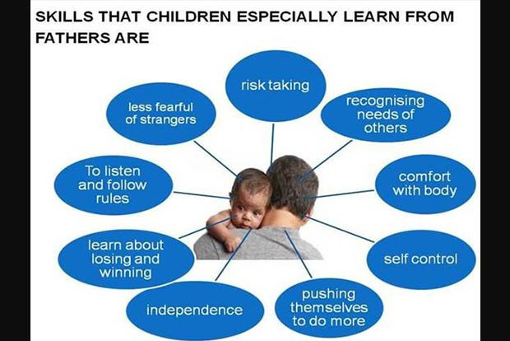
NOTE

Slide 14
INITIATIVES AND SOCIAL MARKETING PROJECTS

Slide 15
Highlighted Projects
Gas Toppers
Conference
Focus Groups
Public Transit Bus Wraps

Slide 16
Marketing and Social Media Projects
Fatherhood/Male Involvement Projects
Gas Toppers
Media- Radio and Television
Safe Sleep Ambassador Training
Google Ads
Availability of Infant Safe Sleep Resources (Pack n Plays, sleep sacks/swaddlers, Safe Sleep demonstrations)
Collaborations and Partnerships – Cribs for Kids
Website Shelby County Health Department (ShelbyTNHealth.com)

Slide 17
Marketing and Social Media Projects
Billboards
Blog Posts
Bus Wraps and Bus Transit Stops
Conferences and Summits (Fetal Infant Mortality Reduction Conference)
Digital Monitors (Department of Motor Vehicles (DMV) and Shelby County Public Health Clinics)
Direct On-Scene Education (DOSE) Training
Focus Groups/Listening Tours

Slide 18
Conclusions and Implications PREVENTION and AWARNESS OPPORTUNITIES
Multifaceted fatherhood/male engagement targeted educational outreach initiatives are essential to reaching at risk families.
Collaboration with community partners is key.
Outreach and Education/Social Media are needed.
Continued expansion and collaboration will continue to address infant mortality and will ensure positive outcomes for infants and their families.

Slide 19
Final Comment
Public Health Community Problems
Community Engagement
An engaged and informed community = Increased Fatherhood/Male Engagement

Slide 20
Infant Mortality Vision for Shelby County The Vision: Healthy Babies Born in Healthy Communities”
Healthy Pregnancies
Healthy Babies/Reduction in Infant Mortality
Healthy Communities

Slide 21
Discussion & Collaboration

Slide 22
Questions
For additional information, please contact :
SHELBY COUNTY HEALTH DEPARTMENT:
Morristein J. Holman, Administrator
Email: morristein.holman@shelbycountytn.gov
****************************************
Leilani Spence, Deputy Administrator
Email: Leilani.Spence@shelbycountytn.gov
(901) 222-9000
****************************************
Greg Dixon, FIMR Team Leader
Email: Greg.Dixon@shelbycountytn.gov
(901) 222-9000

