Slide 1
Sleep-Related Death Data
Ibitola Asaolu, DrPH MPH
Erin Hodson, MPH

Slide 2

PRAMS Data
What is PRAMS?
Pregnancy Risk Assessment Monitoring System
Purpose: Collect state-specific population-based data on maternal attitudes and
experiences before, during and shortly after
pregnancy
The PRAMS sample is chosen from all women who had a live birth recently, so findings can be applied to the state’s entire population of women who have recently delivered a live-born infant
  PRAMS provides data for state health officials to use to improve the health of mothers and infants.

Slide 3
Safe Sleep Practices by Race/Ethnicity
Tennessee, 2016-2017
TN=79%
TN=61%
TN=80%
Data Source: Tennessee Pregnancy Risk Assessment Monitoring System (PRAMS), 2016–2017; Tennessee Department of Health, Office of Population Health Surveillance; Division of Population Health Assessment. Prepared April 2019 by Division of Family Health and Wellness.

Slide 4
Baby’s Usual Sleep Place by Race/Ethnicity
Tennessee, 2016-2017
TN=33%
Data Source: Tennessee Pregnancy Risk Assessment Monitoring System (PRAMS), 2016–2017; Tennessee Department of Health, Office of Population Health Surveillance; Division of Population Health Assessment. Prepared April 2019 by Division of Family Health and Wellness.

Slide 5
How Baby Sleeps by Race/Ethnicity
Tennessee, 2016-2017
TN=51%
Data Source: Tennessee Pregnancy Risk Assessment Monitoring System (PRAMS), 2016–2017; Tennessee Department of Health, Office of Population Health Surveillance; Division of Population Health Assessment. Prepared April 2019 by Division of Family Health and Wellness.

Slide 6
Safe Sleep Practices by Maternal Age
Tennessee, 2016-2017
TN=79%
TN=61%
TN=80%
Data Source: Tennessee Pregnancy Risk Assessment Monitoring System (PRAMS), 2016–2017; Tennessee Department of Health, Office of Population Health Surveillance; Division of Population Health Assessment. Prepared April 2019 by Division of Family Health and Wellness.

Slide 7
Baby’s Usual Sleep Place by Maternal Age
Tennessee, 2016-2017
TN=33%
TN=10%
TN=44%
Data Source: Tennessee Pregnancy Risk Assessment Monitoring System (PRAMS), 2016–2017; Tennessee Department of Health, Office of Population Health Surveillance; Division of Population Health Assessment. Prepared April 2019 by Division of Family Health and Wellness.

Slide 8
How Baby Sleeps by Maternal Age
Tennessee, 2016-2017
TN=51%
TN=10%
TN=29%
Data Source: Tennessee Pregnancy Risk Assessment Monitoring System (PRAMS), 2016–2017; Tennessee Department of Health, Office of Population Health Surveillance; Division of Population Health Assessment. Prepared April 2019 by Division of Family Health and Wellness.

Slide 9
Did Medical Professional Tell You the Following?
Tennessee Mothers by Race/Ethnicity, 2016-2017
TN=97%
TN=92%
TN=57%
TN=92%
Data Source: Tennessee Pregnancy Risk Assessment Monitoring System (PRAMS), 2016–2017; Tennessee Department of Health, Office of Population Health Surveillance; Division of Population Health Assessment. Prepared April 2019 by Division of Family Health and Wellness.

Slide 10
Did Medical Professional Tell You the Following?
Tennessee Mothers by Age, 2016-2017
TN=97%
TN=92%
TN=57%
TN=92%
Data Source: Tennessee Pregnancy Risk Assessment Monitoring System (PRAMS), 2016–2017; Tennessee Department of Health, Office of Population Health Surveillance; Division of Population Health Assessment. Prepared April 2019 by Division of Family Health and Wellness.

Slide 11
Gap Between Recommended and Actual Behavior:
Placing Baby to Sleep on Back
Data Source: Tennessee Pregnancy Risk Assessment Monitoring System (PRAMS), 2016–2017; Tennessee Department of Health, Office of Population Health Surveillance; Division of Population Health Assessment. Prepared April 2019 by Division of Family Health and Wellness.

Slide 12
Sleep-Related Infant Death

Slide 13
Overall and Sleep-Related Infant Deaths
Tennessee, 2014-2018
~23% of all infant deaths in Tennessee
Data Source: Tennessee Department of Health, Office of Vital Records & Statistics, Death Statistical System; Tennessee Department of Health, Division of Family Health and Wellness, Child Fatality Review Database. Prepared May 2020 by Division of Family Health and Wellness.

Slide 14
Infant Age at Time of Sleep-Related Death
Tennessee, 2014-2018
< 1 1 2 3 4 5 6 7 8 9 10 11
    Age in Months
Data Source: Tennessee Department of Health, Division of Family Health and Wellness, Child Fatality Review Database. Prepared May 2020 by Division of Family Health and Wellness.

Slide 15
Infant Age at Time of Sleep-Related Death
Tennessee, 2014-2018
About 4 in 5 (79%) of sleep-related infant deaths occurred when infant was under 5 months of age
< 1 1 2 3 4 5 6 7 8 9 10 11
    Age in Months
Data Source: Tennessee Department of Health, Division of Family Health and Wellness, Child Fatality Review Database. Prepared May 2020 by Division of Family Health and Wellness.

Slide 16
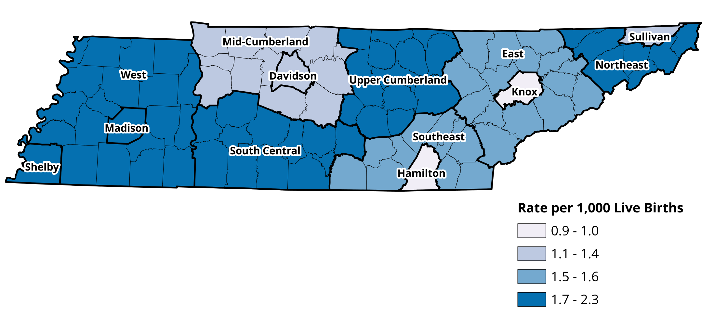
Rate of Sleep-Related Infant Death by Region
Tennessee, 2014-2018
Data Source: Tennessee Department of Health, Division of Family Health and Wellness, Child Fatality Review Database. Prepared April 2019 by Division of Family Health and Wellness.

Slide 17
Racial Disparity in Sleep-Related Infant Death
Tennessee, 2014-2018
Black vs. White Disparity = 2.0 (2014-2017).
Sleep-related death rate decreased
among Blacks in 2018
Data Source: Tennessee Department of Health, Division of Family Health and Wellness, Child Fatality Review Database. Prepared May 2020 by Division of Family Health and Wellness.
Notes:
Disparity Ratio in Black vs. White Sleep-relate infant death rate decreased in 2018

Slide 18
Where was baby placed to sleep?
Tennessee, 2014-2018
Data Source: Tennessee Department of Health, Division of Family Health and Wellness, Child Fatality Review Database. Prepared May 2020 by Division of Family Health and Wellness.

Slide 19
Where was baby placed to sleep?
Tennessee, 2014-2018
Data Source: Tennessee Department of Health, Division of Family Health and Wellness, Child Fatality Review Database. Prepared May, 2020 by Division of Family Health and Wellness.

Slide 20
Contributing Factors in Sleep-Related Infant Deaths
Tennessee, 2014-2018
Data Source: Tennessee Department of Health, Division of Family Health and Wellness, Child Fatality Review Database. Prepared May 2020by Division of Family Health and Wellness.

Slide 21
Contributing Factors in Sleep-Related Infant Deaths
Tennessee, 2014-2018
Data Source: Tennessee Department of Health, Division of Family Health and Wellness, Child Fatality Review Database. Prepared May 2020 by Division of Family Health and Wellness.

