Slide 1
Enhancing SUID Case Reviews: Crafting Effective Narratives and Utilizing the SUID Algorithm Categorization
May 21, 2024

Slide 2
Overview
Section O1 Narrative
Tips on Deidentifying
Components of a thorough SUID narrative
Examples of a Short/Detailed narrative
Categorization Using the Algorithm

Slide 3
Content Warning
This presentation contains references to themes of: infant death, which some people may find distressing. In response, I encourage you to take the necessary steps for your emotional safety. This may include stepping away while some or all this content is being presented.
If you or someone you know are in need of support, call the Suicide and Crisis Lifeline at 988 or the Tennessee Crisis Line at 855-274-7471 or Text TN to 741741. Both programs provide free, confidential support 24/7.

Slide 4
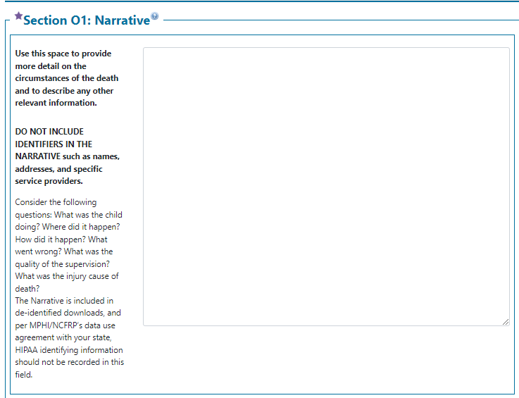
Section O1 Narrative
No identifying information
Dates, names, hospital names, EMS providers, Holidays, road names
Every case should have a narrative!
Narratives can be long or short as long as they provide key details of the child’s death
Notes:
Emphasize every case

Slide 5
Tips to Deidentify Narrative
Child was transported to Vanderbilt University Medical Center by Life Flight
Child was transported to the nearby children’s hospital by air ambulance.
Family was visiting friends for Thanksgiving and the infant was sleeping on an air mattress.
Family was visiting friends, and the infant was sleeping on a queen size air mattress.

Slide 6
Give it a try and Deidentify the Narrative Notes
On March 4th child went to their PCP for a well-child checkup and died 3 days later.
3 days before the child’s death they went to their PCP for a well-child checkup.
Child was born to Julie Smith, a 20-year-old female, and there were no complications.
Child was born without complications to a 20-year-old female.

Slide 7
When Deidentifying a case, you should?
A. Add the Father’s Name and remove the Mother’s name.
B. Remove the Hospital Name.
C. Remove the Mother’s age.
D. Add the date of the time of incident.
Notes:
No Name should be mentioned when deidentifying a case.
B is the correct choice, you should remove Hospital names, EMS providers, Holidays, and Road names
No, Remember saying that the infant was born to a 19-year-old woman is an important factor when considering risk factors.
No, Remember that any date other than the DOD should not be mentioned.

Slide 8
Components of a Thorough SUID Narrative
Details about the caregiver who was responsible for the child at time of death
Details on how the child was placed and found/who found the child
Details on sleep environment
Team discussions
Relevant medical history
Cause and manner of death

Slide 9
Short Narrative
Cause of Death: Asphyxia
Manner of Death: Accident
Child was placed to sleep by their mother and found unresponsive 2 hours later by the mother. Upon discovery; the child was found supine and not breathing, it was noted that their airway was obstructed by a pillow. The child was also sleeping on an adult king-sized bed with multiple pillows and blankets.
Medical records were reviewed, and the child had no known health conditions.
Team Discussion: The CFR team discussed the unsafe sleep environment and determined this was a preventable death.
Notes:
Details about the caregiver who was responsible for the child at time of death
Details on how the child was placed and found/who found the child
Details on sleep environment
Team discussions
Relevant medical history
Cause and manner of death

Slide 10
Short Narrative
Notes:
Details about the caregiver who was responsible for the child at time of death
Details on how the child was placed and found/who found the child
Details on sleep environment
Team discussions
Relevant medical history
Cause and manner of death

Slide 11
More Detailed Narrative
Death Circumstances: Father was at home with infant while mom left to go eat with friends while the child napped. Child woke up from nap around 4 PM and was doing well. Child was later placed to sleep for the night. Around 10 PM, mother and father laid the infant on his back on a king-sized adult bed with a bottle, which was normal as he could hold it himself. The mother advised the child had no pillow under his head. They went to bed around 2AM after taking some melatonin for insomnia. At that time, the child was in the same position he was placed in-on his back-one hour prior. The mother used a thick quilt to cover herself and the child which was their normal sleeping position. Dad slept beside the child under a separate blanket. Mother woke at approximately 5 AM to find the child with blue lips and unresponsive. The child was still on his back with airway completely unobstructed. Mother called 911 and father performed CPR per dispatch instructions. EMS continued resuscitative efforts on the way to the hospital where the child was pronounced as deceased at 6:15 AM.
Notes:
Details about the caregiver who was responsible for the child at time of death
Details on how the child was placed and found/who found the child
Details on sleep environment
Team discussions
Relevant medical history
Cause and manner of death

Slide 12
More Detailed Narrative Cont.
Post-Death: Nasal swab performed at autopsy came back positive for adenovirus/rhinovirus. This was thought to be post-mortem contamination. The most likely explanation for the death is overlay by asphyxia (obstruction of his airway by another person who rolled onto him while sleeping). The manner of death was listed as undetermined since asphyxia could not be confirmed.

Slide 13
More Detailed Narrative Cont.
Child Medical History: Infant born at 41 weeks at 2900 grams. Child most recently had contact with his pediatrician 3 weeks prior for strep throat and 7 days before that for a checkup and shots. He was meeting all developmental milestones. Child was able to roll front to back and back to front.
Social Factors: Mother, father, and infant lived in an apartment. Mother expressed she needed help financially with diapers and wipes. Hospital SW referred her to a local non-profit that supplies diapers to families in need. Enrolled in WIC, Medicaid, SNAP, and SSI benefits. No home visiting referral documented.
Team Discussion: A portable crib was in the residence, but it was filled with various items making it unusable in its state at the time of death.
Notes:
Details about the caregiver who was responsible for the child at time of death
Details on how the child was placed and found/who found the child
Details on sleep environment
Team discussions
Relevant medical history
Cause and manner of death

Slide 14
How to Categorize?

Slide 15
Algorithm Categorization V8.3

Slide 16
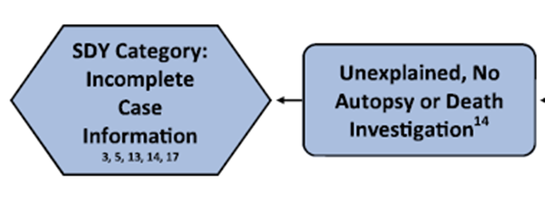
Algorithm Categorization
Was an autopsy AND death investigation completed?
Yes: move on to next step
No:
Unexplained, No Autopsy or Death Investigation
Notes:
ALL teams statewide should be categorizing cases based on the algorithm at the CFR meeting. If your team hasn’t been categorizing at the meetings and you need assistance, please let me know

Slide 17
Categorization: Complete Autopsy Report?
If an autopsy was performed, were ALL of the following also completed?
Toxicology
Imaging
Pathology
Yes: move on to the next step.
No:
Unexplained, Incomplete Case Information

Slide 18
Categorization: Location and Position?
Is there detailed information about the location AND position of how the infant was placed and found?
This information needs to be consistent. If multiple people have reported different scenarios this would be a true unknown.
Where: couch, crib, adult bed, bassinet
Position: Was found supine, prone, on side, face up, face down, face turned
Yes: move on to next step
No:
Unexplained, Incomplete Case Information
Example of Incomplete Case Information:
Mother and father completed doll reenactment and both placed infant in bassinet, face up.
Hospital notes indicate mother stated they were sleeping with the infant in their bed.
Statements were later made to the MEI that the parents couldn’t remember if the infant was found on their back or stomach.

Slide 19
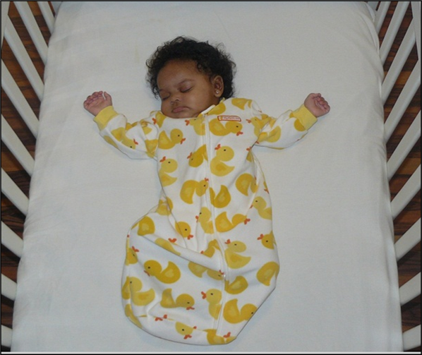
Categorization: Unsafe Sleep Factors?
Was there ANY evidence of Unsafe Sleep Factors?
Co-sleeping: with another person or animal
Soft bedding: blankets, pillows
Stuffed animals
Placed on stomach or side
Placed to sleep anywhere other than crib: swing, infant seat, car seat, adult bed
Yes: move on to next step
No:
Unexplained, No Unsafe Sleep Factors
This category also includes infants who were witnessed going unresponsive
https://www.in.gov/isdh/files/SUIDI%20and%20DOSE%20Training.pdf

Slide 20
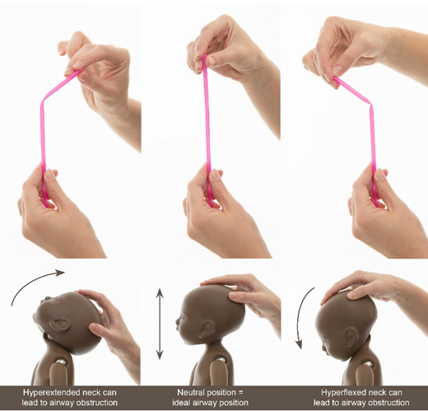
Categorization: Airway Obstruction?
Was there evidence of partial or full obstruction of the airway?
Nose or mouth obstructed
Chest compressed
Head was chin to chest or hyperextended
Infant was found face down on a surface, including a crib (exception is if the infant was at an age they could roll, typically 3 months)
Infant trapped between mattress and wall
Yes: move on to next step
No or Unknown
Unexplained, Unsafe Sleep Factors
Source: Google Images
Notes:
A couple of images to show examples of airway obstruction: Hyperextended, Neutral, Hyperflexed

Slide 21
Categorization: Known Cause of Obstruction?
Do we know WHAT obstructed the airway?
Adult mattress
Blanket
Sibling
Stuffed animal
Adult
Swing padding
Lose clothing
Yes: Move on to next step
No or unknown
Unexplained, Unsafe Sleep Factors

Slide 22
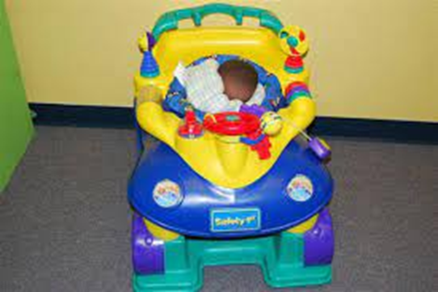
Categorization: Strong Evidence?
Were ALL of the following present?
Non-conflicting and reliable witness accounts
No other potentially fatal findings
An age/developmental stage that suffocation is feasible
Strong evidence of full external obstruction when found
No or unknown
Unexplained, Possible Suffocation with Unsafe Sleep Factors
Continue to next step: Mechanism
Yes:
Explained Suffocation with Unsafe Sleep Factors
Continue to next step: Mechanism
Example of Possible Suffocation:
Infant was placed on an adult comforter
Infant was found on their side, with the left nostril pressed into the mattress
Mouth was not obstructed
https://www.in.gov/isdh/files/SUIDI%20and%20DOSE%20Training.pdf

Slide 23
Last step: Mechanism Selection
For possible suffocation and explained suffocation categories
Four Possible Mechanisms
Soft Bedding
Wedging
Overlay
Other
A Combination of Mechanisms May be Selected
Notes:
Note: Cause of death does not indicate category. Example, COD: Asphyxia, but the way the infant was found does not fit into explained suffocation category

Slide 24
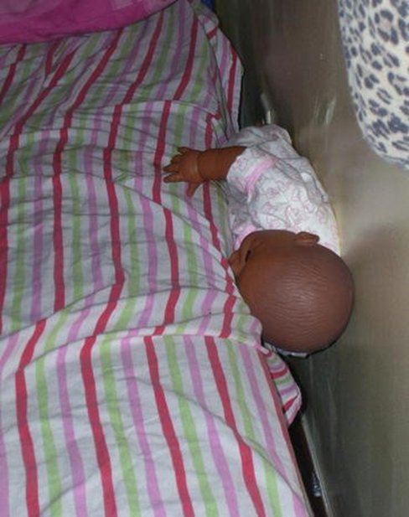
Mechanism Selection
Wedging
Soft Bedding
Source: Google Images
Source: Google Images
Notes:
Here are some examples of what soft bedding and wedging might look like.

Slide 25
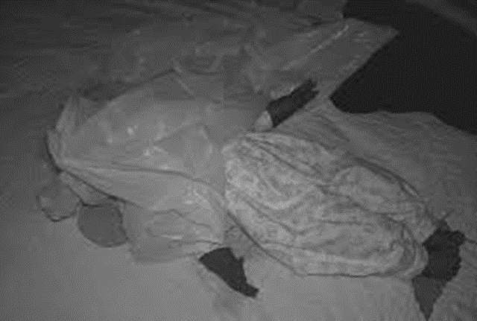
Mechanism Selection Cont.
Overlay
Other
Source: Google images
Source: Google images
Notes:
Here are some examples of what overlay and other might look like.
Overlay is when an infant’s airway is compressed or obstructed by a person or animal. A good example of other would be suffocation from a trash bag in the sleep environment.
A good example of other would be suffocation from a trash bag in the sleep environment.

Slide 26
Contact Information
Chyna Branch
SUID Coordinator
Phone: 615-253-8393
Email: chyna.branch@tn.gov

