Slide 1
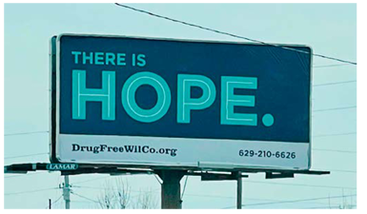


Temporal and comparative analysis of drug use stigma among rural law enforcement and community members in rural Tennessee.
Kahler Stone, DrPH, MPH | Angela Bowman, PhD | Michael Ayalon, MSP | Gabrielle Chesak, MPH | Cynthia Chafin, PhD
TPHA - October 10, 2024

Slide 2



Who We Are - MTSU RCORP Team, RCORP Wilson County Consortium

Slide 3

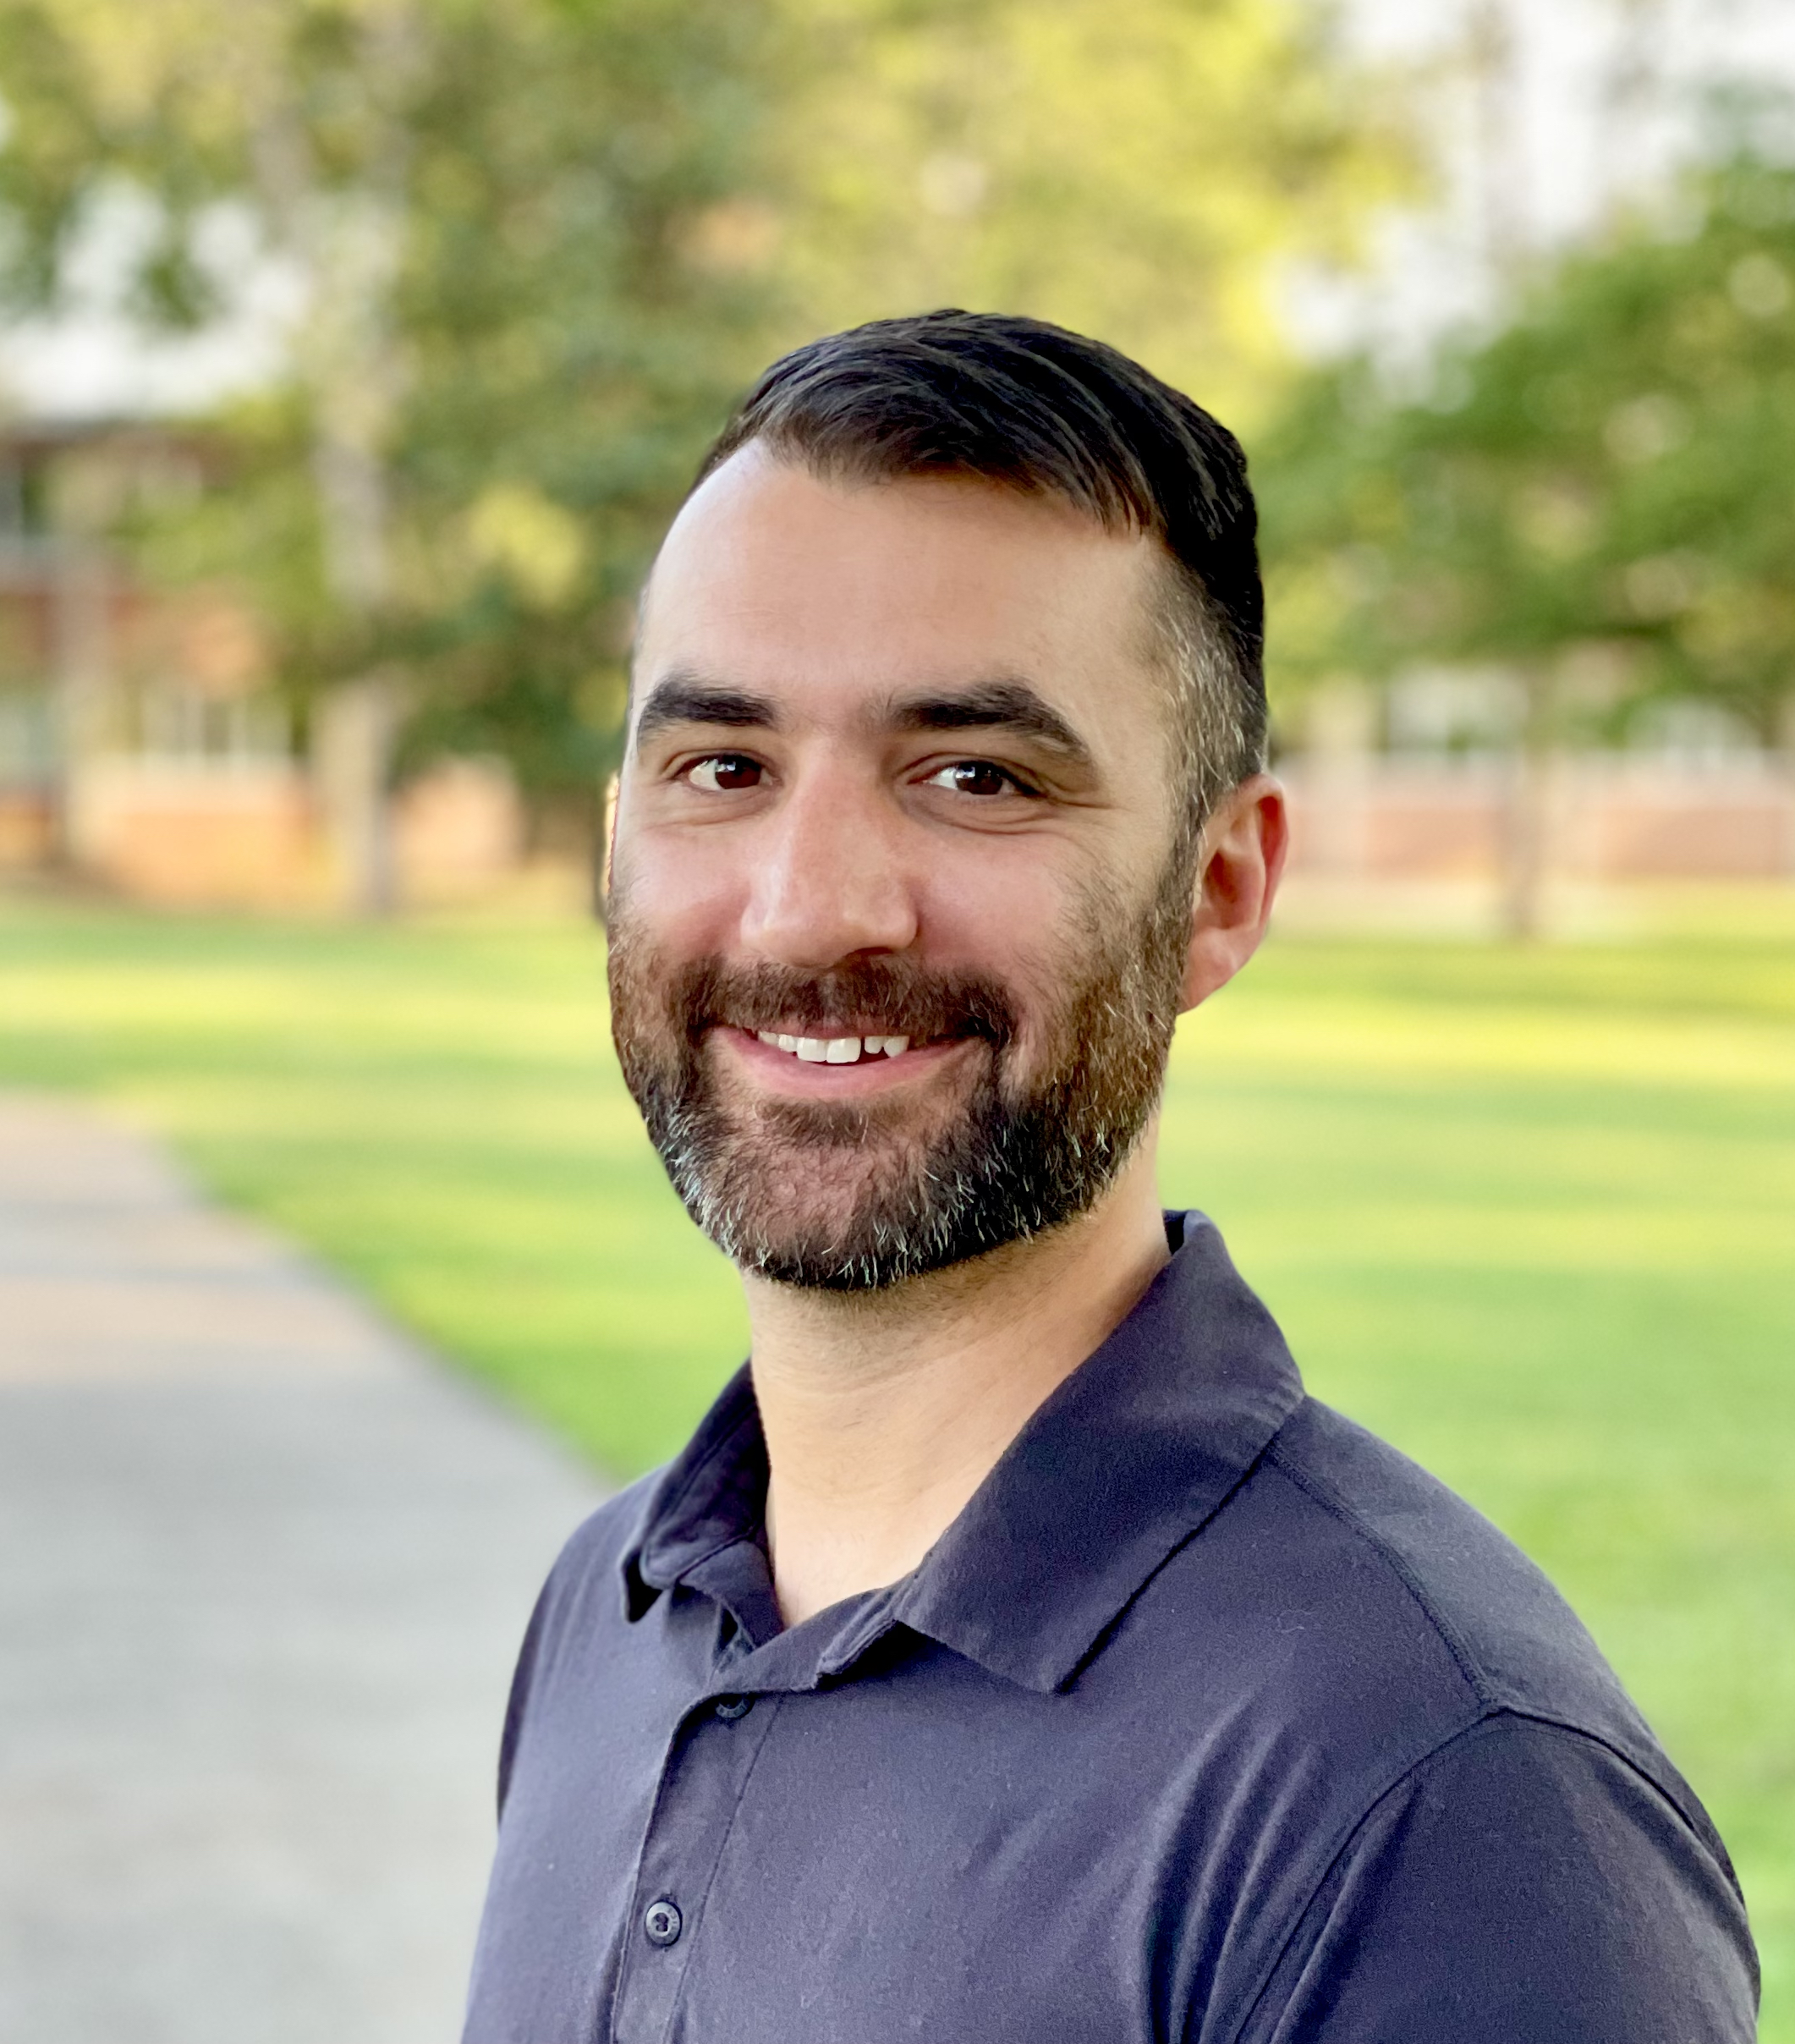
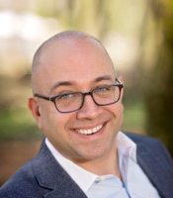
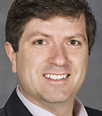
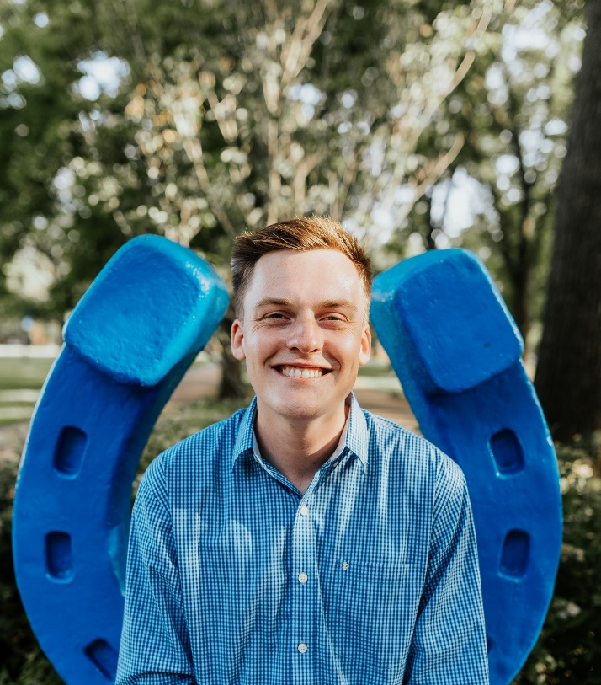

MTSU RCORP TEAM
Lead PI & Project Director: Cynthia Chafin, PhD, MCHES ®, Director, Center for Health and Human Services
Co-PI and Project Director: Kahler Stone, DrPH, MPH, Associate Professor, Dept. of Health and Human Performance, Public Health Program
Local Coordinator: Michael Ayalon, Master of Public Service, Program Coordinator, Center for Health and Human Services
Data Analyst: Keith Gamble, Director, Data Science Institute, Professor Economics and Finance
Project Assistants: Chipper Smith, MPH & Maimoonah Dabshee , MPH

Slide 4


Project Partners forming MTSU RCORP Consortium (formal MOUs in place)
DrugFree WilCo: Drug use prevention coalition of Wilson County
MTSU Center of Health and Human Services: To shape a healthier future and advance the health and well-being of Tennesseans – Lead Agency for RCORP Wilson County grants
Cedar Recovery: Largest addiction treatment center in Wilson County
Mid-Cumberland Transportation: public transit system serving Wilson County and PIC Center needs and Uber.

Slide 5
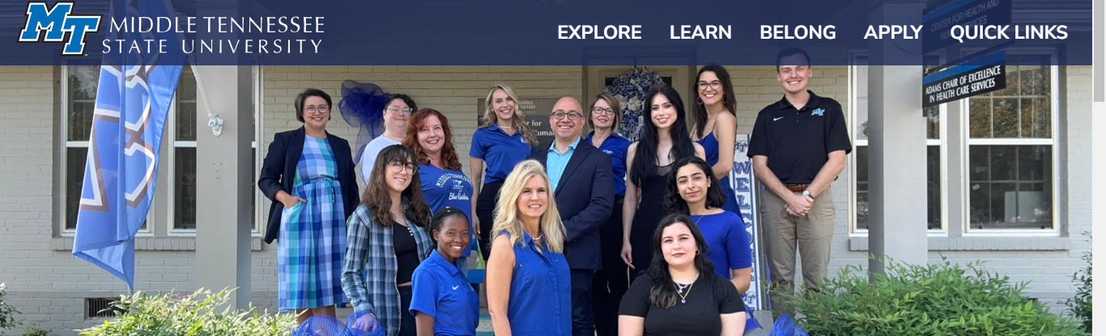
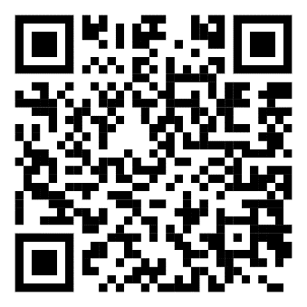
MTSU Project Team - Center for Health and Human Services (CHHS), Lead Partner
MTSU CHHS is a primarily grant-funded center and recipient of the Health Resources and Services Administration (HRSA) Rural Communities Opioid Response Program (RCORP) grant funding that supports activities to address opioids in Wilson County, Tennessee.
During 2020-2024 CHHS received $1.2 million in grant funding through HRSA’s RCORP to support this work in Wilson County.
Since its founding in 1993 by the Adams Chair of Excellence in Healthcare Services, CHHS has received more than $25 million in external dollars to support public health research and outreach in areas of importance to Tennesseans.
www.mtsu.edu/chhs

Slide 6

Rural Communities Opioid Response Program (RCORP) Grant Funding
The Rural Communities Opioid Response Program (RCORP) is a multi-year initiative by the Health Resources and Services Administration (HRSA)
It is aimed at reducing the morbidity and mortality of substance use disorder (SUD), including opioid use disorder (OUD), in high-risk rural communities

Slide 7
Two Grants, One Goal: Reducing fatalities due to overdose and the associated economic burden related to misuse.
Planning Grant (18 months, 9/1/2020 – 2/28/2022)
Understand the needs of those in Wilson County specific to opioid use disorder
Focus Group studies
Needs Assessment and Gap Analysis
Implementation Grant (3 years, 9/1/21 – 8/31/24)
Put ideas into action
Educate and inform
Reduce stigma
Save lives
These projects are supported by the Health Resources and Services Administration (HRSA) of the U.S. Department of Health and Human Services (HHS) as part of a financial assistance awards totaling $200,000 and $1,000,000 with 100% funded by HRSA/HHS and $0 amount funded by nongovernment sources. The contents are those of the author(s) and do not necessarily represent the official views of, nor an endorsement, by HRSA/HHS, or the U.S. Government.” For more information, please visit hrsa.gov

Slide 8
Four Project Core Areas
Prevention
Treatment
Recovery
Site-specific initiatives

Slide 9

What is Stigma and Why is Reducing it Important?
Stigma against substance use disorder involves negative attitudes that hinder treatment and worsen outcomes (Volkow, 2020).
Stigmatizing attitudes can come from anyone—individuals, healthcare providers, or other professionals.
Stigma is a key focus in the Wilson County RCORP project.
By addressing stigma, we enhance project success and demonstrate positive impact.
Source: Volkow, ND. Stigma and the toll of addiction. New England Journal of Medicine. 2020;382 (14): 1289-1290. doi: 101056/nejmp191736-
Notes:
Stigma visualizations

Slide 10
Stigma Assessment and Tracking Timeline
Law Enforcement
Trainings
Stigma assessment
Community
Aug 2022
Wilson County and State Fair of TN
Community
Aug 2023
Wilson County and State Fair of TN
Jan 2022
Community
Aug 2024
Wilson County and State Fair of TN
Objectives
Develop/adapt a tool to measure provider stigma toward PWUD.
Quantify stigma level in Law Enforcement and Community members (the public).
Assess differences in Law Enforcement and Community.
Track Community over time.
Notes:
This needs to be an outline/timeline and what we want to answer to walk us through this.

Slide 11
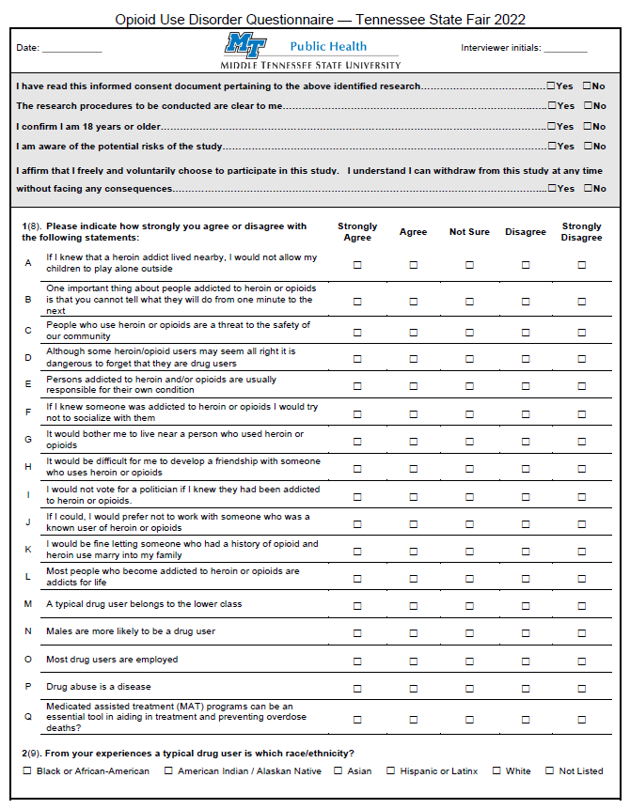
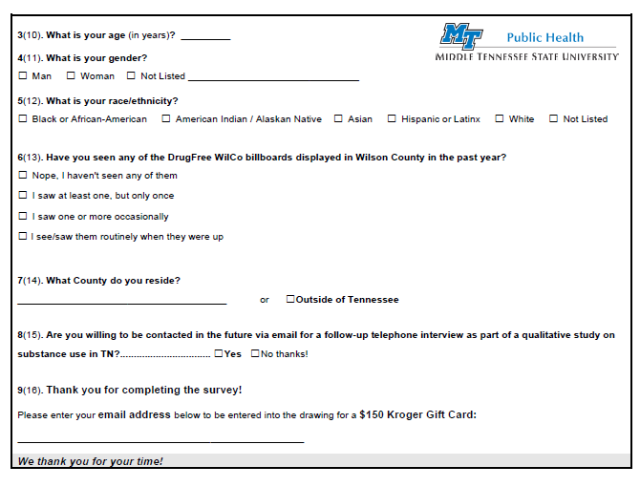
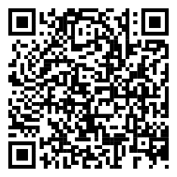
Middle Tennessee State University
Informed Consent
14 Stigma oriented questions
Billboard sign visibility
Drug user stereotyping questions (biases)
Respondent demographics (age, gender, race)
Loved/close one affected question added

Slide 12
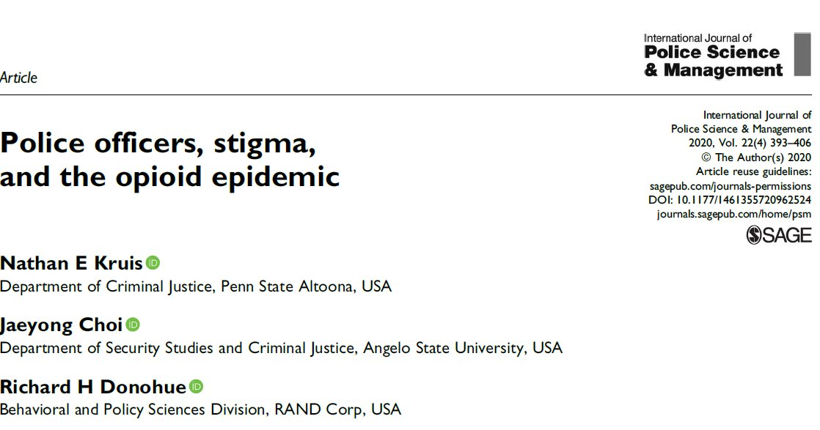
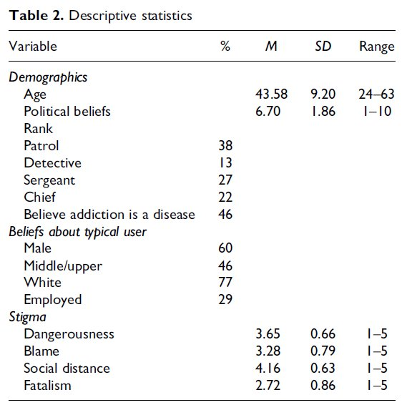
Middle Tennessee State University
Disease Model of addiction overarching scheme​
​
Dangerousness​
Blame​
Social distance​
Fatalism​

Slide 13
Middle Tennessee State University
​Law Enforcement Training - Six virtual (held via Zoom) peer-led harm reduction model presentations were delivered over two days in January 2022, for local law enforcement officers in Wilson County. Of those that attended a classroom with lunch (N=112), 48 agreed to participate in the survey (N=48).
Provider-level stigma is measurably present in Law Enforcement
Opportunities for further training
“We all work in this field with a bias already and with the right information and tools the next generation of LEO learning from us, and I saw a lot of LEO leaders in this group, we could definitely get the wheels moving so that the newer guys do not wind up with the same biases we hold.”
Proportion of participants strongly agreeing or agreeing to the statement​

Slide 14
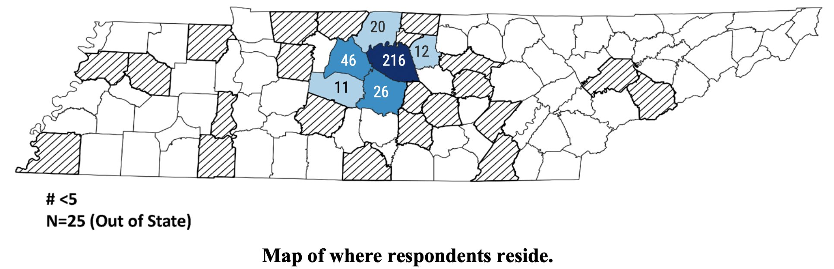
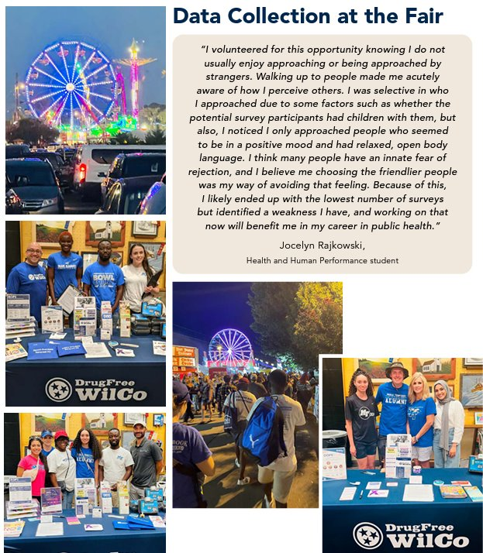
Middle Tennessee State University
August 18-27, 2022 – Year 1
(Collected data on Saturday (7 hours), Sunday (8+ hours), Thursday (4 hours) , Saturday(6 hours)​
Adults 18+, informed consent, surveyors roamed fairgrounds and stationed at booth
​
N=393​
326 paper surveys​
67 Online using QR Code Cards
Notes:
This needs to be the community data collection slide for year 1

Slide 15
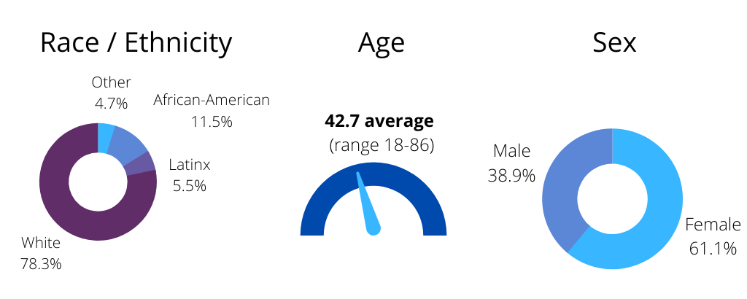
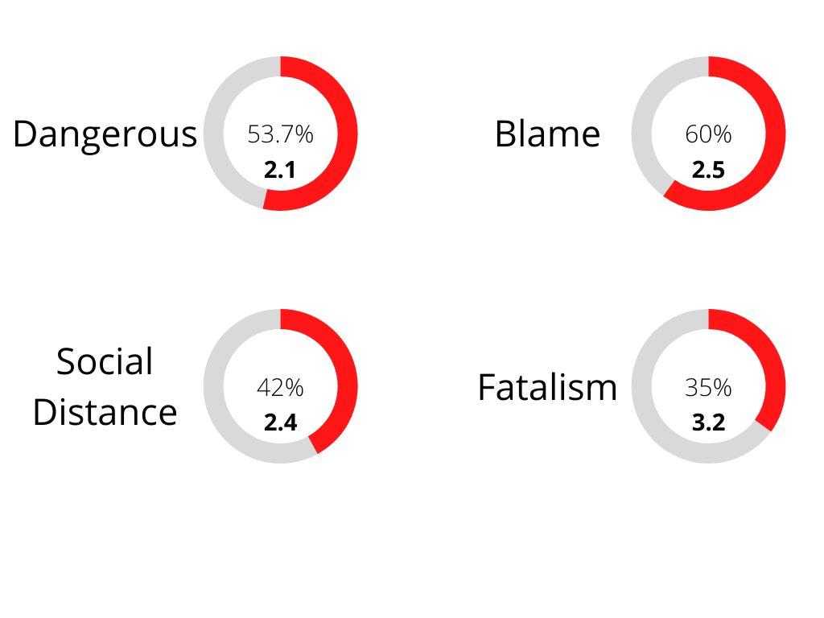
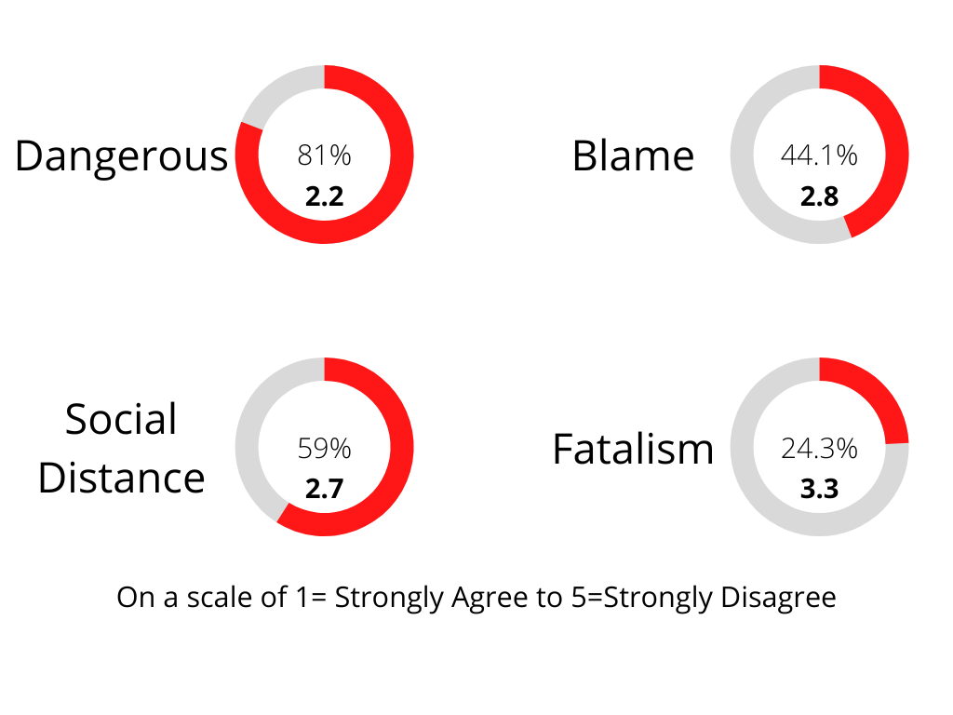
2022 Law Enforcement Sample
2022 Community Sample

Slide 16
Middle Tennessee State University
Stigma Domains Combined – LEO (N=48) vs. Community (N=393) 2022

Slide 17
So after year 1 (2022)?
Middle Tennessee State University
Both LEOs and community members showed “similar” stigma levels in dangerousness, blame, social distance, and fatalism domains with different distributions and marginal significance when adjustment is taken.
Study achieved its objective of estimating stigma prevalence and highlighting parallels between LEOs and community members.

Slide 18
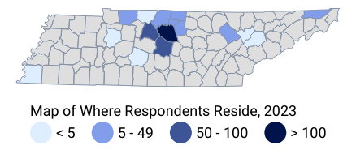
Middle Tennessee State University
August 17-26, 2023 – Year 2
Data collection occurred over five days (August 17-26, 2023).
2,250 recruitment cards were distributed.
359 online surveys and 28 paper surveys were completed (N=387).
Incomplete surveys, lacking consent, or missing significant sections were excluded.
Notes:
Community 2 survey collection summary (pictures)

Slide 19
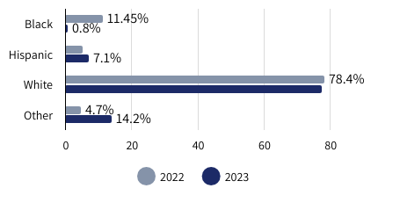
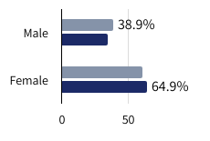
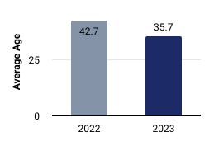
Middle Tennessee State University
Data Collection / Demographics
Race/Ethnicity Proportion by Survey Year
At the fair, RCORP staff and MTSU student volunteers, using a questionnaire that included a new query about personal connections to substance use disorder, assessed perceptions of drug use and the visibility of DrugFree WilCo billboards. They engaged adults, offering both digital and paper survey options. The 2023 survey revealed a younger average age of 35.7, a higher female participation, stable white representation, fewer black respondents, and an increase in non-disclosures on race from under 5% to 15.2%.
Respondent Reported Gender by Survey Year
Average Age of Respondents by Survey Year

Slide 20
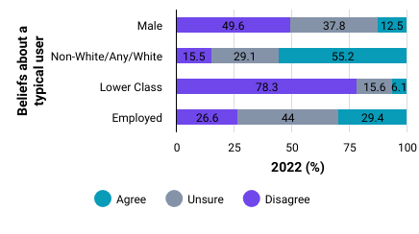
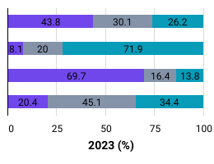
Middle Tennessee State University
Our survey inquired about participants' views regarding the typical profile of a drug user, focusing on attributes such as gender, race/ethnicity, socioeconomic background, and employment status. Our findings show that the variation in these perceptions is marginal from 2022 to 2023 within our sample.
TDH Overdose Estimates (2021)
White: 77.9%
Black: 19.7%
Other: 3.1%
Men: 65.8%
Women: 34.2%
Existing Literature
Income and education linked with fatal and nonfatal overdoses
Beliefs (gender, race, socioeconomic status, employment) About a Typical Drug User by Survey Year

Slide 21
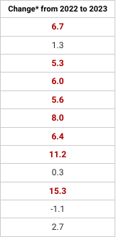
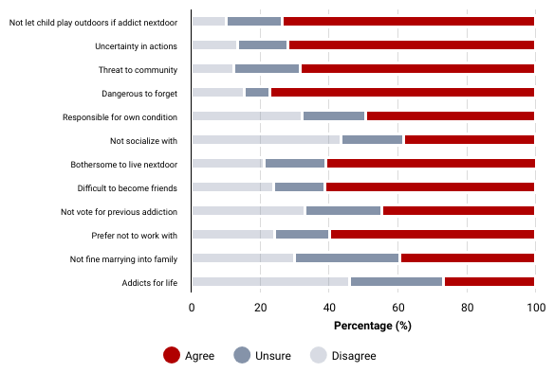


Middle Tennessee State University
Stigma Item-Specific Changes by Year and Across Domains

Slide 22
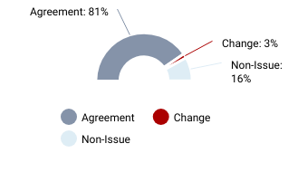
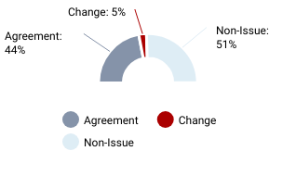
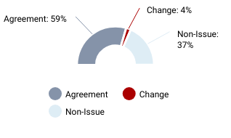
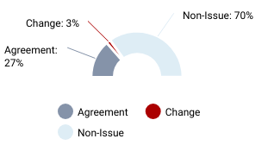
Middle Tennessee State University
Stigma Domain Changes from 2022 to 2023

Slide 23
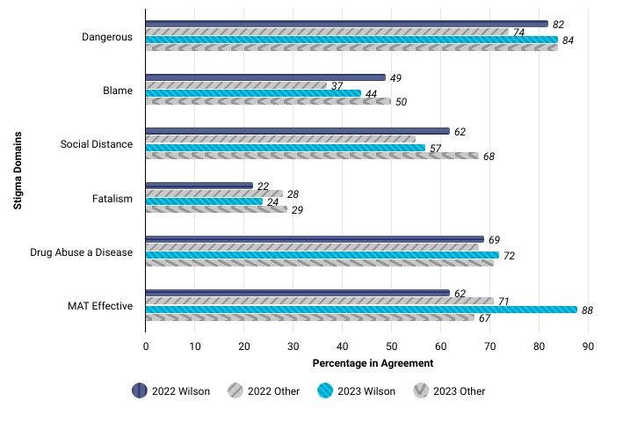
Middle Tennessee State University
Stigma Domain Changes from 2022 (N=393; n=216) to 2023 (N=387; n=158) by Wilson County Resident Status
Wilson County participants showed a modest decrease in blame and social distance stigma
and
improved acceptance of MAT effectiveness.

Slide 24
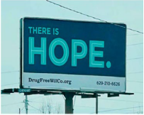

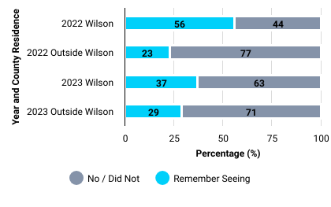
Middle Tennessee State University
Billboard Viewing Recall by County and Year
A billboard campaign aimed at reducing stigma towards individuals using drugs and promoting recovery and treatment efforts ran from March to December 2022. We surveyed respondents in August 2022 and again a year later in August 2023 to see if they remembered seeing any of the billboards. As anticipated, Wilson County residents showed better recall in both years, with 37% still remembering the billboards after more than a year. Notably, there was an increase in recall among respondents from outside the county.

Slide 25
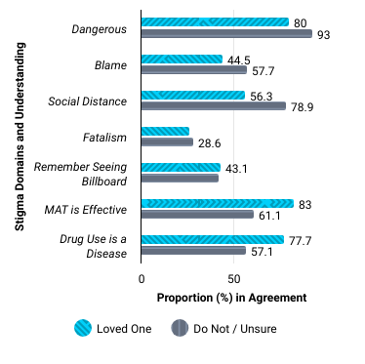
Middle Tennessee State University
Stigma Domain Level by Affected Loved One Status
Overall, data indicate that individuals with a close friend or family member involved in drug use tend to have:
lower levels of stigma across all domains,
are more likely to believe in the effectiveness of Medication-Assisted Treatment (MAT),
and recognize drug abuse as a disease.

Slide 26










Middle Tennessee State University
So after year 2 (2023)?
Wilson County saw blame & social distance stigma fall, and acceptance of treatment improved.
Individuals with affected loved ones exhibit lower drug stigma and greater belief in treatment effectiveness.
Minimal change in perceptions of a drug user's profile from 2022 to 2023.
This publication is supported by the Health Resources and Services Administration (HRSA) of the U.S. Department of Health and Human Services (HHS) as part of an award totaling $333,000 with 0% percentage financed with non-governmental sources. The contents are those of the author(s) and do not necessarily represent the official views of, nor an endorsement, by HRSA, HHS, or the U.S. Government. For more information, please visit HRSA.gov. The survey methodology and data collection processes received approval from the MTSU Human Subjects Institutional Review Board under protocol number: 22-1072 1q.

Slide 27


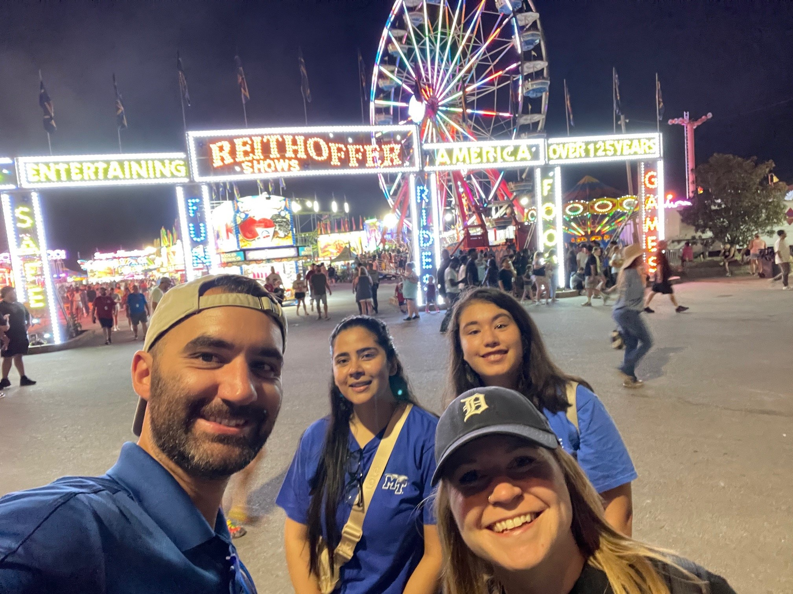
Middle Tennessee State University
Third Year Data Collection (2024)
Attended fair over 5 days/evenings
Team of Six Public Health Students (not all shown)
Passed out 1527 QR cards
Preliminary collection results
N = 359
68 paper versions
291 electronic via QR Code
Notes:
Reshape to projected date of next report and papers.

Slide 28
Next steps and take home
Middle Tennessee State University
Thank you!
Students from 3 years
Chipper Smith
Kira King
Maimoonah Dabshee
Jocelyn Rajkowski
Gabrielle Chesak
Imuwahen Uzzi
Patience Akanwogba
Sherry Jernigan
Abigail Kwarteng
Benjamin Antwi
Augustine Afriyie
Anakarina Lorenzana De Witt
Xaviera Gladden
Fnu Pragya
Tess Swastek
Complete Year 3 Stigma Report
Winter 2024/2025
Temporal analysis
Continue the Work
Repositioning to assess stigma in new ways
Newly funded projects focused on prevention, treatment, and recovery underway at MTSU CHHS
Kahler Stone, DrPH
Kahler.stone@mtsu.edu
615-494-7898
Cynthia Chafin, PhD
Cynthia.Chafin@mtsu.edu
615-898-5493

